Slide 1
Chapter 14 Thermal Energy and Heat
14.1 Temperature, Thermal Energy, and Heat

Slide 2
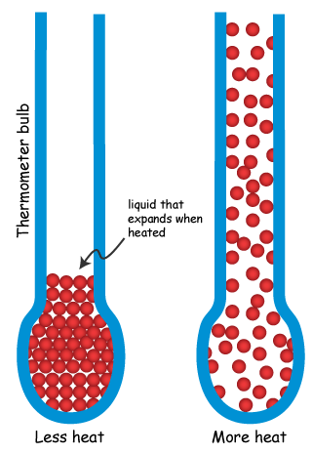
All matter is made up of tiny particles that are always in motion. This energy of motion is
kinetic energy
Temperature =
a measure of the average kinetic energy of the individual particles in matter.
Thermometers
glass tube with sealed liquid
the particles speed up/spread
out when heated (more volume)

Slide 3
If the kinetic energy of the particles in an object increases, what happens to the temperature of the object?
The temperature increases.
Three common scales for measuring temperature are the Fahrenheit, Celsius, and Kelvin scales.
Which temperature scale are you most familiar with? Why?
Fahrenheit.
weather, recipes, health

Slide 4
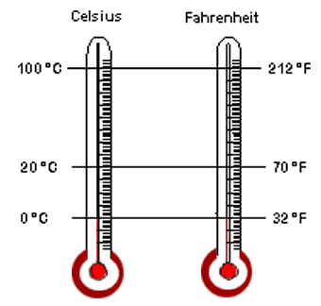
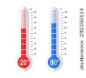
DIFFERENCES?

Slide 5
Kelvin scale:
most commonly used in
physical science
units are the same size as the degrees on the Celsius scale
freezing point = 273 K
boiling point = 373 K
-273 ºC is the lowest temp. possible
ABSOLUTE ZERO
0 on Kelvin represents
-273º C
No more thermal energy can be removed from matter at that temperature.

Slide 6
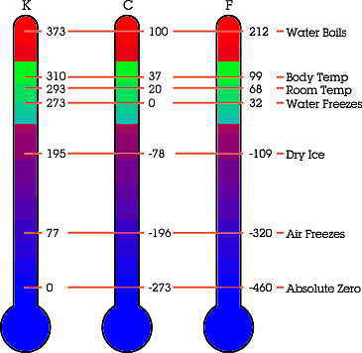

Slide 7
Thermal energy = Internal energy
total energy of all of the particles
Thermal energy depends on 3 things:
number of particles in the object
more is hotter
temperature of the object
higher is hotter
the arrangement of the object’s particles
coming up in section 3

Slide 8
Thermal energy that is transferred from matter at a higher temperature to matter at a lower temperature is called
Remember:
Objects contains
thermal energy, not heat.
Only when thermal energy is is it called heat.
transferred
Heat is thermal energy being transferred from a warmer object to a cooler one.
Work and heat are both energy transfers and are both measured in
joules

Slide 9
What is temperature?
The measure of the average kinetic energy of the particles in a substance.
What is thermal energy?
The total energy of all the particles in an object.
Pretend I have a bucket and a mug filled with water of the same temperature.
Which contains water with a greater temperature?
They are the same.
Which contains a greater thermal energy? Why?
The bucket, because there are a greater number of particles.

Slide 10
Specific Heat
When being heated, objects’ temperatures do not rise at the same rate.
To change the temperature of different objects by the same amount, different amounts of heat are required.
Scientists have defined a quantity to measure the relationship between heat and temperature change.
The amount of energy required to raise the temperature of 1 kg of a material by 1K is called its specific heat.
kg X K = joule

Slide 11
A material with a high specific heat can absorb a great deal of thermal energy without a great change in temperature.
A material with a low specific heat would have a large temperature change after absorbing the same amount of thermal energy.
Changes in energy =
Mass X Specific heat X Change in temperature
(kg) (kg X K) (K)

Slide 12
Converting Units
ºC = 5/9 (ºF-32)
ºC = 5/9 (77º-32)
ºC = 5/9 (45º)
ºC = 25º
Convert ocean temperature, 77º F, to degrees Celsius.
ºC = 5/9(5º – 32)
ºC = 5/9 (-27º)
ºC = -15º
Convert 5ºF to
degrees Celsius.
Convert the surface temperature on the surface of Venus (860ºF) to degrees Celsius.
ºC = 5/9(860º-32)
ºC= 5/9 (828º)
ºC= 460º

