Slide 1
Chapter 14 Thermal Energy and Heat
NOTES on 14.4 Uses of Heat

Slide 2
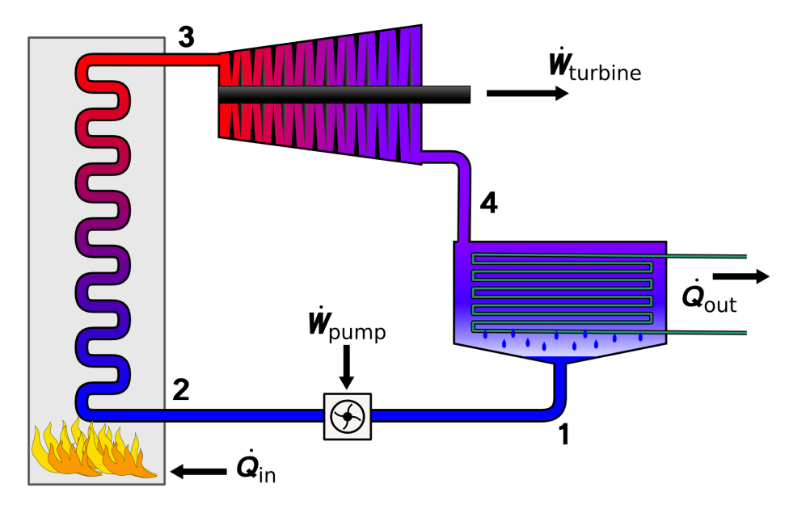
The transformation of thermal energy to mechanical energy requires a device called a heat engine.
First there is combustion where the chemical energy that is stored in the fuel is transformed to thermal energy.
Then, the heat engines transform thermal energy to mechanical energy.

Slide 3
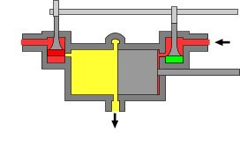
Heat engines are classified according to whether combustion takes place inside or outside the engine
External Combustion Engines
These are engines that burn fuel outside the engine in a boiler.
The combustion of the fuel heats water in the boiler.
The water turns to water vapor (steam).
The steam passes through a sliding valve into the engine where it pushes against a metal plunger called a piston.
Work is done as the piston moves back and forth in the cylinder. The piston’s motion turns a flywheel.

Slide 4
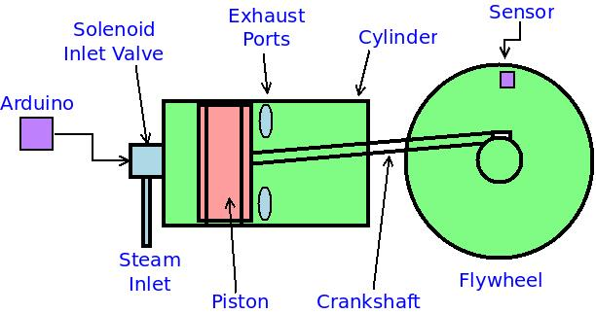

Slide 5
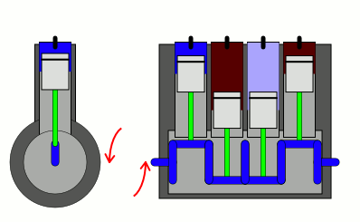
Engines that burn fuel in cylinders inside the engine are called internal combustion engines.
Diesel and gasoline engines which power most automobiles are internal combustion engines.
A piston inside a cylinder moves up and down, turning a crankshaft. This motion is transferred to the wheels of the vehicle.
Each up and down movement by a piston is called a stroke. Most cars have 4,6, or 8 cylinders.
Spark plugs ignite the mixture of fuel and air. COMBUSTION.

Slide 6
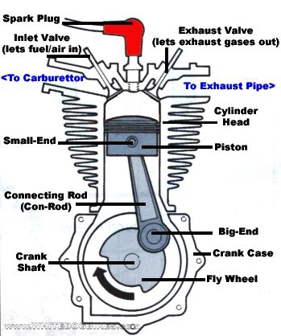
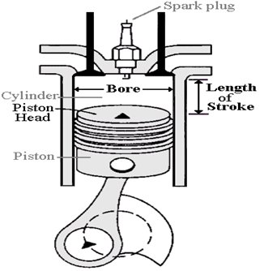
Make sure to look on p. 493.

Slide 7
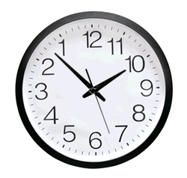
Some devices, such as refrigerators, can transfer heat from cold areas to warm areas.
But, that’s backwards!
A substance called a refrigerant absorbs and releases heat in a refrigerator.
The refrigerant moves through pipes that run along the back and inside. It absorbs the food’s thermal energy since it is cooler than the food. This increase in thermal energy causes the refrigerant to evaporate.
From here, it goes to a compressor which increases pressure, resulting in raising the refrigerant’s temperature.

Slide 8
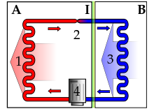
From the compressor, the warm refrigerant flows to the coils of pipes at the back of the refrigerator – the condenser. It will release heat into the air since it is warmer than the air around it.
This causes the refrigerant to become cooler, more condensed.
As this now passes through the expansion valve, pressure is decreased on the refrigerant, allowing the temperature to drop even more.
From here, the cycle continues.

Slide 9
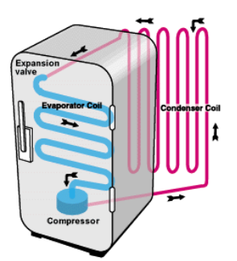
Expansion Valve
The liquid refrigerant goes through this valve which decreases the pressure, dropping temperature.
Condenser
The gas refrigerant releases heat into the room and changes to a liquid.
Evaporator
Cool, liquid refrigerant absorbs heat from the food and changes to a gas.
Compressor
The gas flows to the compressor where its temperature is raised.

Slide 10
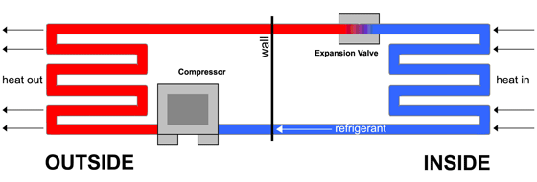
Air conditioners
Air conditioners act like a refrigerator in that the refrigerant is in pipes, changing from liquid to gas and back to a liquid to transfer heat.
The major difference is that an air conditioner absorbs heat from the air inside a room or car and transfers it to the outside.

