Slide 1
15.2 NOTES Properties of Waves
Chapter 15
Characteristics of Waves

Slide 2
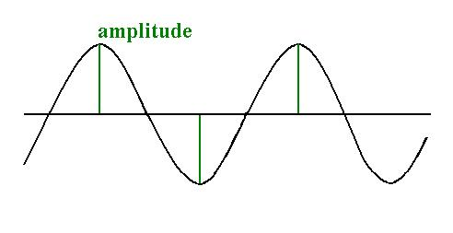
The basic properties of waves are amplitude, wavelength, frequency, and speed.
Amplitude: the maximum distance that the particles of the medium carrying the wave move away from their rest position.
The more energy a wave has, the greater its amplitude.
To find the amplitude in a transverse wave, measure the distance from the rest position to either a crest or a trough.
The amplitude of a longitudinal wave depends on how compressed or rarefied the medium becomes – denser compressions mean a larger amplitude.

Slide 3
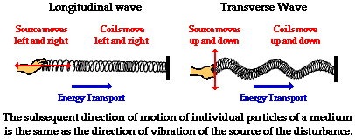

Slide 4
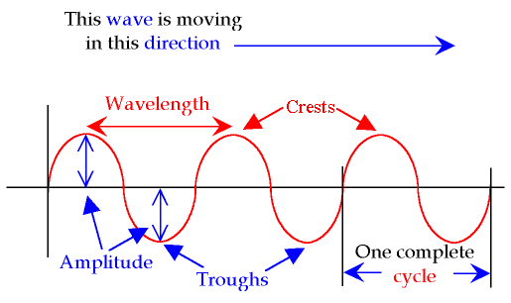
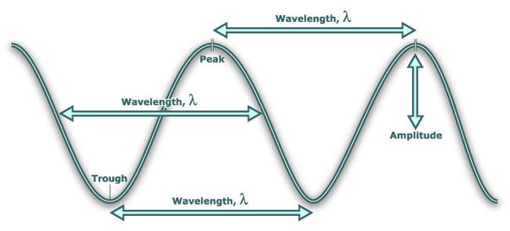
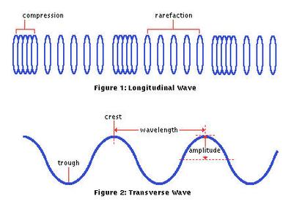
Wavelengths
: The distance between two corresponding parts of a wave is its wavelength.
For a transverse wave, you could measure from crest to crest, or trough to trough.
The wavelength of a
longitudinal wave is the
distance between
compressions.

Slide 5
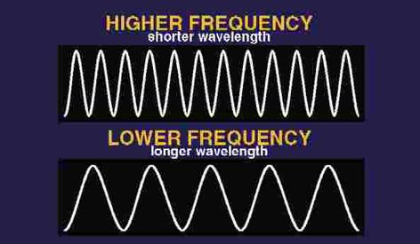
Frequency: The number of complete waves that pass a given point in a certain amount of time.
Frequency is measured in hertz (Hz). A wave that occurs every second has a frequency of 1 Hz. Heinrich Hertz was a German scientists that discovered radio waves.

Slide 6
3. Speed: The speed of a wave is how far the wave travels in a given length of time, or its distance divided by the time it took to travel that distance.
Why do we see lightning before we hear the thunder?
Because light waves travel faster than sound waves.
Speed = Wavelength X Frequency
Speed____ Wavelength
Wavelength =
Speed
Frequency
Frequency =
If a medium does not change, the speed of a wave is constant.
Do the math problems on p 519.

