Slide 1
Chapter 9 Motion
9.2 Speed and Velocity

Slide 2
If you know the distance an object travels in a certain amount of time, you can calculate the speed of the object.
A rate tells you the amount of something that occurs or changes in one unit of time.
Speed is a type of rate.
The speed of an object is the distance the object travels per unit of time.
DISTANCE
SPEED = TIME
kilometers
SPEED = hour
Say: km per hour
Write: km/h

Slide 3
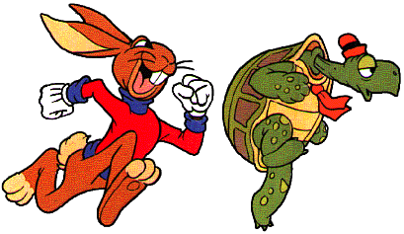
The speed of most moving objects is not constant.
There is an average speed, however!
Average speed = total distance/ total time
Rabbit chases Turtle for 3 hours and travels 15 km. Then Rabbit chases Turtle for 2 more hours and travels 10 km.
15 km + 10 km/ 3 h + 2 h
25 km/ 5 h
5 km/h

Slide 4
Thinking about speed = distance/time, what are two ways to increase speed?
increase the
distance traveled
2. decrease the
time
Any object in motion has SPEED! That is different than being QUICK.
Knowing the average speed is useful, but often it is necessary to know the
instantaneous speed.
This is the rate at which an object is moving at a given instant in time. A may be used to give both average and instantaneous speeds.
cyclometer

Slide 5
Velocity: speed in a given direction
25 km/h westward
What is the speed?
25 km/h
What is the direction?
westward
Motion can be plotted on a line graph.
DISTANCE is the variable that is being measured.
Y axis
TIME is the variable that is being changed.
X axis
SLOPE – the steepness of a line on a graph.
More to follow on the exciting topic of slope!
HURRY UP AND CLICK!

Slide 6
SLOPE tells you how fast one variable changes in relation with another.
I tried to warn you about how exciting this was!
HOLD ON! THERE’S MORE!
SLOPE is the rate of change.
*The steeper the slope, the greater the speed.
*Conversely (this has NOTHING to do with Converse tennis shoes), the more constant the slope, the more constant the speed of motion.

Slide 7
Calculate: SLOPE = RISE / RUN
RISE = vertical difference between any 2 points
RUN = horizontal difference between the same
2 points

Slide 8
Turn to pages 314 and 315 in your book. You and your group have 3 minutes to prepare a presentation on one of the modes of transportation. Include a positive and negative aspect of it. Go!

