Slide 1
NOTES for 20.1 Electric Charge and Static Electricity
PS Chapter 20 Electricity

Slide 2
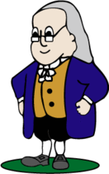
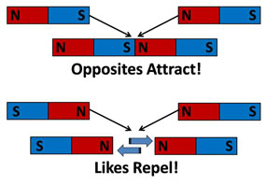
In the 1700’s, Benjamin Franklin gave the terms “positive” and “negative” to the charges on the proton and the electron, respectively.
Opposites attract ( + and - ) while same charges repel (++, --)
Sounds just like magnetic poles, right?
This interaction between magnetic poles is called .
MAGNETISM
ELECTRICITY
The interaction between electric charges is called .
There’s one major difference, however. With magnets, IF you have a north pole, you will ALWAYS have a south pole.
Electric charges can exist alone. A negative charge can exist without a positive, and vice versa.

Slide 3
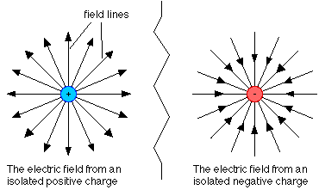
A force is a push or pull on an object. Magnetic force is the attraction or repulsion between magnetic poles. In electricity, electric force is the attraction or repulsion between electric charges.
An electric field is a region around a charged object where the object’s electric force is exerted on other charged objects.
The electric force ALWAYS points away FROM positive charges and TOWARDS negative charges.
The strength of an electric field is
related to the distance from the charged object. The greater the distance, the weaker the electric field.
The closer the lines, the stronger the field that the lines represent.

Slide 4
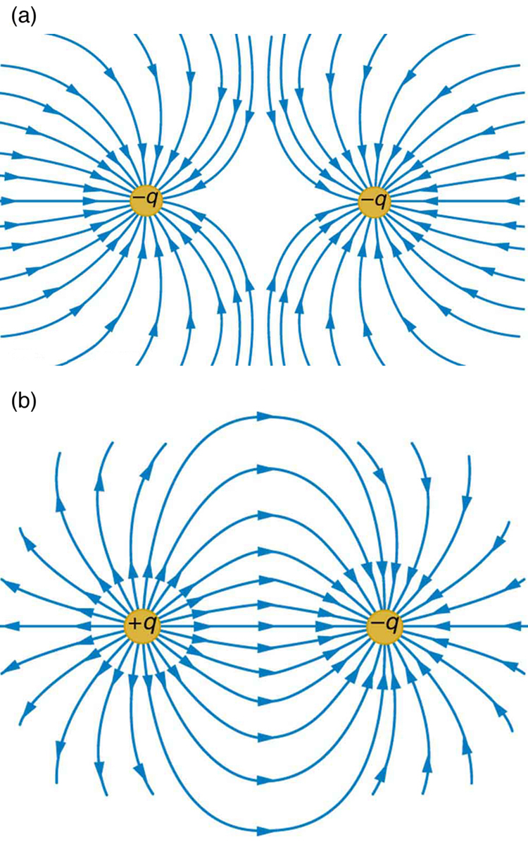
When there are two or more charges, the shape of the electric field of each charge is altered. The electric fields of each individual charge combine by repelling or attracting.

Slide 5
Most objects have no overall charge. The number of protons equals the number of electrons.
In materials such as silver, copper, gold, and aluminum, some electrons are held loosely by the atoms.
These electrons can move to other atoms. If electrons leave an atom, that atom now has more protons than electrons so it has a
charge.
positive
If those electrons move to another atom, that atom will now have more electrons, resulting in a overall charge.
negative

Slide 6
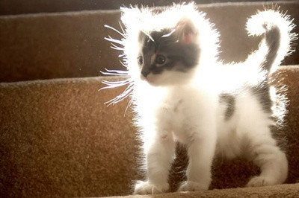
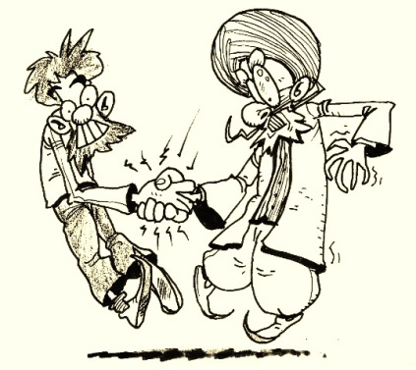
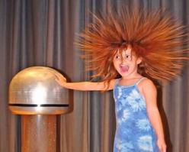
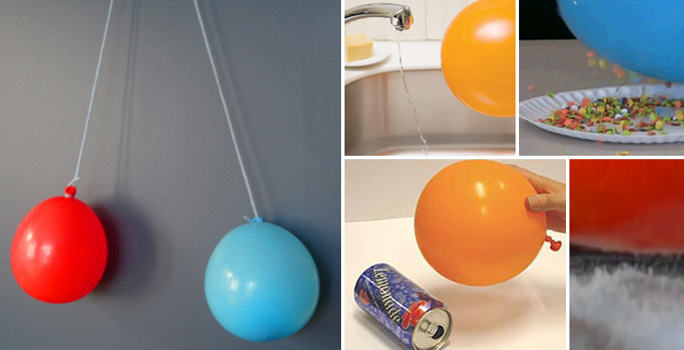
The buildup of charges on an object is called
STATIC ELECTRICITY
Static means “not moving or changing.”
In static electricity, charges build up on an object, but they DO NOT FLOW CONTINUOUSLY.

Slide 7
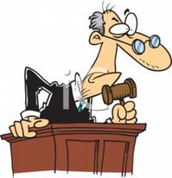
The law of conservation of charge states that charges are neither created nor destroyed.
There are 3 methods by which charges can be transferred to build up static electricity:
1) charging by FRICITON
FRICTION
When 2 uncharged objects rub together, , some electrons from one object move to the other. The one that loses the electrons now has a positive charge, while the one that gains it has a negative charge.
This is what happens when you walk across carpet with socks on.
Electrons move from the carpet to your socks, giving them an overall negative charge.

Slide 8
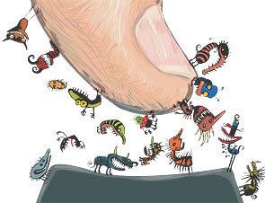
2) charging by CONDUCTION
CONDUCTION,
When a charged object touches another object, electrons can be transferred between the objects. The object that gains electrons becomes negatively charged and the object that loses electrons becomes positively charged.
So, as with the before-mentioned socks, since they touch your skin, the electrons are now transferred to the rest of your body.

Slide 9
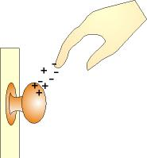
3) charging by INDUCTION
In charging by friction and by conduction, electrons are transferred when objects touch. However, when the electrons move to one part of an object that is caused by the electric field of a second object, causing the charged objects to attract or repel electrons in the second object is called
INDUCTION.
Now that your body has these extra electrons spread throughout, when you go to touch someone, the electric field in your finger repels the electrons in the object you are going to touch. Their electrons move away from your finger. This movement produces an induced positive charge on the object.
Turn to pages 686-687.

Slide 10
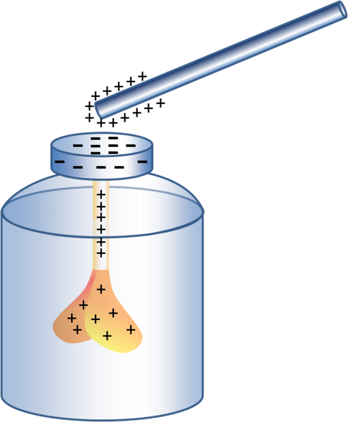
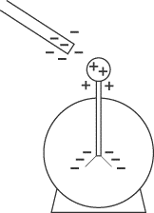
Detecting Charge
Electricity is , but it can be detected by an instrument called an .
INVISIBLE
electroscope
An electroscope can be used to detect the presence of a charge, but it does not tell you whether the charge is positive or negative.
Since the charge is the same on both leaves, the leaves repel each other and spread apart.
Therefore, you cannot use an electroscope to determine the type of charge.

Slide 11
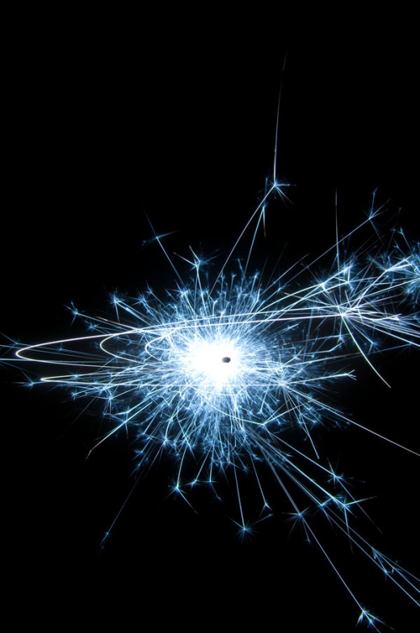
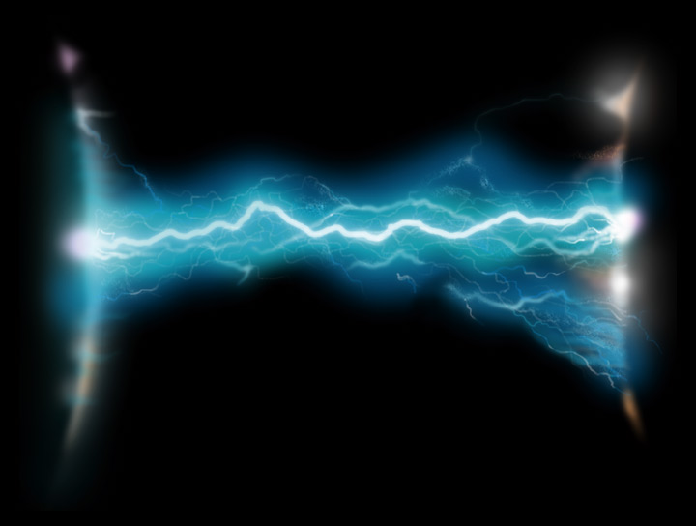
When two objects with opposite charges touch each other, electrons transfer until both objects have the same charge.
The loss of static electricity as electric charges transfer from one object to another is called STATIC DISCHARGE.
Often, a static discharge produces a spark.
As electrons transfer between objects, they heat the air around the path they travel until it glows. That glowing air is the spark you see.

Slide 12
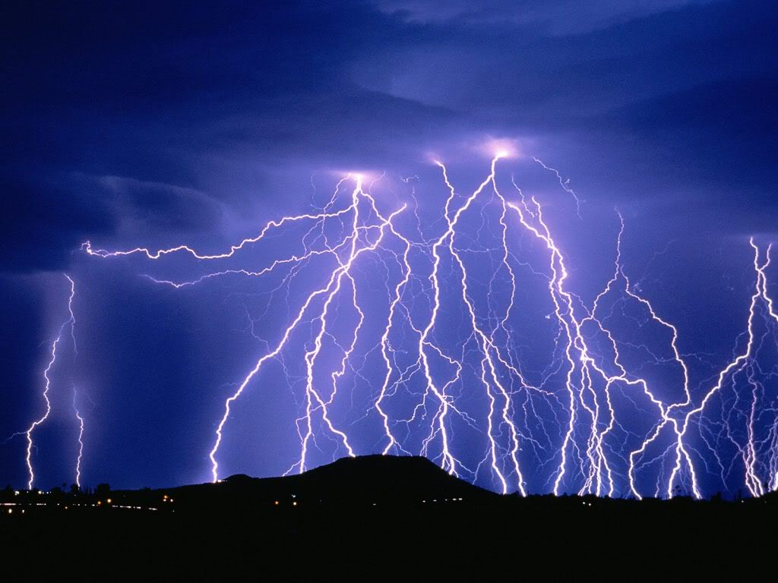
Lightning is a dramatic example of static discharge.
Like me?
Think of lightning as a really big spark!
No, more like me!
During a thunderstorm, the wind swirls furiously. The water droplets in the cloud become electrically charged. To restore its neutral state in the clouds, electrons move from areas of negative charge to areas of positive charge Ta da! Lightning!

Slide 13
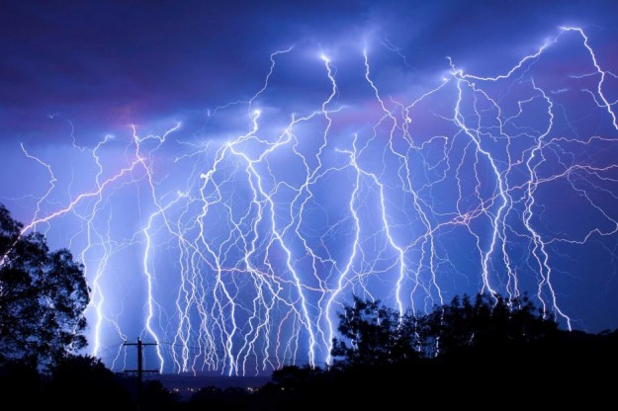
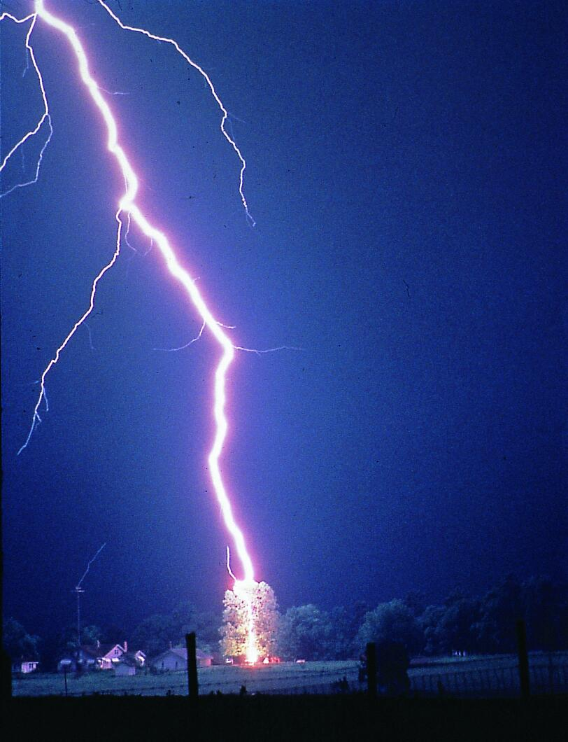
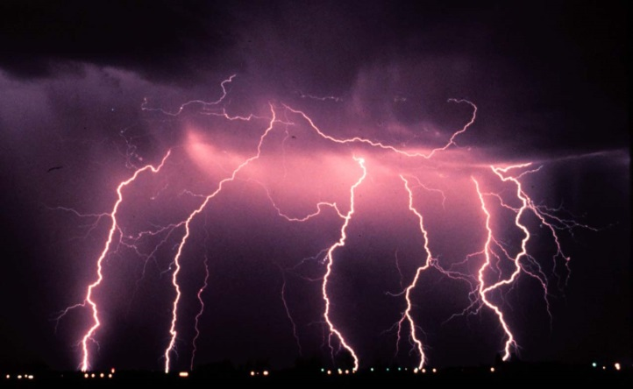
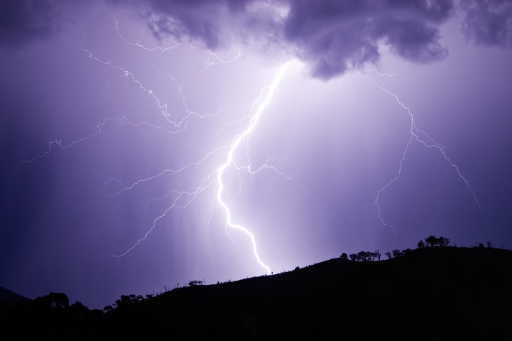
Some lightning reaches Earth because negative charges at the bottom of storm clouds may cause the surface of Earth to become positively charged by induction.
Electrons jump between the cloud and Earth’s surface, producing a giant spark as they travel through the air. This is possible because of charging by conduction.

