Slide 1
NOTES on 16.5 Using Sound
Chapter 16 Sound

Slide 2
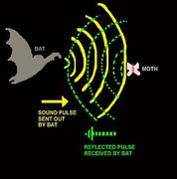
The use of reflected sound waves to determine distances or to locate objects.
Echolocation
Bats use ultrasound waves with frequencies up to 100,000 Hz to move around and hunt.
As it flies, the bat will emit short pulses of ultrasound waves – as many as 200 pulses per SECOND!
These pulses reflect off surfaces and give the bat a picture of what lies ahead.

Slide 3
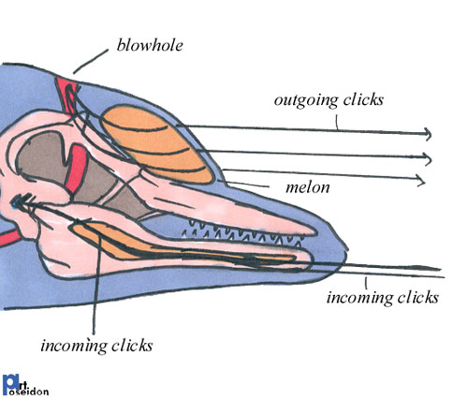
Dolphins, porpoises, and some whales also use echolocation.
Dolphins send out ultrasound waves – clicking sounds -with frequencies up to 150,000Hz.
These clicking sounds travel through the water and bounce off fish and obstacles.
Dolphins sense the reflected waves through their jawbones, allowing them to “see” when it is dark or deep, murky water.

Slide 4
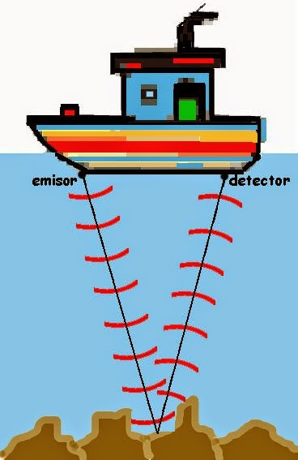
SONAR= SOund Navigation And Ranging
*uses reflected sound waves to detect and locate objects underwater.
Navigation means:
finding your way around on the ocean, air, or land.
Ranging means:
finding the distance between objects.
A computer measures the time it takes for the sound waves to go out and return. Then it multiplies it by the speed of sound in water. The result is the total distance the sound has traveled. Then it is divided by two to find out how far away the object is. Why?
What else is sonar used for?

Slide 5
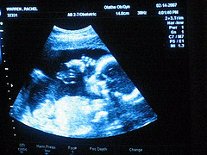
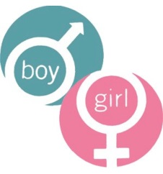
Ultrasound Imaging
*used to look inside the human body
Different parts of the body, such as bones, muscles, the liver, or the heart, reflect the sound waves differently.
The sonogram is used to create a picture of the reflected waves. It is used to diagnose and treat many medical conditions.
It is also used to examine developing babies before they are born.

