Slide 1
NOTES on 20.4 Electric Circuits and Power
PS Chapter 20 Electricity

Slide 2
Ohm found that if the factors that affect resistance are held constant, the resistance of most conductors does not depend on the voltage across them.
Changing the voltage in a circuit changes the current, but will not change the resistance.
Ohms’ Law:
Resistance = Voltage/Current
( ohms) = (V) / (A)
or
Voltage = Current X Resistance
(V) = (A) X (ohms)
Use Ohm’s law to calculate the voltage of a circuit with a resistance of 15.2 ohms and a current of 0.10 amps.
Voltage = Current X Resistance V = .1 A X 15.2 ohms = 1.52 V

Slide 3
In a circuit, there is a 0.5-A current in the bulb. The voltage across the bulb is 4.0 V. What is the bulb’s resistance?
What is being calculated?
resistance
What values are given?
current and voltage
What is the formula used to solve the problem?
R = V/I
What is the unit used for the answer?
ohms
What is the answer?
R = 4.0 V / .5 A R = 8 Ώ
A waffle iron has a 12-A current. If the resistance of the coils is 10 Ὼ, what must the voltage be?
V = A x Ώ V = 12A x 10 Ώ 120V

Slide 4
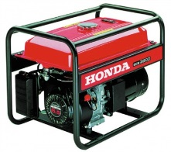
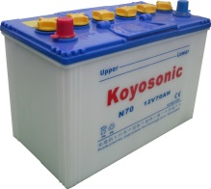
Features of a Circuit
Circuits have devices that are run by electrical energy.
* These devices transform electrical energy into another form of energy.
to mechanical
electromagnetic and thermal energy
2. Circuits have a source of electrical energy.
* These sources make charges move around a circuit, allowing the device to work.
3. Electric circuits are connected by conducting wires.
*The conducting wires complete the path of the current. They allow charges to flow from the energy source to the device that runs on electric current and back to the energy source. A switch is usually included to turn a device on or off by closing or opening the circuit.

Slide 5
Look at page 709, figure 17, to answer the following questions.
What is the device, or resistor, in this circuit?
The light bulb.
What is the source of electrical energy?
The battery.
What connects this electric circuit?
Wires.
What is the direction of the current?
From positive to negative.
What is used to open and close the circuit?
A switch.

Slide 6
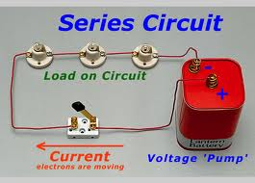
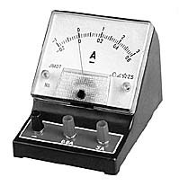
All the parts of an electric circuit are connected one after another along one path.
Series circuit
There is only one path for the current to take.
If one light goes out, the rest go out as well since there is only one path.
The more light bulbs are added, the dimmer each one becomes.
If the voltage remains constant, if resistance increases, current decreases.
An ammeter is a device used to measure current.
The ammeter must be connected in series with the device in the circuit.

Slide 7
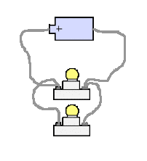
Parallel circuits
The different parts of the circuit are on separate branches.
There are several paths for current to take.
Each bulb is connected by a separate path from the battery and back to the battery.
If one bulb goes, out, the others remain lit.
Switches can be added to each branch to turn lights on and off without affecting the other branches.
As new branches are added to a parallel circuit, the electric current has more paths to follow, so the overall resistance decreases.
As you add branches to a parallel circuit, the brightness of the light bulbs does not change.

Slide 8
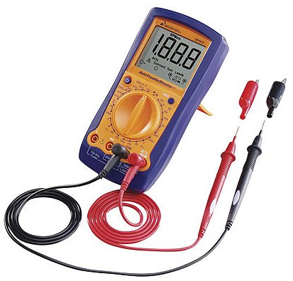
A voltmeter is a device used to measure voltage, or electrical potential energy difference. The voltmeter and the device should be wired as a parallel circuit.
Electrical energy enters a home through heavy-duty wires. These wires have very low resistance. Parallel branches extend out from the heavy-duty wires to wall sockets, and then to appliances and lights in each room.
The voltage in most household circuits is 120 volts.

Slide 9
Power is the rate at which energy is transformed from one form to another. The unit of power is the
watt (W).
ie: 60 W vs 100 W The 100 W uses (transforms)
electrical energy at a faster rate.
The power of a light bulb or appliance depends on two factors:
1. voltage (V)
2. current (I)
German word intensitat = intensity.
Therefore, P= VI
1. A flashlight bulb uses two 1.5-V batteries in series to create a current of 0.5 A. What is the power rating of the bulb?
P =VI P=3.0V x 0.5 A P = 1.5W
2. A hair dryer has a power rating of 1,200 W and uses a standard voltage of 120V. What is the current through the hair dryer?
I = P/V 1,200/120 I = 10A

Slide 10
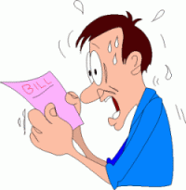
The electric bill that your parents get to pay is for energy USE, not POWER.
Energy use depends on both the power of the appliance and the amount of time it is used.
Energy = Power x Time
Power is usually measured in thousands of watts, or kilowatts; time in hours.
The unit of electrical energy is the kilowatt-hour (kWh)
An electric water heater that requires 40kW runs for 5 hours. How much energy does it use? How much energy in 20 hours?
40kW x 5h = 20 kWh
40kW x 20h = 800 kWh

