Slide 1
Chapter 10 Forces
Notes on 10.1
The Nature of Force

Slide 2
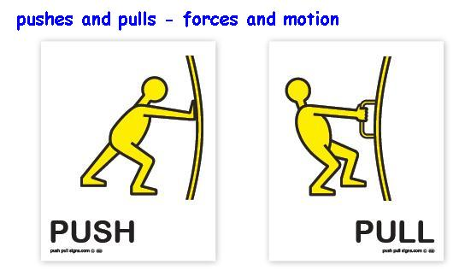
Force is a push or pull.
When one object pushes or pulls another object, that first object is exerting a force on the second object.
Like velocity and acceleration, a force is described by its strength and by the direction in which it acts.
The force is exerted in different directions in a push or pull.

Slide 3
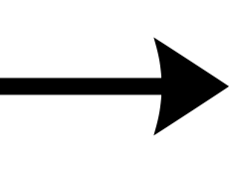
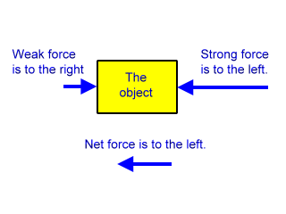
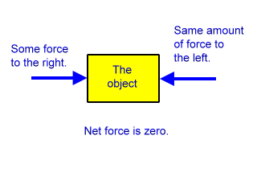
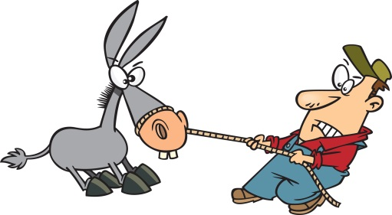
The strength of a force is measured in the SI unit called the newton (N).
The direction and strength of a force can be represented by an arrow.
More than one force can act upon an object at one time. The combination of all forces acting on an object is called the net force.. The net force determines whether an object moves and in what direction it moves.
Forces can add together to produce a larger net force than either of the originals.
Two forces can subtract to produce a net force in the direction of the larger force.
Two forces may cancel each other and produce no net force.

Slide 4
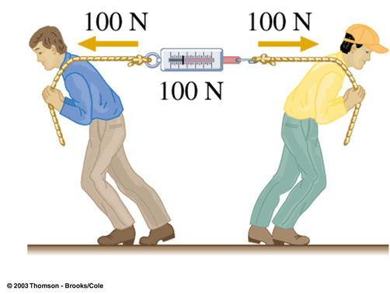
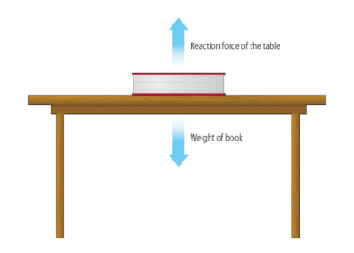
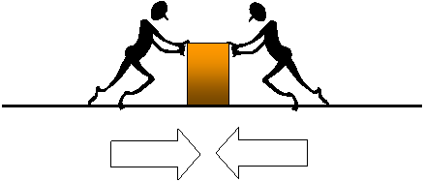
Unbalanced forces acting on an object result in a net force and cause a change in the object’s motion.
Unbalanced forces can cause an object to start moving, stop moving, or change direction.
Equal forces acting on one object in opposite directions are called balanced forces. Balanced forces do not change the object’s motion. There is NO net force.

