Slide 1
Chapter 10 Forces
NOTES on 103. Newton’s First and Second Laws

Slide 2
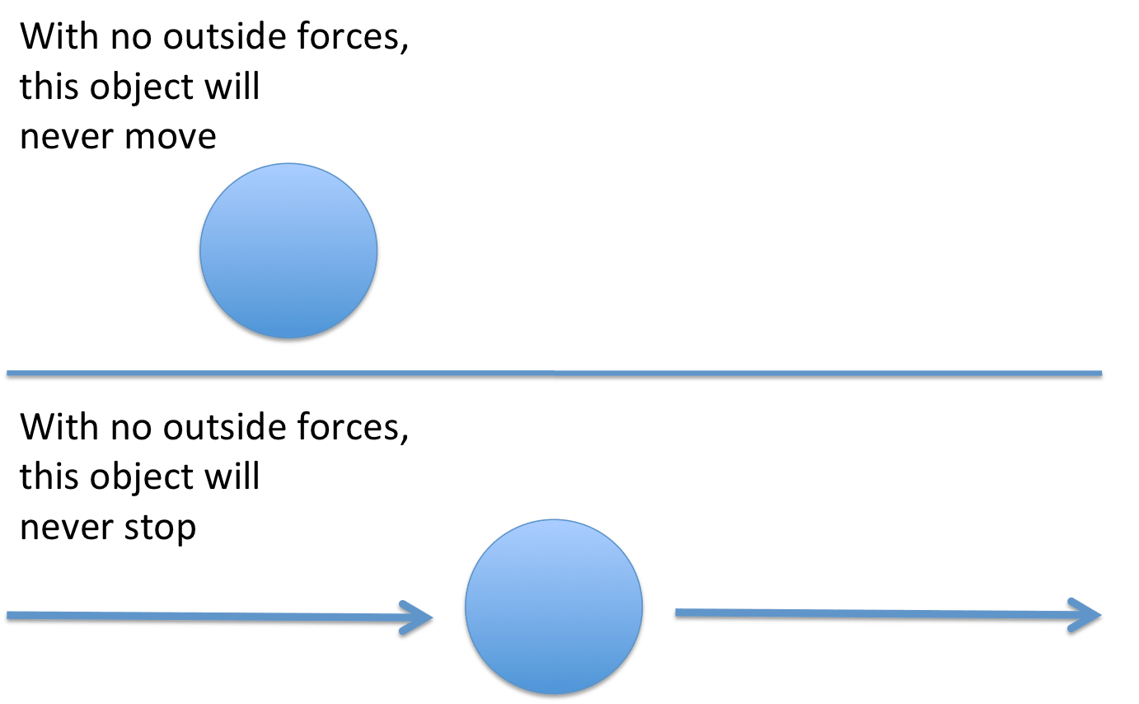
Newton’s First Law of Motion
An object at rest will remain at rest, and an object moving at a constant velocity will continue moving at a constant velocity, unless it is acted upon by an unbalance force.
I guess you could say that objects are basically lazy! They want to continue to do whatever it is they are doing, and not change unless forced to!

Slide 3
Inertia
The resistance to a change in motion
Newton’s first law is also called The Law of Inertia.
The greater the mass of an object, the greater its inertia; therefore, the greater the force required to change its motion.

Slide 4
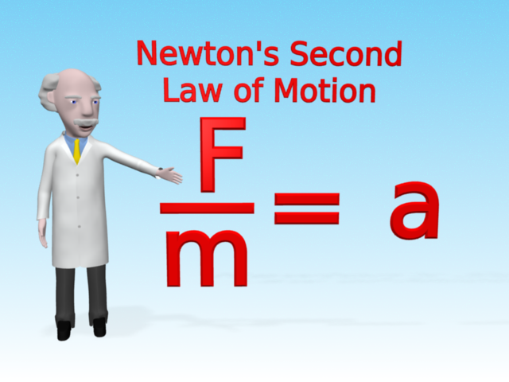
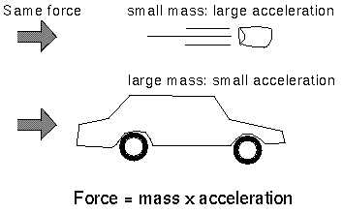
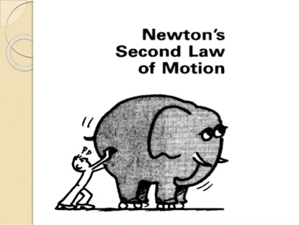
Newton’s Second Law of Motion
Acceleration depends on the object’s mass and on the net force acting on the object.
Acceleration = m/s²
Mass = kg
Force then is =kg(m/s²)
Aka = newton (N)
This means that 1 N is the force required to give a 1-kg mass an acceleration of 1 m/s²)

Slide 5
One way to increase acceleration is
*by changing the force.
Increase acceleration → increase the force
Another way to increase acceleration is
*by changing the mass.
Acceleration and mass change in opposite ways.
To increase acceleration → decrease its mass.

