Slide 1
Notes on 16.3 Music
Chapter 16 Sound

Slide 2
Music is a set of notes that combine in patterns that are pleasing. How does that differ from noise?
When you describe sound as being pleasant or unpleasant, you are referring to the sound quality, which depends on the instruments making the music.
The sound quality of musical instruments results from blending a fundamental tone with its overtones. Resonance also plays a role in the sound quality.

Slide 3
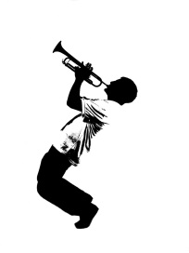
Standing waves – when waves with just the right frequency interfere as they reflect back and forth - occur in musical instruments
vibrating string
column of vibrating air
A standing wave can only occur at specific frequencies, which every object has its own, called natural frequencies .
The lowest natural frequency of an object is its FUNDAMENTAL TONE.
The object’s higher natural frequencies are called OVERTONES.
+
Turn to p. 553
The fundamental tone determines what note you hear. Two instruments could play the same sound but produce different sound qualities.
What factors might account for the natural frequency of a particular instrument?

Slide 4
Resonance affects the sound quality of a musical instrument by increasing the loudness of certain overtones.
Resonance occurs when one object causes a nearby object to vibrate at a natural frequency.
How does that work in the guitar and trumpet?
1. How do overtones affect the sound quality of a musical instrument?
Sound quality results from the blending of a fundamental tone with its overtones.
2. How does resonance affect the sound quality of a musical instrument?
Resonance affects the sound quality of a musical instrument by increasing the loudness of certain overtones.

Slide 5
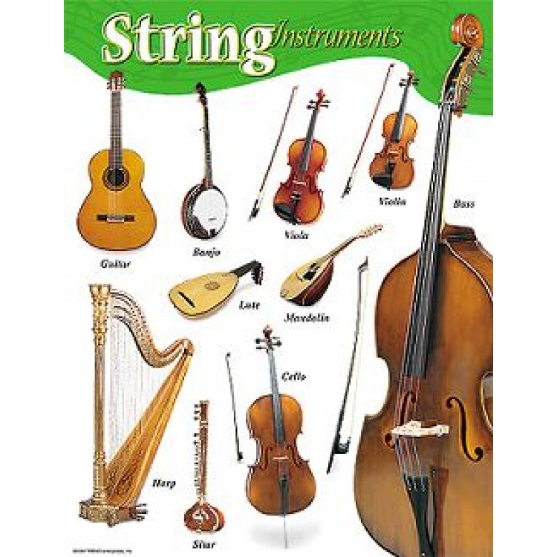
GROUPS OF MUSICAL INSTRUMENTS
Sound is produced from vibrations caused by strumming or rubbing the strings with a bow.
Loudness is increased by resonance when the instrument’s hollow body vibrates as strings vibrate. Loudness is increased by the musician applying more pressure on the strings while strumming or with the bow.
Pitch (for each string) depends on its length and thickness, the material it is made from, and how tightly it is stretched.

Slide 6
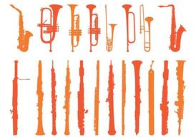
WIND INSTRUMENTS
Brass and Woodwinds
Brass instruments produce sound when musician’s lips vibrate against the mouthpiece, whereas woodwinds contain a reed which vibrates. Both cause the air in the instrument’s air column to vibrate.
Loudness is controlled by how hard the musician blows.
Pitch depends on the length of the column, which can be changed by covering different holes.

Slide 7
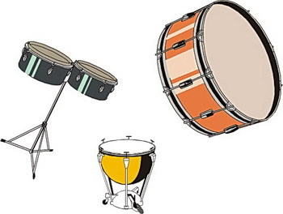
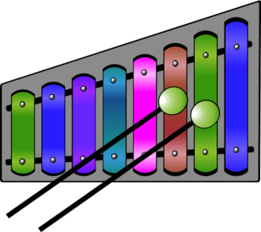
PERCUSSION INSTRUMENTS
These instruments vibrate when struck, making sound.
Pitch depends on the size of the drum head, the material, and the tension in the drum head.
Loudness is controlled by how hard the musician strikes the instrument.

Slide 8
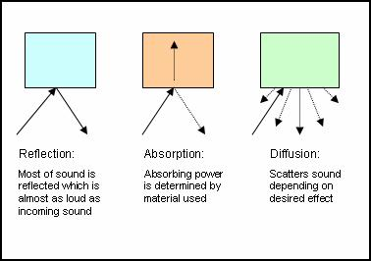
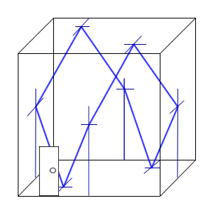
The study of how sounds interact with each other and the environment.
ACOUSTICS
Constructive interference may distort sound while destructive interference can cause “dead spots” where loudness is reduced.
Reverberation is the echoes of a sound that are heard after the sound source stops producing sound waves.
Acoustics is used in the design of concert halls to control reverberation and interference.
Curved, hard surfaces= direct sound waves
Soft surfaces = absorb sound waves (Goldilocks)

