Slide 1
Chapter 17: The Electromagnetic Spectrum
Notes on 17.1
The Nature of Electromagnetic Waves

Slide 2
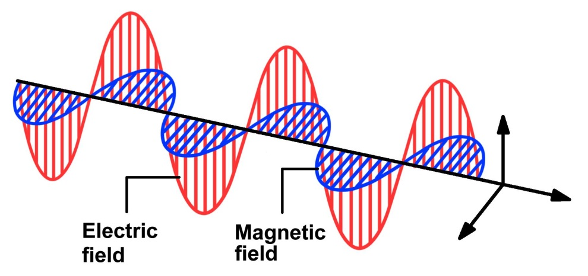
Electromagnetic waves:
transverse waves
can transfer energy without a medium
transfers electrical and magnetic energy
consists of vibrating electric and magnetic fields that move through space at the speed of light
The speed of light in a vacuum is 186,282 miles per second (299,792 kilometers per second), and in theory nothing can travel faster than light. In miles per hour, light speed is, well, a lot: about 670,616,629 mph. If you could travel at the speed of light, you could go around the Earth 7.5 times in one second.

Slide 3
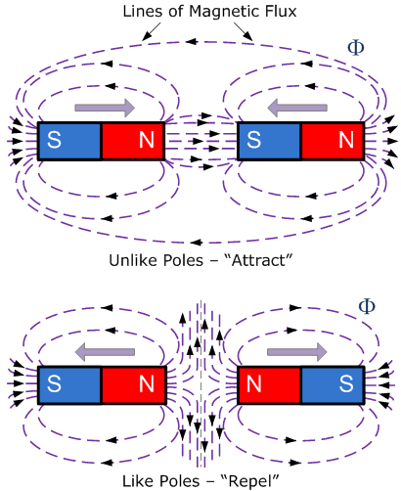
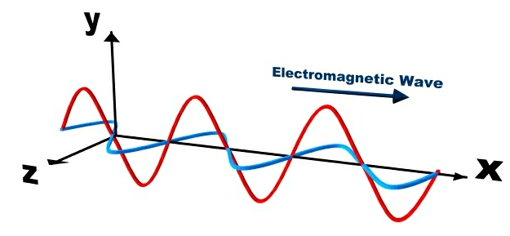
Light and all other electromagnetic waves are produced by charged particles. Every charged particle has an electric field surrounding it. The electric field produces electric forces that can push or pull on other charged particles.
When a charged particle moves, it produces a magnetic field. The magnetic field exerts magnetic forces that can act on certain materials.
When a charged particle changes its motion, its magnetic field changes. This changing magnetic field causes the electric field to change. When one field vibrates, so does the other. In this way, the two fields constantly cause each other to change. This results in an electromagnetic wave. The two fields vibrate at right angles to each other.

Slide 4
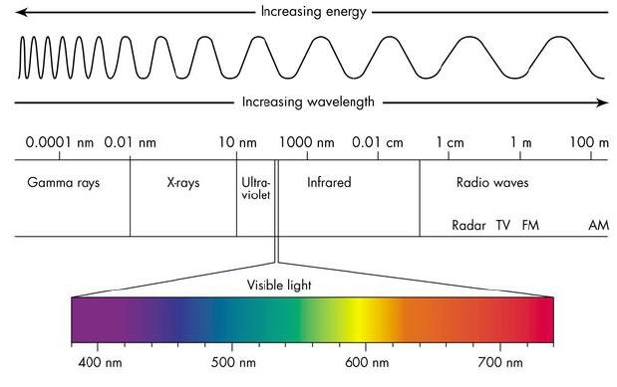
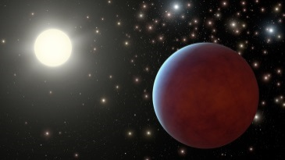
Electromagnetic radiation:
energy that is transferred through space by electromagnetic waves.
This is the reason you can see the sun and
stars – their light reaches Earth through a
vacuum of space.
At the speed of light in a vacuum(˜ 300, 000 km/s), the sun takes about 8 minutes to travel the 150 million kilometers to Earth.
Light waves travel through air a bit slower, but they are still about million times faster than the speed of sound waves in air!

Slide 5
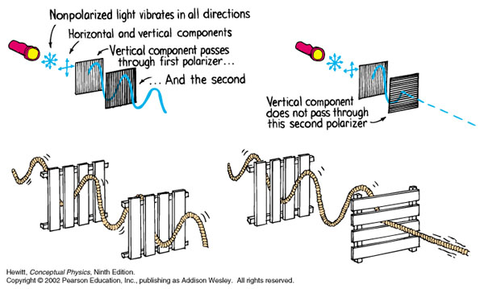
An electromagnetic wave vibrates back and forth like a transverse mechanical wave when it travels through space. However, when an electromagnetic wave strikes some substances, it acts like a stream of tiny particles of energy. Both models are needed to explain all of the properties of light.
Many properties of electromagnetic waves can be explained by a wave model. Think of light waves as being transverse waves on a rope. This explains polarization!
Ordinary light has waves that vibrate in all directions, up and down, left and right, and at all other angles.
Light that passes through vibrates in only one direction. “Polarized light.”
A polarizing filter acts as though it has tiny slits that are aligned in one direction.
No light passes through two polarizing filters that are placed at right angles to each other.

Slide 6
A little background information:
Around 1900, the German physicist Max Planck introduced the idea that light sometimes acts like particles instead of waves. Planck used the photon to describe particles of light. The idea of photons was soon adopted by German-American physicist Albert Einstein, who was studying a phenomenon called the photoelectric effect. The photoelectric effect occurs when light shines on a metal surface and causes the surface to give off electrons. Einstein argued that the photoelectric effect could happen only if light struck the metal as particles and not as waves. Einstein reasoned that waves would cause each surface electron to gain more and more energy. In fact, each electron gains the same amount of energy for any given electromagnetic wave. Einstein observed that even increasing the energy of a wave does not cause individual electrons to gain more energy. Instead, it causes more electrons to gain the same amount of energy. Based on his observations, Einstein theorized that light strikes a metal surface as particles of energy and that each electron absorbs the energy of one particle of light .
Photons are now classified as elementary particles, or particles that cannot be divided into smaller units. Photons have no mass or electrical charge. Without mass, they can travel at the speed of light.

Slide 7
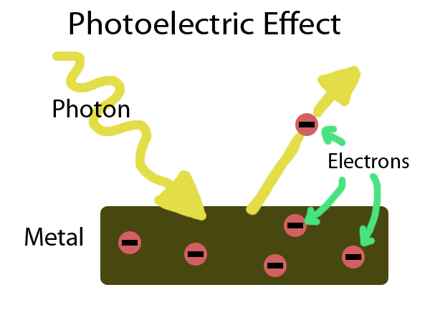
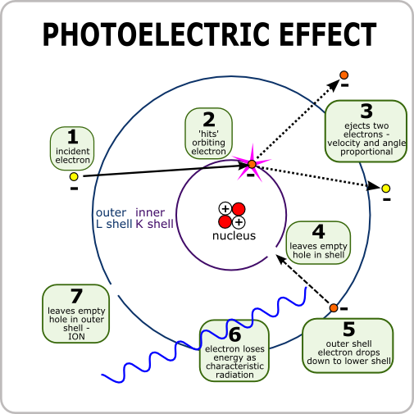
Particle model of light:
When a beam of light shines on some substances, it causes electrons to move. The movement of electrons causes an electric current to flow. Sometimes light can even cause an electron to move so much that it is knocked out of the substance.
Think of light as a stream of tiny packets, or particles, or energy called a photon.

