Slide 1
Chapter 11: Forces in Fluids
11.2
Floating and Sinking

Slide 2
Buoyancy= the ability to float
buoyant force – acts in a direction opposite gravity so it makes an object feel lighter.
Ok. Let’s make sure we understand what is going on.
1. A fluid exerts pressure on all surfaces of a submerged object.
Ta da! BUOYANCY!
2. Since pressure in a fluid increases with depth, the upward pressure on the bottom of the object is greater than the downward pressure on the top.

Slide 3
WEIGHT! I MEAN, WAIT!
An object will sink if its weight (a downward force) is greater than the buoyant force.
If the object’s weight is equal to the buoyant force, no net force acts on it, so it will not sink.
A submerged object whose weight is equal to the buoyant force also has no net force acting it and it will not sink.

Slide 4
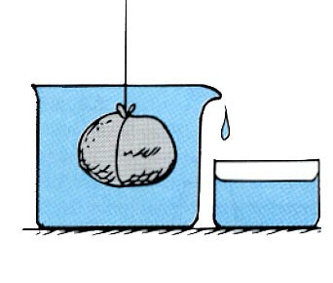
A submerged object displaces (takes the place of)
a volume of fluid equal to its own volume.
A partly submerged object, displaces a volume of fluid equal to the volume of its submerged portion only.
Archimedes’ Principle
The buoyant force acting on a submerged object is equal to the weight of the fluid the object displaces.
A greater buoyant force acts on a larger object even if the large object has the same weight as the small object.

Slide 5
If a boat developed a leak and some water entered the ship, use Archimedes’ principle to explain why the boat might sink.
The added water would increase the ship’s weight. If the weight of the ship and the added water exceeds the buoyant force, the ship will sink.

Slide 6
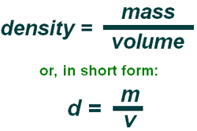
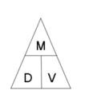
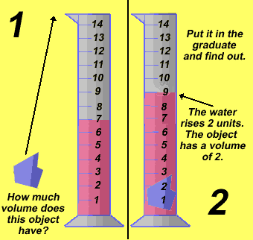
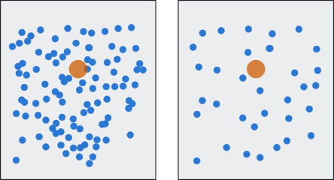
Why do some objects float and others sink?
It’s all about DENSITY!
object > fluid → sinks
object < fluid → floats
object = fluid →
floats at constant depth

Slide 7
Changing the density of an object will change whether the object sinks or floats.
ie: ice cube
Water expands when it is frozen, thereby ice occupies more space than water, making it less dense.
Most of it will be below the water line – like an iceberg.

Slide 8
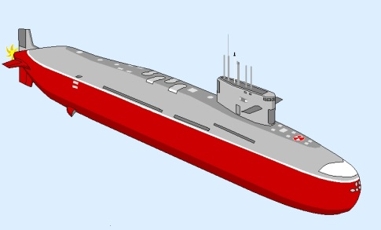
You can make an object sink or float in a fluid by changing its density.
Take a submarine.
The density increases when its flotation tanks are filled with water.
This makes the overall mass of the sub increase.
The volume remains the same, but both its density and mass have increased. This makes it dive.
DIVE! DIVE! DIVE!

Slide 9
This can also be explained by means of the buoyant force.
buoyant force = the weight of the displaced fluid
Does this water make me look fat?
The buoyant force remains the same, but changing the water level in the flotation tanks changes the weight of the submarine.
The sub will dive when its weight is greater than the buoyant force and rise when its weight is less than the buoyant force.
Let me rise! Think light thoughts!

Slide 10
If you blow a balloon up with air, it
sinks! Why?
It is denser than surrounding air because the air inside is under pressure.
If you would blow that same balloon up with helium what would happen?
It would rise because it is less dense than air!

