Slide 1
11.3 Pascal’s principle
Chapter 11 Forces in Fluids

Slide 2
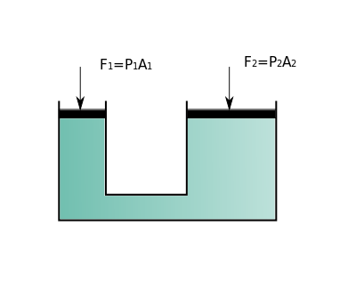
Pascal’s Principle
When force is applied to a confined fluid, the change in pressure is transmitted equally to all parts of the fluid.
The force that is exerted on the left piston is multiplied by the area of the right piston.
Hydraulic systems multiply force by applying the force to a small surface area. The increase in pressure is then transmitted to another part of the confined fluid, which pushes on a larger surface area.

Slide 3
Turn to page 391: Analyzing Data.
Describe what happens in the brake system of a car from the time a driver steps on the brake pedal to the time the car stops.
The driver exerts a force on the , which causes the brake pedal to exert increased pressure on the . The confined fluid transmits the increased pressure to pistons that push on the in the car’s wheels. When the pads rub against , the force of between pads and discs slows the car’s wheels.
brake pedal
piston
brake fluid
brake pads
brake discs
friction

