Slide 1
Chapter 11 Forces in Fluids
11.4
Bernoulli’s Principle

Slide 2
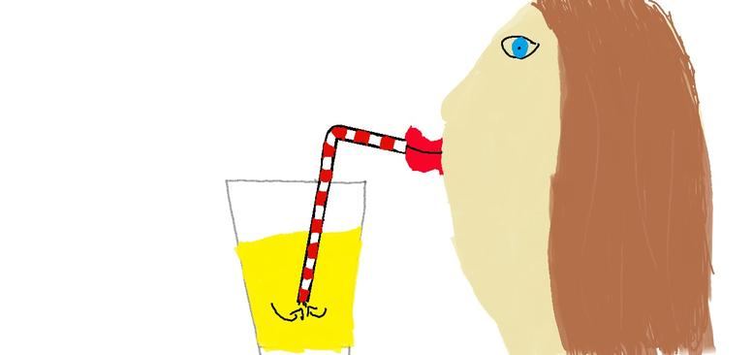
Something you should know about fluids:
They flow from areas of
to areas of
HIGH PRESSURE
low pressure
When you sip, you remove air from the straw, creating an area of low pressure.
Now, the air pressure pushing down on the drink in the bottle forces the drink up your straw.

Slide 3
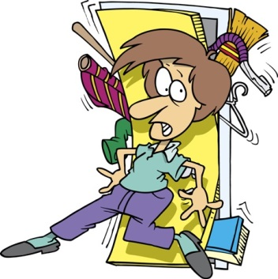
What would happen if someone opened a window in an airplane that was in flight?
Things wouldn’t get “sucked out” if there was an opening in an airplane – they would get “pushed out”.
The air pressure in the cabin is greater than the air pressure outside.

Slide 4
Bernoulli’s Principle
As the speed of a moving fluid increases, the pressure within the fluid decreases.
Try the Discover Activity on page 393.
The air under the paper is exerting a pressure that is stronger than the moving pressure from above.
Now try the Faucet Force Activity on page 394.
The spoon moved toward the stream of water because the moving water caused the pressure to be lower on the back of the spoon.

Slide 5
Bernoulli’s Principle
This principle helps to explain so many things like why smoke rises up a chimney, how atomizer works, how flying disks glide through the air, how planes fly, but it does not explain why this is upside down!
This principle helps to explain so many things like why smoke rises up a chimney, how atomizer works, how flying disks glide through the air, and how planes fly.
If the air moves faster above the object, fluid pressure pushes the object upward. If the air moves faster below the object, fluid pressure pushes it downward.

Slide 6
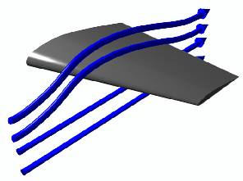
The wing of an airplane is designed to produce LIFT, or an upward force.
The wing is slanted; this causes the air that hits it to be forced downward as the plane moves.
The air exerts an equal and opposite on the wing and pushes it upward. TAKE OFF!

Slide 7
The curved shape of a wing also gives an airplane lift. The curved shape at the top allows the air moving over it to have a greater speed (less pressure) than the air moving under the bottom.
This is LIFT.

Slide 8
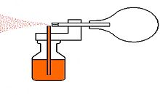
atomizers
Bernoulli strikes again!
Squeeze the rubber ball.
Air moves quickly past the top of the tube.
Now, the pressure above is less than the pressure below.
The greater pressure in the flask pushes the liquid up into the tube.
The air stream breaks the liquid into small drops so that it comes out in a fine mist.

Slide 9
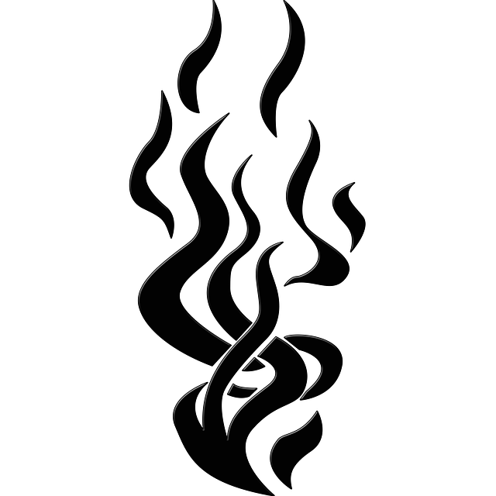
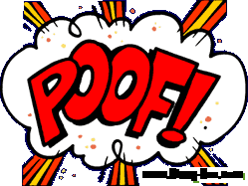
Chimneys
Yes, smoke rises up the chimney because hot air rises, but this is all about BERNOULLI!
So, the wind that is blowing across the top of the chimney creates an air pressure that is lower there.
Thusly (sounding smug and intelligent), the higher air pressure at the bottom pushes air and smoke up the chimney.

Slide 10
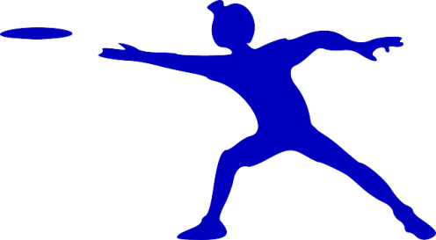
Flying Disks aka Fribees
Notice the curved upper surface of the disk.
Just like a plane’s wing, the faster moving air following the upper curve exerts less pressure than the slower-moving air beneath it.
Then, if you slightly tilt it toward you as you throw it, it will help keep it in the air. A tilted disk pushes the air down.
The air exerts an equal and opposite force on the disk, pushing it up.
The spinning motion keeps it stable as it flies.

