Slide 1
Chapter 12 Work and Machines
12.1
What is Work?

Slide 2
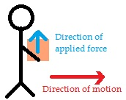
Work is done on an object when the object moves in the same direction
in which the force is exerted.
Work is being done on these books. There is an upward force to hold them so they don’t fall to the ground.
work
This guy, however, is not working as he carries his pack. The work is vertical (holding up the load) but the motion of the pack is horizontal.
work

Slide 3
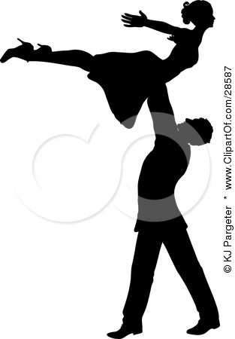
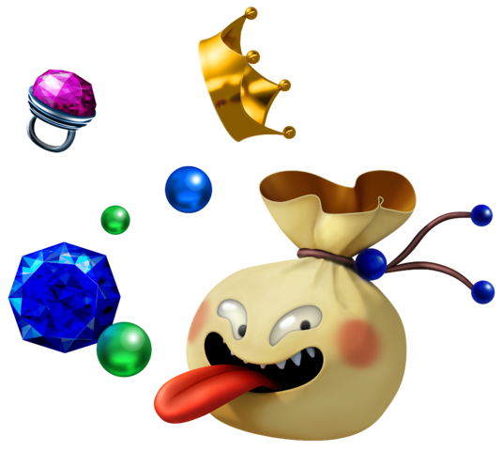
work = force X distance
Remember: In order to lift something, you must exert an upward force at least equal to the object’s weight.
newton x meter
= joule
Force is measured in newtons.
Distance is in meters.
Will this help you to remember it?
Great work is like a jewel (joule).

Slide 4
POWER!
Power equals the amount of work done on an object in a unit of time.
If something is powerful, it can do the same amount of work in a shorter amount of time.

Slide 5
WORK
POWER = TIME
THEREFORE,
FORCE x DISTANCE (joule)
POWER = TIME (seconds) joule/sec = watt
Boyerese Mnemonics
force → newtons (N)
(I’ll force those newtons down.
distance → meters (m)
(No matter the distance, I’ll meet her there.)
work → joules (J)
(Work is a jewel.)
power → watts (W)
(What power!)

Slide 6
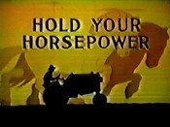
One more thing!
A watt is a relatively small unit of power. Oftentimes another larger power unit is used.
1 kilowatt (kW) = 1,000 watts
And yet another power unit is used when referring to vehicles.
The horsepower is not an SI unit of measure.
HORSEPOWER
1 horsepower =
746 watts
Turn to page 410 and work the math problems.

