Slide 1
Chapter 12 Work and Machines
12.2 NOTES
How Machines Do Work

Slide 2
A machine is a device that allows you to do work in a way that is easier by changing at least 1 of 3 ways:
1. the amount of you exert
FORCE
2. the over which you exert your force
DISTANCE
3. the in which you exert your force
DIRECTION
Say if these are machines or not:
can opener
ball
corkscrew
pliers
paper
eraser
screwdriver
YES
NO
YES
YES
NO
NO
YES

Slide 3
INPUT FORCE:
the force you exert on the machine
The input force moves the machine a certain distance called the INPUT DISTANCE.
OUTPUT FORCE:
the force the machine exerts on an object
The machine does work by exerting a force over another distance called the OUTPUT DISTANCE.
INPUT FORCE x INPUT DISTANCE = INPUT WORK
OUTPUT FORCE x OUTPUT DISTANCE = OUTPUT WORK
When you use a machine, the OUTPUT WORK can never be greater than the amount of INPUT WORK.

Slide 4
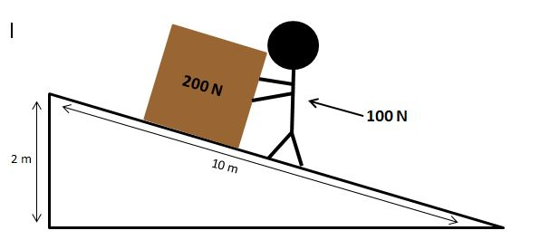
In some machines the output force > input force. HOW?
work = force x distance
If work stays the same, a decrease in force
means an increase in distance.
So, if a machine allows you to use less input force to do the same amount of work, you must apply that force over a greater distance.
Input work = Output work
SMALL INPUT x LARGE INPUT = LARGE OUTPUT x SMALL OUTPUT
FORCE X DISTANCE = FORCE X DISTANCE

Slide 5
In some machines, the output force < input force.
Why would you want that kind of machine?
This allows you to exert your input force over a shorter distance.
Input work = Output work
LARGE INPUT x SMALL INPUT = SMALL OUTPUT x LARGE OUTPUT
FORCE X DISTANCE = FORCE X DISTANCE

Slide 6
Some machines don’t change either force or distance!
When a machine changes the direction of the input force, the amount of force and distance remain the same.
WELL, WHAT GOOD IS THAT?
Input work = Output work
SMALL INPUT x LARGE INPUT = LARGE OUTPUT x SMALL OUTPUT
FORCE X DISTANCE = DISTANCE X FORCE

Slide 7
A machine’s MECHANICAL ADVANTAGE is the number of times a machine increases a force exerted on it.
Finding the ratio of output force to input force gives you the MECHANICAL ADVANTAGE of a machine.
output force
MECHANICAL ADVANTAGE = input force
1.) INCREASING FORCE
OUTPUT FORCE > INPUT FORCE
MECHANICAL ADVANTAGE >1
2.) INCREASING DISTANCE
OUTPUT FORCE < INPUT FORCE
MECHANICAL ADVANTAGE < 1
3.) CHANGING DIRECTION
MECHANICAL ADVANTAGE = 1
Math p. 417

Slide 8
We have learned that input is equal to output, but in actuality that isn’t quite true.
In reality, output work is always less than the input work.
In every machine, some work is wasted overcoming the force of friction.
The less friction, the closer the output work is equal to the input work.

Slide 9
The EFFICIENCY of a machine compares the
output work to the input work.
OUTPUT WORK
EFFICIENCY = INPUT WORK x 100%
The IDEAL MECHANICAL ADVANTAGE is its mechanical advantage with 100% efficiency.
A machine’s measured mechanical advantage is called ACTUAL MECHANICAL ADVANTAGE.
Math p 418

