Slide 1
Chapter 12 Work and Machine
12.3 Simple Machines NOTES

Slide 2
There are 6 basic kinds of simple machines:
the inclined plane
the wedge
the screw
the lever
the wheel and axle
the pulley
Nothing fancy here. See if you can say them all.

Slide 3
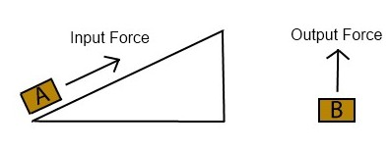
1) The Inclined Plane : a flat, sloped surface
This allows you to exert your input force over a longer distance.
input force = force needed to push or pull an object
output force= force you would need to lift the object without the inclined plane
( the weight of the object)

Slide 4
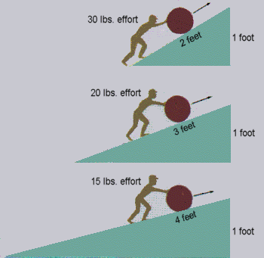
length of incline
ideal mechanical advantage = height of incline
The longer the incline, the less input force you need to push or pull an object.
2ft/1ft = 2 times input force
3ft/1ft = 3 times input force
4ft/1ft = 4 times input force

Slide 5
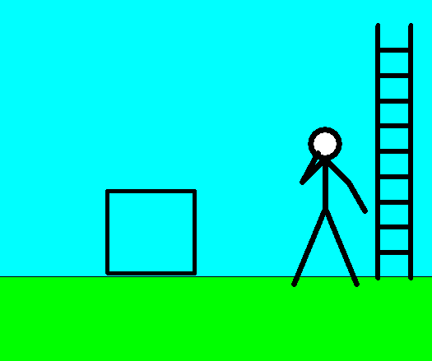
2) Wedge:
*a device that is thick at one end and tapers to a thin edge at the other end
* an inclined plane that can move
With this, instead of moving an object along the inclined plane, you move the inclined plane itself.

Slide 6
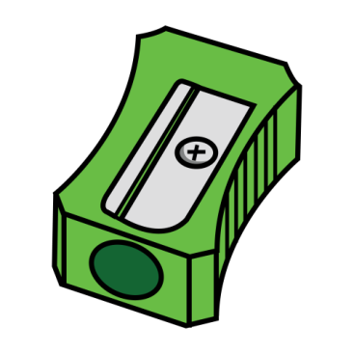
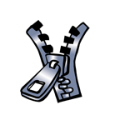
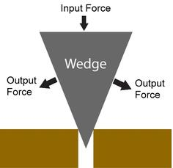
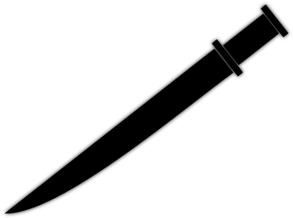
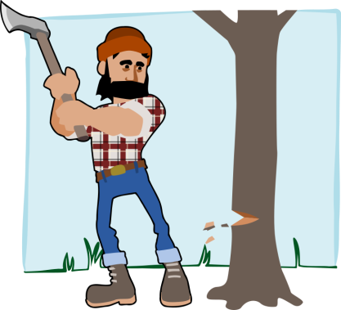
length of the wedge
ideal mechanical advantage = width of the wedge
The longer and thinner a wedge is, the greater its mechanical advantage.
That’s why sharp knives cut better than dull ones.

Slide 7
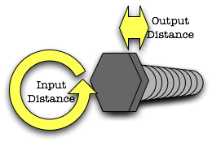
3) Screws:
an inclined plane wrapped around a cylinder
this spiral inclined plane forms the threads of
the screw
You exert input force on the screw.
The threads of the screw act like an inclined plane to increase the distance over which you exert the input force.
As the threads turn, they exert an output force on the wood, pulling the screw into the wood.
Friction between the screw and the wood holds the screw in place.

Slide 8
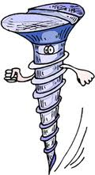
The closer together the threads of the screw are, the greater the mechanical advantage.
The closer the threads, the more times you must turn the screw. Your input force is applied over a longer distance which results in an increased output force.
Length around the screws is the length of
the inclined plane. The length of the screw
is the height.
length around threads
ideal mechanical advantage = length of the screw

Slide 9
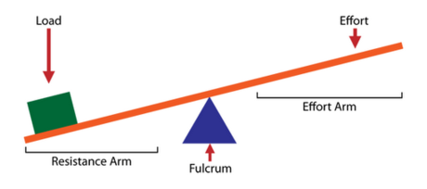
4) Levers:
rigid bar that is free to pivot, or rotate, on a fixed position – the fulcrum
increases input force
changes the direction of the input force
Ideal mechanical advantage =
distance from fulcrum to input force
distance from fulcrum to output force

Slide 10
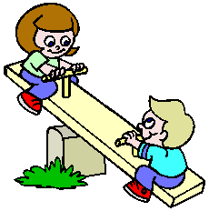
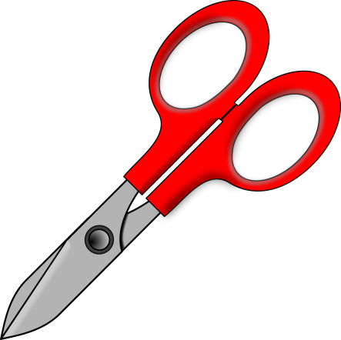
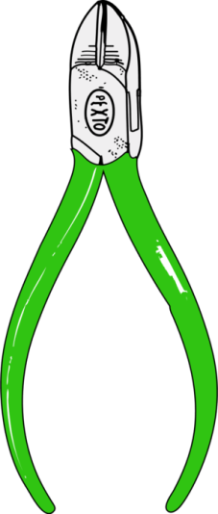
Levers are classified according to the location of the fulcrum relative to the input and output forces.
First-Class Levers:
always changes the direction of the input force
If the fulcrum is closer to the output force, they increase force.
If the fulcrum is closer to the input force, they increase distance.

Slide 11
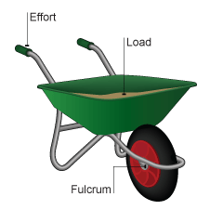
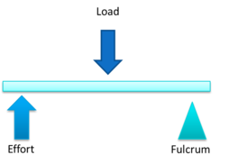
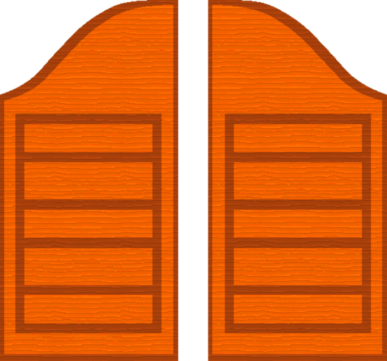
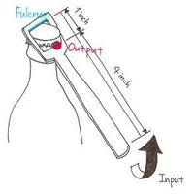
Second-Class Levers:
increase force
DO NOT change the direction

Slide 12
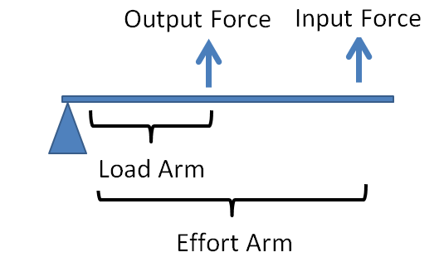
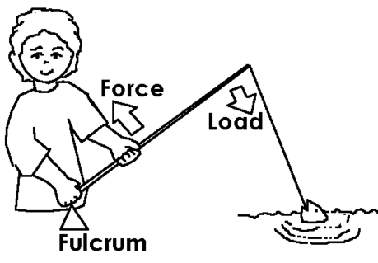
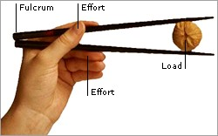
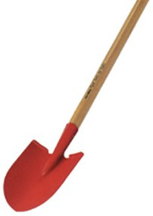
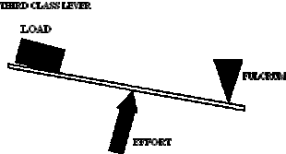
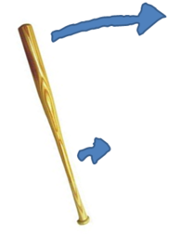
Third-Class Levers:
increase distance
DO NOT change the direction of the input force

Slide 13
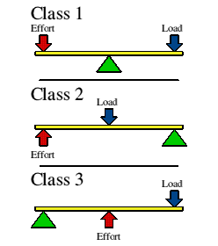
FULCRUM POSITIONING

Slide 14
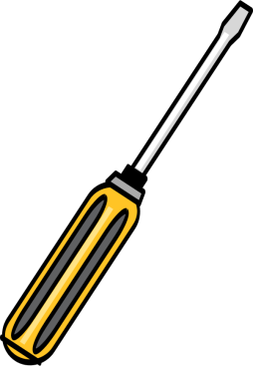
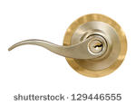
5) Wheel and Axle:
made of 2 circular or cylindrical objects fastened together that rotate about a common axis
The object with the larger radius = wheel
The object with the smaller radius = axle
axle
wheel

Slide 15
If the wheel (handle) is larger than the axle (shaft), the axle rotates and exerts a large output force.
The wheel and axle increase your force, but you must exert your force over a long distance.
When the input is applied to the axle, the input force is exerted over a short distance.
Therefore, the wheel and axle multiplies distance.
radius of wheel
mechanical advantage = radius of axle

Slide 16
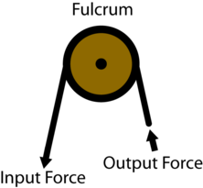
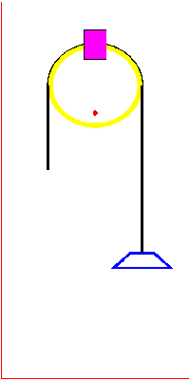
6) Pulley:
made of a grooved wheel with a rope or cable wrapped around it
Pull on one end of the rope = input force
The other end of the rope the output force pulls up on the object you want to move.

Slide 17
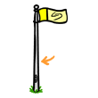
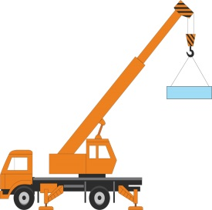
A pulley can make work easier in 2 ways:
1) It can decrease the amount of input force needed to lift the objects.
2) The pulley can change the direction of your input force.
There are 2 basic types of pulleys:
FIXED PULLEY: attach this to a structure
MOVABLE PULLEY:
attach the object you want to move
The ideal mechanical advantage of a pulley is equal to the number of sections of rope that support the object.
Look at p. 431. Discuss different pulleys, including block and tackle.

Slide 18
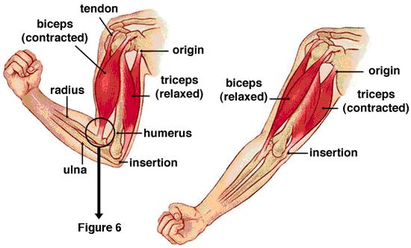
Most of the machines in your body are levers that consist of bone and muscle.
Your muscles are attached to your bones by connecting tissue called tendons.
The tendons and muscles pull on bones, making them work as levers.
The joint, near where the tendon is attached to the bone, acts as the fulcrum.
The muscles produce the input force.
The output force is used for doing work.

Slide 19
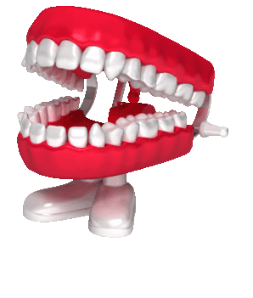
Your front teeth, incisors, are shaped like wedges to enable you to bite off pieces of food.
Turn to page 432 and look at the first-, second-, and third-class levers used in our bodies.

Slide 20
A compound machine is a machine that utilizes two or more simple machines.
The ideal mechanical advantage of a compound machine is the product of the individual ideal mechanical advantages of the simple machines that make it up.

