Slide 1
Chapter 13: Energy
notes
13.1 What is Energy?

Slide 2
Discover Activity page 442
energy
The ability to do work or cause change is called .
When an object does work on another object, some of its energy is transferred to that object.
Energy is measured in – the same units as work.
joules
Power is the rate at which work is done.
If the transfer of energy is work, then power is the rate at which energy is transferred, or the amount of energy transferred in a unit of time.
A breeze and a tornado both can lift a leaf. Which one has the most power? Why?
ENERGY TRANSFERRED
POWER = TIME

Slide 3
Two basic kinds of energy: and
kinetic
potential .
The energy an object has due to its motion is called kinetic energy.
“Kinetic” = the Greek work “kinetos” which means “moving”.
The kinetic energy depends on both its MASS and its VELOCITY.
Kinetic energy increases as MASS increases.
← Which would knock over more pins? →
If you have two identical bowling balls, but you throw one harder, it will move faster than the other one because it now has more kinetic energy. You transferred your energy to it!

Slide 4
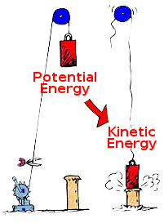
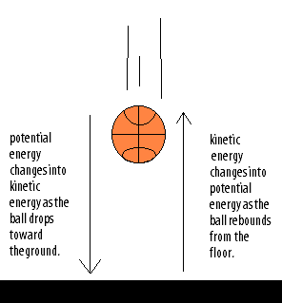
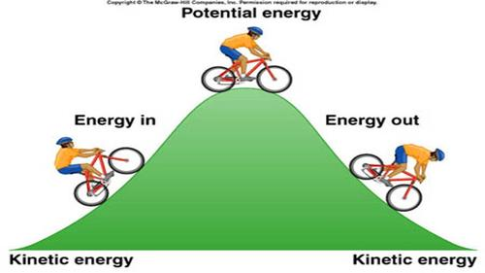
1
KINETIC ENERGY = 2 X MASS X VELOCITY ²
Velocity will have a greater affect on kinetic energy since it is squared.
These pictures are not showing mass or velocity. They are just a lead-in to the next kind of energy - potential

Slide 5
Stored energy that results from the position or shape of an object is called . This energy is held in readiness.
potential energy
Potential energy related to an object’s height is called
gravitational potential energy.
This is equal to the work done to lift it. Work = Force X Distance.
gravitational potential energy = weight X height
The force you use to lift an object is its
The distance you move an object is its
The more an object weighs, or the greater the object’s height, the greater its gravitational potential energy.

Slide 6
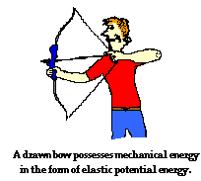
The potential energy associated with objects that can be stretched or compressed is called
elastic potential energy.

