Slide 1
Chapter 13 : Energy
NOTES for
13.2 Forms of Energy

Slide 2
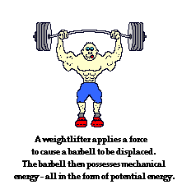
The form of energy associated with the position and motion of an object is called
mechanical energy.
This is a combination of its potential energy and kinetic energy.
mechanical energy = potential energy + kinetic energy
The higher it is, the greater its potential energy.
The faster it is, the greater its kinetic energy.
An object with mechanical energy can do work on another object.

Slide 3
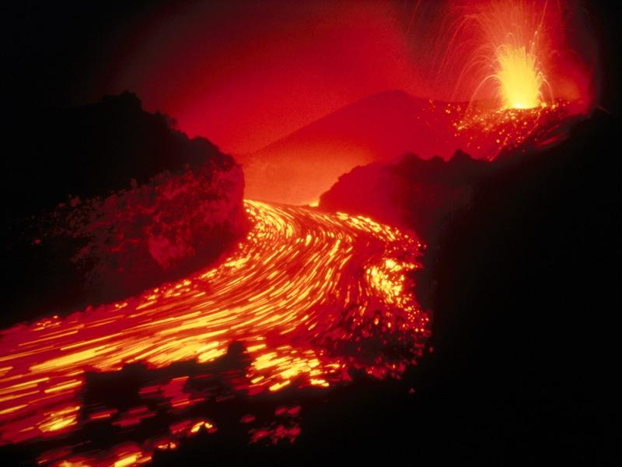
Forms of energy associated with the particles of objects include:
thermal energy
electrical energy
chemical energy
nuclear energy
electromagnetic energy
1) Thermal energy.
The total potential and kinetic energy of the particles in an object.
Particles (atoms and molecules) are constantly moving. The more movement means the more kinetic energy they have.
The particles are arranged in specific ways in different objects. This gives them their potential energy.

Slide 4
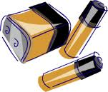
2) Electrical energy
CRACK !
Depending on whether the charges are moving or stored, electrical energy can be a form of kinetic or potential energy.

Slide 5
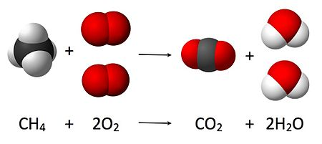
Chemical Energy is potential energy stored in the chemical
bonds that hold chemical compounds together.
When bonds in chemical compounds break, new chemical compounds may form. When this happens, chemical energy may be released.
The energy in food is chemical energy. While energy is often measure in joules, stored food energy is generally measured in kilocalories. Kilocalories are commonly called Calories. The caloric content of a food depends on the quantity of fat, protein, and carbohydrates it contains.
So, when you look at a food label, what does the number of Calories per serving indicate?
The amount of stored energy in one serving of the food.

Slide 6
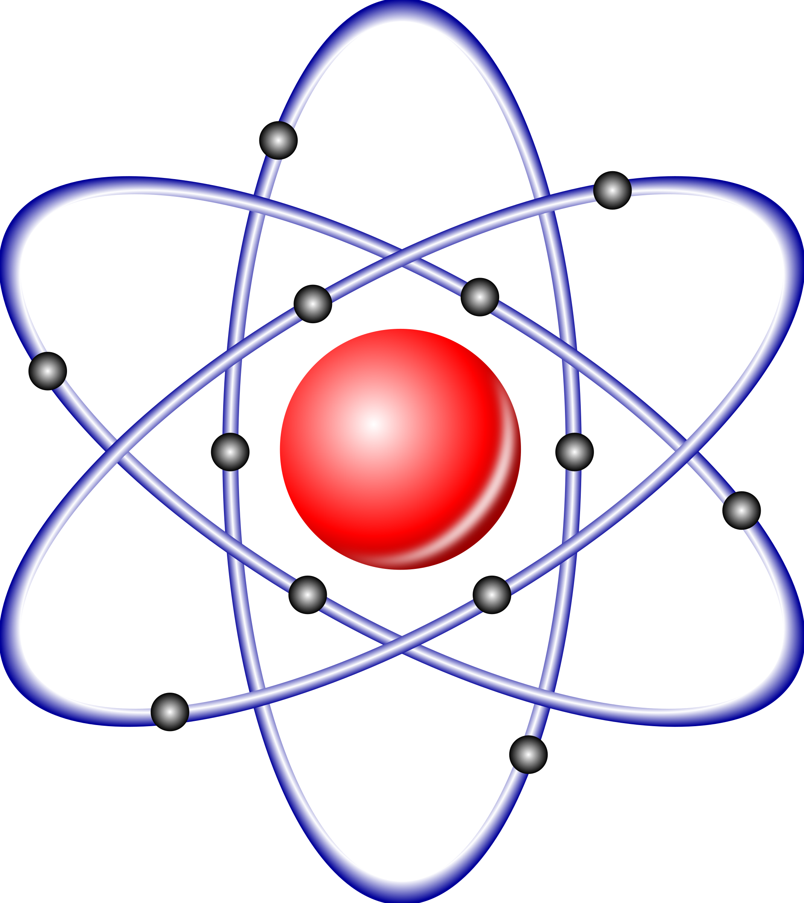
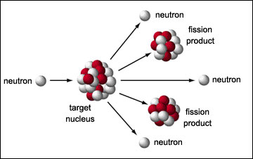
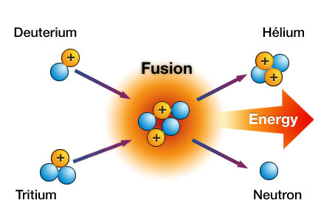
Nuclear energy is a type of potential energy that is stored in the nucleus of an atom. Nuclear energy is released during a nuclear reaction.
One type of nuclear reaction is nuclear fission.
This occurs when a nucleus splits.
Nuclear power plants use nuclear fission reactions to produce electricity.
Nuclear fusion is a nuclear reaction that happens when the nuclei of atoms fuse, or join together.
This occurs continuously in the sun, releasing tremendous amounts of energy.

Slide 7
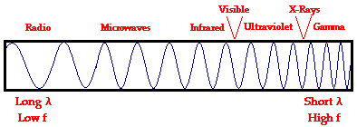
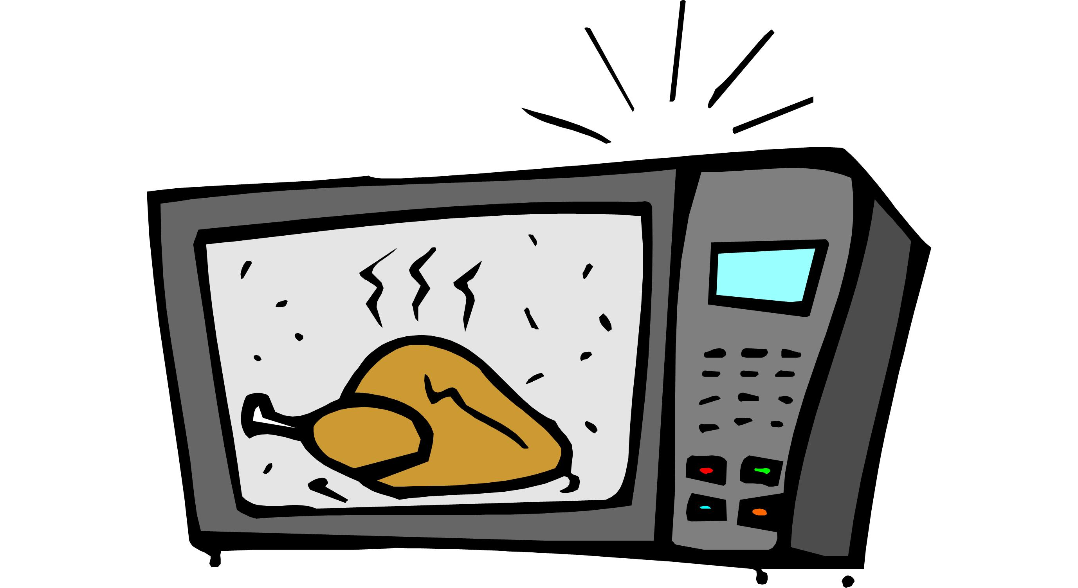
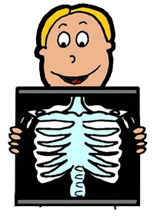
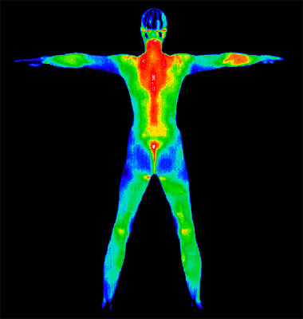
5) Electromagnetic energy travels in waves.
Some common examples are:
radio waves
microwaves
infrared
radiation
ultraviolet radiation
x-rays
Just the waves,
not the appliance.

Slide 8
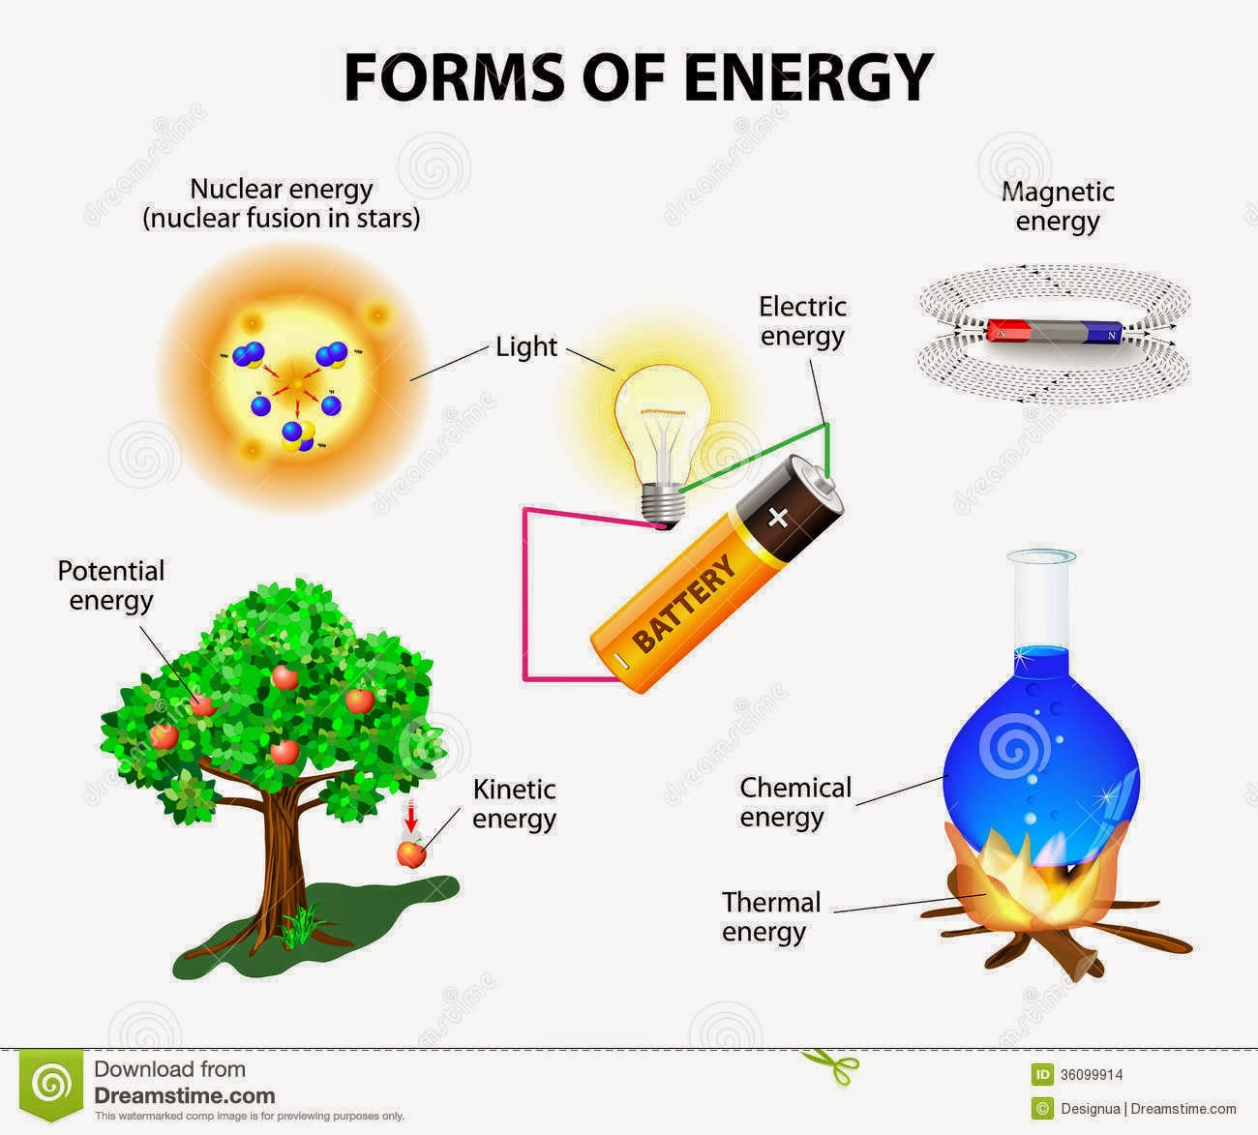
Just a visual review.

