Slide 1
Chapter 13 : energy
Notes on
13.3 Energy Transformations and Conservation

Slide 2
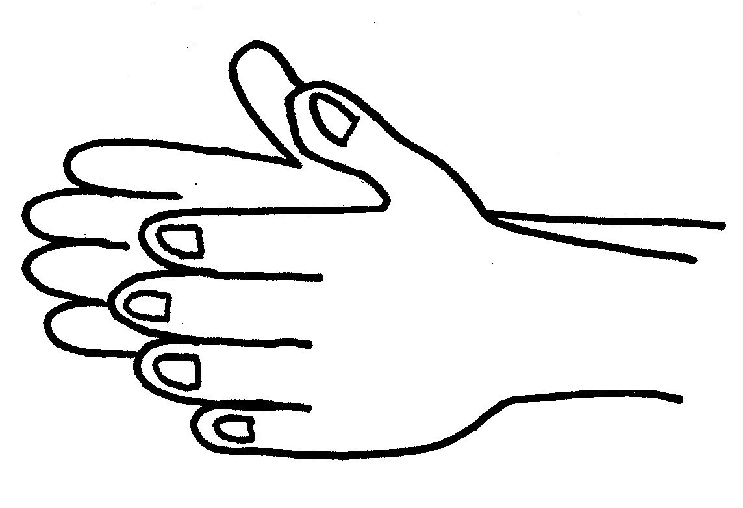
What happens when you rub your hands together?
When you are cold, what are some ways you can get warm?
Most forms of energy can be transformed into other forms of energy
This change of one form of energy to another is called
energy transformation
Some energy changes involve single transformations, while others involve many. Let’s look ahead and learn even more!

Slide 3
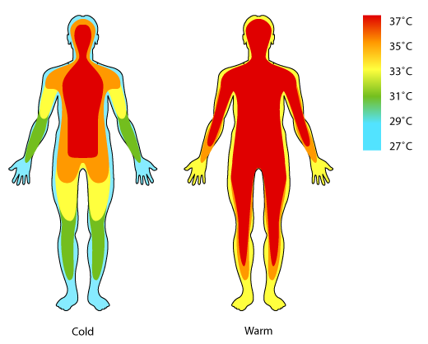
Single Transformations
Some examples are:
A toaster transforms electrical energy into thermal energy to toast your bread.
2. A cell phone transforms electrical energy to electromagnetic energy that travels to other phones.
3. Your body transforms the chemical energy in your food to mechanical energy you need to move your muscles.
4. Chemical energy in food is also transformed to the thermal energy your body uses to maintain its temperature.

Slide 4
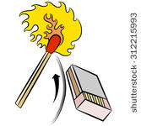
Multiple Transformations
Often, a series of energy transformations is needed to do work.
1. The mechanical energy used to strike a match is transformed first to thermal energy.
2. The thermal energy causes the particles in the match to release stored chemical energy, which is transformed to thermal energy and the electromagnetic energy you see as light.
3. Make sure to read the paragraph on page 455 about car engines. It will spark your interest. (See what I did there.. spark.. sparks that are produced with electrical energy.)

Slide 5
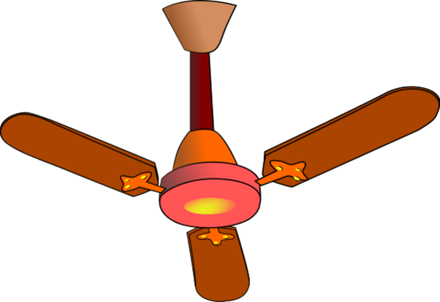
Many common devices transform electrical energy into other forms. Think about the following devices in terms of energy transformations.
For each device, describe which form or forms of energy the electrical energy becomes. Do these devices produce single or multiple transformations of energy?
steam iron
ceiling fan
digital clock
dryer
electrical to thermal
electrical to mechanical
ALL ARE SINGLE TRANSFORMATIONS!
electrical to electromagnetic
electrical to mechanical and thermal

Slide 6
One of the most common energy transformations is the transformation between potential energy and kinetic energy.
Any object that rises and falls experiences a change in its kinetic and gravitational potential energy.
Reaches its peak-
potential energy
4. Speeding up- more kinetic, less potential
Slowing down –
less kinetic energy,
potential energy increases.
1. Starts to move - greatest kinetic energy.
No movement
potential energy
Check out the pendulum on p. 456.
It’s a swinging good example of this!

Slide 7
1. In juggling, what two points have the highest potential energy with the lowest kinetic energy?
When there is no movement; at the bottom and at the top of the curve.
2. Where, on a pendulum, is it at its greatest speed, making it all kinetic energy?
At the bottom of its swing.
3. Where does the pendulum have its greatest amount of gravitational potential energy?
At its highest point of the swing.
elastic energy
With a pole vault, kinetic energy is transformed into
as the pole-vaulter plants the pole and it bends backwards.
5. Once the pole-vaulter is over the bar, his gravitational potential energy is transformed back to as he falls towards the safety cushion.
kinetic energy

Slide 8
Conservation of Energy
Energy cannot be created or destroyed.
The total amount of energy is the same before and after any transformation.
Why, then, does a spinning top stop spinning after awhile?
As it spins, it encounters friction with the floor and the air.
Some of its kinetic energy is transformed in thermal energy.
That means its mechanical energy is now thermal energy.
Eventually, the top will slow down and fall on its side. All is not lost! Do not despair! It is just transformed.
This transformation from mechanical to thermal energy because of friction happens all the time. That’s why the output work of any real machine is less than the input work. FRICTION!

Slide 9
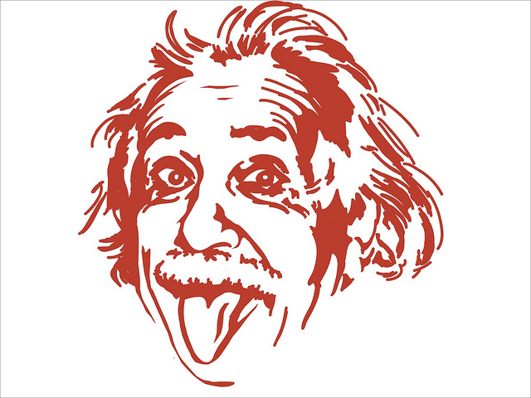
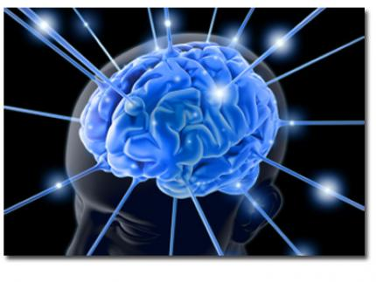
And then along came Albert Einstein!
His theory of relativity states that energy CAN sometimes be created
BY DESTROYING MATTER!
MIND BLOWING!
This way matter can be transformed into energy.
This caused an adjustment to the law of conservation of energy. Now, scientists say matter and energy together are always conserved.

