Slide 1
Chapter 13: Energy
NOTES on 13.4
Energy and Fossil Fuels

Slide 2
A fuel is a material that contains stored potential energy.
Some of the fuels used today were made from materials that formed hundreds of millions of years ago.
These are known as fossil fuels and include coal, petroleum,, and natural gas.
When plants and animals died, their remains piled up in thick layers of swamps and marshes. Clay and sand covered them. With the great build up of pressure and intense heat, the remains were turned into coal.
Result
In
Petroleum

Slide 3
Fuels do not CREATE energy – they store it.
Fossil fuels contain energy that came from the sun.
The sun is the source of energy for most of Earth’s processes.
Within the sun’s core, because of nuclear fusion, nuclear energy is transformed into energy as well as other forms.
elctromagnetic
Some of this electromagnetic energy reaches Earth in the form of light.

Slide 4
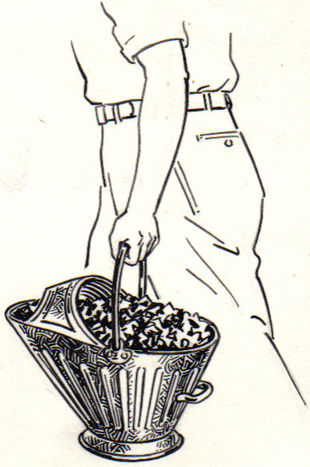
When the sun’s energy reaches Earth, certain living things- plants, algae, and certain bacteria – transform some of it to chemical energy.
The rest is stored. Animals that eat the plants store some the plant’s chemical energy in their cells.
When these ancient animals and plants die, the energy they had stored inside is now trapped inside them.
This trapped energy is the chemical energy found in coal.
Plants store the energy. Animals eat the . Plants and animals . The remains are . Heat and pressure turn the remains into .
sun’s
plants
die
buried
coal

Slide 5
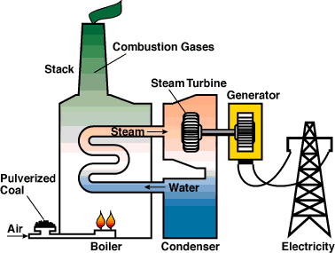
burned
Fossil fuels can be to release the chemical energy stored millions of years ago.
The process of burning fuels is known as
combustion.
During combustion, the fuel’s chemical energy is
transformed to energy.
thermal
This thermal energy can be used to heat water, producing steam, which is used in power plants, to turn the turbines.
Ends with generators producing electricity.
Starts with fossil fuels.

Slide 6
chemical
A power plant that uses fossil fuels, transforms energy to
energy to energy to energy.
thermal
mechanical energy
electrical
chemical energy =
coal
thermal energy =
heat from combustion
moving turbine
electrical energy =
electricity
mechanical energy =

