Slide 1
Chapter 14 Thermal Energy and Heat
NOTES on 14.2
The Transfer of Heat

Slide 2
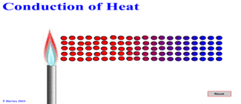
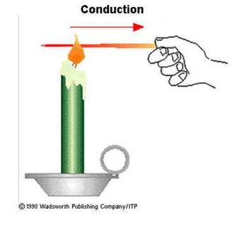
There are 3 ways that heat can move:
1. Conduction
2. Convection
3.Radiation
Heat is transferred from one particle of matter to another without the movement of the matter.

Slide 3
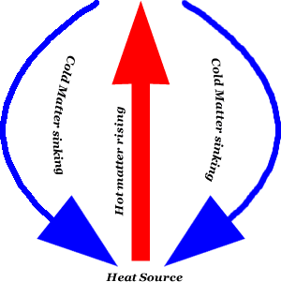
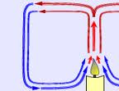
Convection:
Heat is transferred by the movement of
currents within a fluid.
circular motion
CONVECTION CURRENT

Slide 4
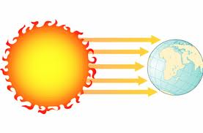
Radiation:
The transfer of energy by electromagnetic waves.
Does not require matter to transfer thermal energy

Slide 5
1. CONDUCTION
transfer of heat by the movement of currents in a fluid
2. CONVECTION
transfer of energy by electromagnetic waves
3. RADIATION
transfer of heat between particles without the movement of matter.

Slide 6
If two objects have different temperatures, heat will flow from the warmer object to the colder one.
As the thermal energy increases, temperature increases.
At the same time, the temperature of the matter losing the heat decreases.
Get it while it’s hot!

Slide 7
WHAT?
There is no such thing as “coldness”!
Things grow colder as thermal energy flows from one object to another. Heat transfer occurs only in one direction. Heat is always transferred from a warm object to a cooler one.
Which direction is the heat flow between these pairs?
ice lemonade
cool air warm bath water
hot clothes dryer cold clothes

Slide 8
Conductors transfer thermal energy well.
A material that conducts heat well is called a .
conductor
Some materials are good conductors because of the particles they contain and how those particles are arranged.
They will feel cool to the touch at room temperature because they easily transfer heat away from your skin.

Slide 9
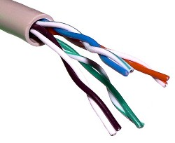
An insulator does not transfer thermal energy well.
Insulated windows have two panes of glass with a thin space of air between them. The trapped air does not transfer heat well.
Which are conductors?
metal spoon jacket
wood gases in the air
straw paper
stainless steel silver
wool plastic
copper
Nope!
Nope!
Nope!
Nope!
Nope!
Nope!
Nope!

