Slide 1
Chapter 14 Thermal Energy and Heat
NOTES for 14.3
Thermal Energy
and
States of Matter

Slide 2
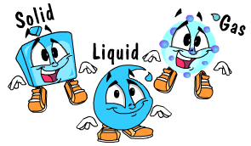
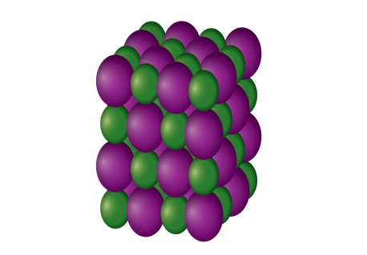
Most matter on Earth can exist in three states (not like AZ, CA, or PA) or forms:
SOLIDS
particles packed together in relatively fixed position
they can only vibrate back and forth

Slide 3
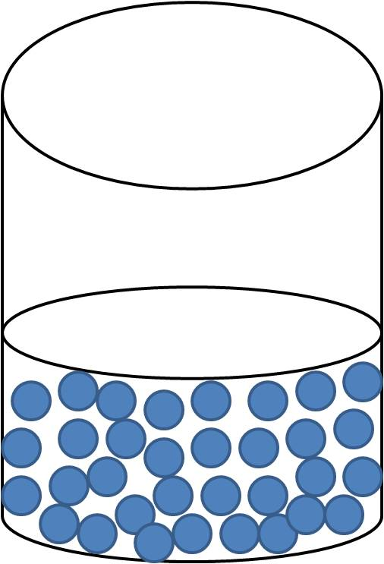
LIQUIDS
particles are close together, but they are not held together as tightly as those of a solid
Liquids do NOT have a definite shape
Round is a shape; therefore, I AM IN SHAPE! Therefore, I am a liquid!
Liquids do have a definite volume.

Slide 4
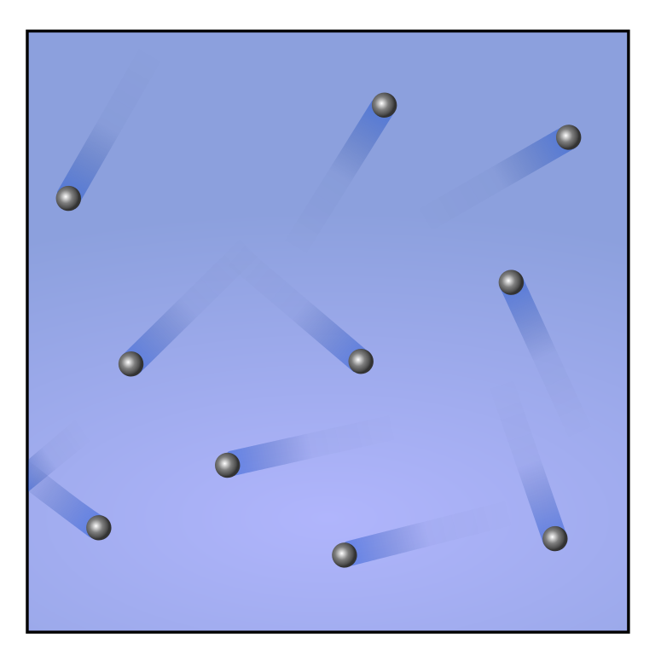
GASES
particles are moving so fast that they don’t even stay close together
After great consideration, I believe this definition suits me the best. I AM A GAS!
expands to fill all the space available
Gases DO NOT have a fixed shape or volume.

Slide 5
Change of state
The state of matter depends on the amount of thermal energy it has.
Matter can change from one state to another when thermal energy is absorbed or released.
During a change of state, the addition or loss of thermal energy changes the arrangement of the particles.
The average kinetic energy does not change. Since temperature is a measure of the average kinetic energy, temperature does not change as the state of matter changes.

Slide 6
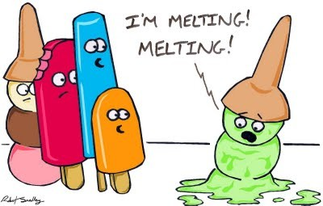
The change of state from a solid to a liquid is called
Melting occurs when a solid absorbs thermal energy.
The structure of its particles breaks down.
The particles become freer to move
around.
The temperature at which a solid changes to a liquid is called its melting point.

Slide 7
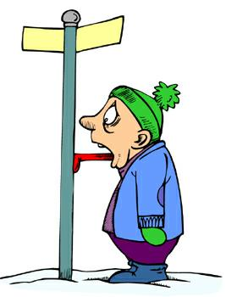
FREEZING
* the change of state from a liquid to a solid*
Freezing occurs when matter releases thermal energy.
The temperature at which matter changes from a liquid to a solid is called its freezing point.

Slide 8
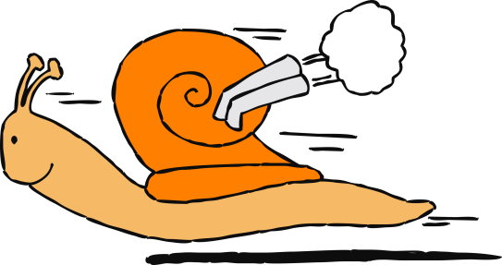
The process by which matter changes from the liquid to the gas state is called
vaporization
Particles in a liquid absorb thermal energy and move faster.
If vaporization takes place on the surface of the liquid, it is called
Eventually, they move fast enough to escape the liquid as gas particles.
evaporation
If vaporization occurs below the surface of the liquid, it is called .
boiling

Slide 9
When gas loses a certain amount of thermal energy, it will change into a liquid. This is called
condensation.
As thermal energy of matter increases, its particles spread out and the substance expands. This is true for most matter, even if the matter is not changing state.
thermal expansion
Just the opposite is true as well. When matter is cooled, thermal energy is released. The motion of the particles slows and down and the particles move closer together, decreasing volume.

Slide 10
heat-regulating device
Contains bimetallic strips – 2 different metals joined together that expand at different rates.
thermostat
When this strip is heated, one side expands more than the other. This causes the strip to uncurl, which operates a switch that can turn the heating system on or off.

