Slide 1
Chapter 15 Characteristics of Waves
NOTES 15.1 What are Waves?

Slide 2
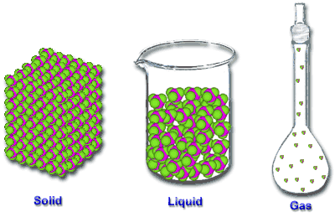
Waves are disturbances that transfer from place to place. Energy is the ability to do .
energy
work
Most kinds of waves need something to travel through. That’s called a .
medium
Mediums can be .
Waves that need a medium to travel through are called .
Waves that can travel without mediums are called electromagnetic waves.
mechanical waves.

Slide 3
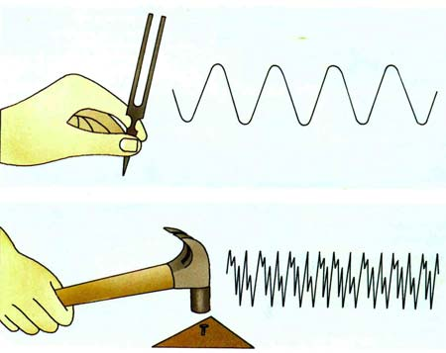
Mechanical waves are produced when a source of energy causes a medium to vibrate.
A vibration is a repeated back-and-forth
or up-and-down motion.
When a vibration moves through a medium, a wave results.

Slide 4
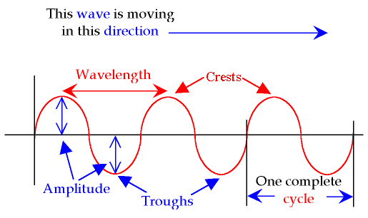
Types of Waves
Mechanical waves are classified by how they move.
Transverse Waves – means “across”
As a transverse wave moves, the particles of the medium move across, or at a right angle to, the direction of the wave.
Notice crests vs troughs.

Slide 5
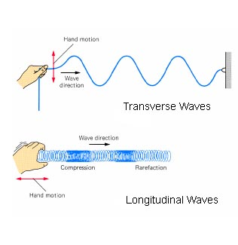
2. Longitudinal Waves
Notice the direction of both the hand movement and the wave.
Compression vs
rarefaction
Can you tell the difference between the two waves?

Slide 6
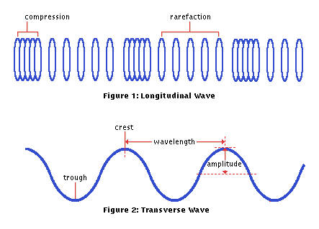
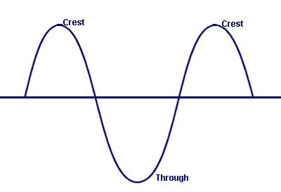
Drawing Transverse and Longitudinal Waves
Treat compressions as the crests.
Treat rarefactions as the troughs.
------------------------------------------
-----------------------------------------
rest position- horizontal line before disturbance.
Can you find the misspelled word?

