Slide 1
Chapter 15 Characteristics of Waves
15.3 NOTES
Interactions of Waves

Slide 2
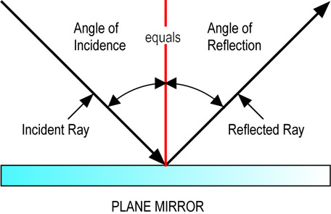
When an object or a wave hits a surface through which it cannot pass, it bounces back.
Reflection
Incoming wave
Wave that is bouncing off surface.
The Law of Reflection states that the angle of incidence equals the angle of reflection.

Slide 3
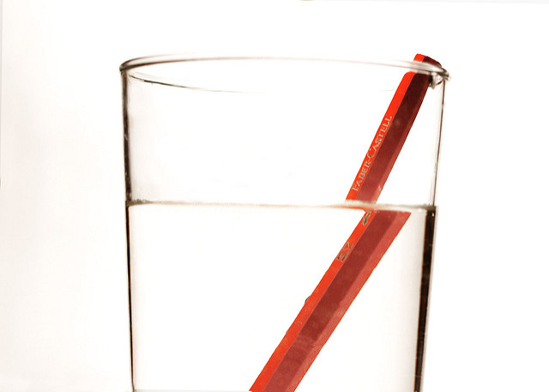
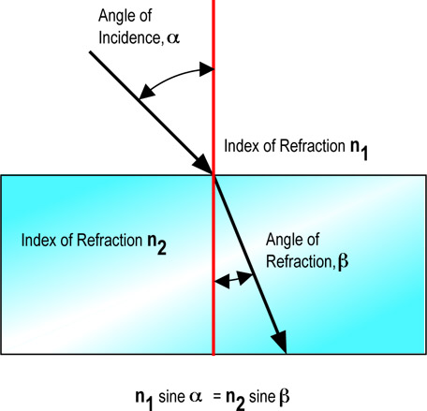
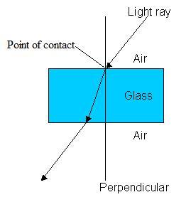
When a wave enters a new medium at an angle, one side of the wave changes speed before the other side, causing the wave to bend.
Refraction

Slide 4
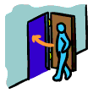
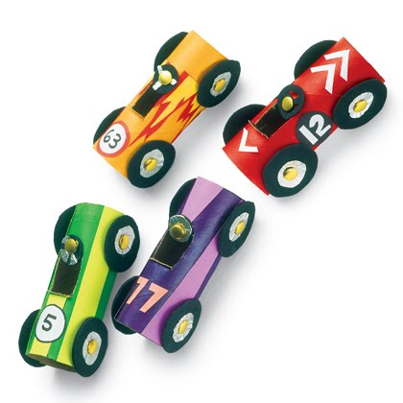
Refraction – bending – does not always happen when a wave enters a new medium.
The wave must enter at an angle.
This makes one side of the wave enter the medium
This side changes speed, but the other side still travels at its original speed.
Bending occurs because the 2 sides of the wave travel at different speeds.

Slide 5
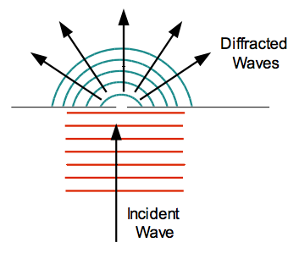
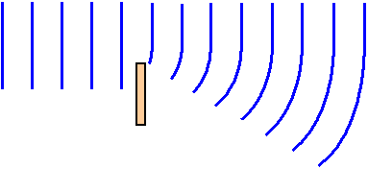
Diffraction
When a wave moves around a barrier or through an opening in a barrier, it bends and spreads out.
As the wave passes a barrier, it bends around the barrier.
After a wave passes through a narrow opening, it spreads out.

Slide 6
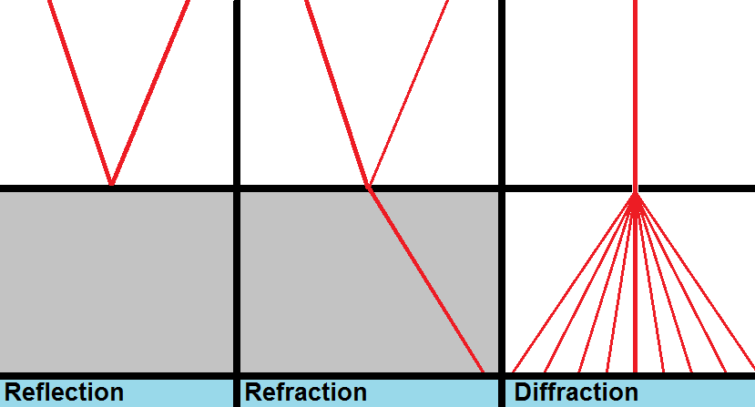

Slide 7
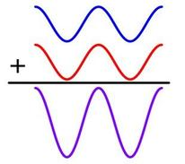
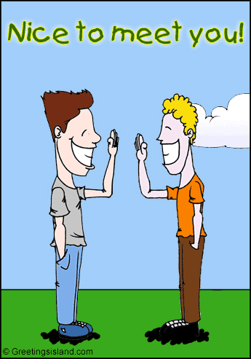
Interference is the interaction between waves that meet.
The first type is constructive interference.
These waves “help each other”. They combine to make a wave that with a larger amplitude.
Both the crests and the troughs will increase when the two waves overlap.
After the waves pass through each other, they continue on as though they had never met… but they had!

Slide 8
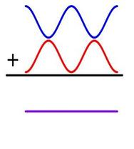
The second interference is destructive interference.
This is when two waves combine to make a wave with a smaller amplitude.
This happens when the crest on one wave overlaps the trough of another wave.
If the crest has a larger amplitude than the trough, the crest “wins” and part of it remains.
If the original trough has a larger amplitude, the result is a trough.
If the original waves had equal amplitudes, the crest and troughs can completely cancel.

Slide 9
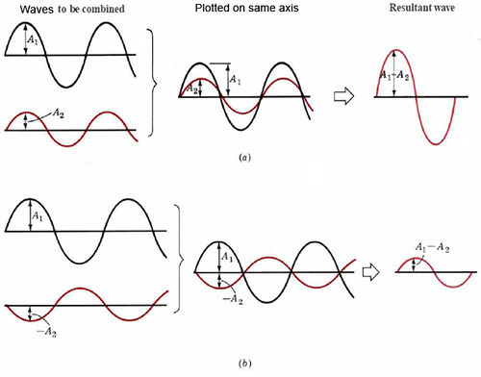
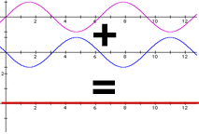
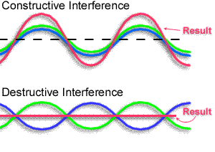

Slide 10
If an incoming wave and a reflected wave have just the right frequency, they produce a combined wave that appears to standing still.
It appears to be standing still, but it is really two waves interfering as they pass through each other.

Slide 11
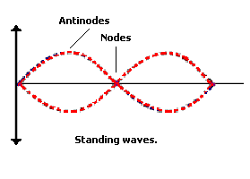
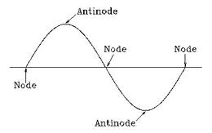
In a standing wave, destructive interference produces points with an amplitude of zero.
These nodes are evenly spaced along the wave.
At points in the standing wave where constructive interference occurs, the amplitude is greater than zero.
Antinodes are the points of maximum energy on the wave.
Antinodes always occur halfway between two nodes.

Slide 12
Most objects have at least one natural frequency of vibrations.
Standing waves occur in an object when it vibrates at a natural frequency. If a nearby object vibrates at the same frequency, it can cause resonance.
Resonance is an increase in the amplitude of a vibration that occurs when external vibrations match an object’s natural frequency.
Musical instruments use resonance to produce stronger, clear sounds.

Slide 13
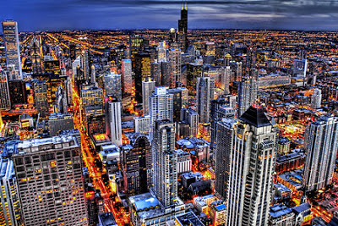
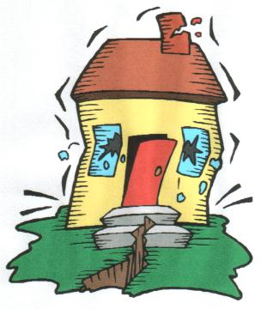
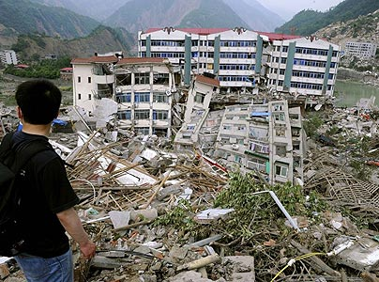
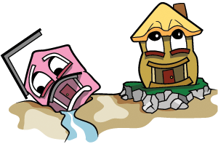
In Mexico City, earthquake waves matched the natural frequency of the clay the city is built upon.
Resonance occurred.
Building that were 8 to 18 stories high had the same natural frequency.
Because of resonance, these buildings had the most damage.
Shorter and taller buildings were left
standing because their natural frequency
did not match the natural frequency
of the clay.

