Slide 1
Chapter 15 Characteristics of Waves
15.34 Seismic Waves

Slide 2
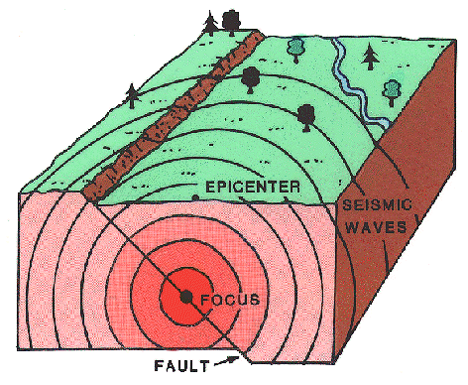
Deep inside Earth, stress and pressure begin to build up.
Finally, the rock breaks or changes shape, releasing energy in the form of waves.
This comes from the Greek word seismos which means earthquake.
These waves are called seismic waves.
Seismic waves ripple out in all directions from the point where the earthquake occurred.
As these waves move, they carry energy through Earth.

Slide 3
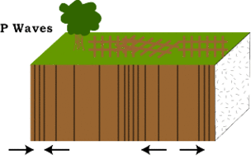
Seismic waves include 3 types of waves:
1. P waves 2. S waves 3. surface waves
P waves (or primary waves) are longitudinal.
They are called primary or
P waves because they move faster and arrive at distant points before other seismic waves.
These waves compress and expand the ground like a spring toy as they move through it.

Slide 4
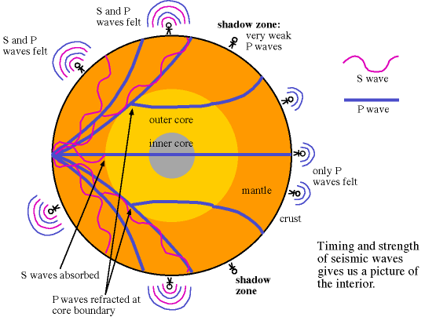
S waves ( or secondary waves) are transverse waves.
These seismic waves shake the ground up and down and side to side as they move through it.
S waves CANNOT move through liquids. Therefore, they cannot travel through the part of the Earth’s core that is liquid like the P waves can.
S waves cannot be
detected on the side
of Earth opposite an
earthquake.

Slide 5
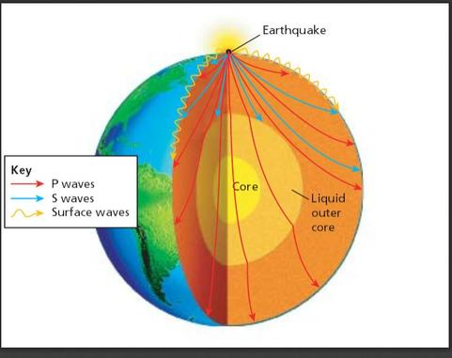
Surface waves are created when P and S waves reach Earth’s surface.
Surface waves are created by longitudinal and transverse waves that travel along the surface of a medium.
These are the slowest seismic waves, but are the most severe and cause the most damage.
Why?
Surface waves combine the up-and-down and side-to-side motions, making the ground roll like ocean waves.

Slide 6
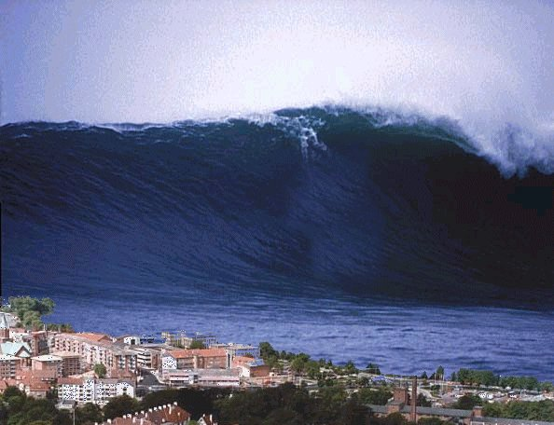
Tsunamis are huge surface waves on the ocean caused by underwater earthquakes.

Slide 7
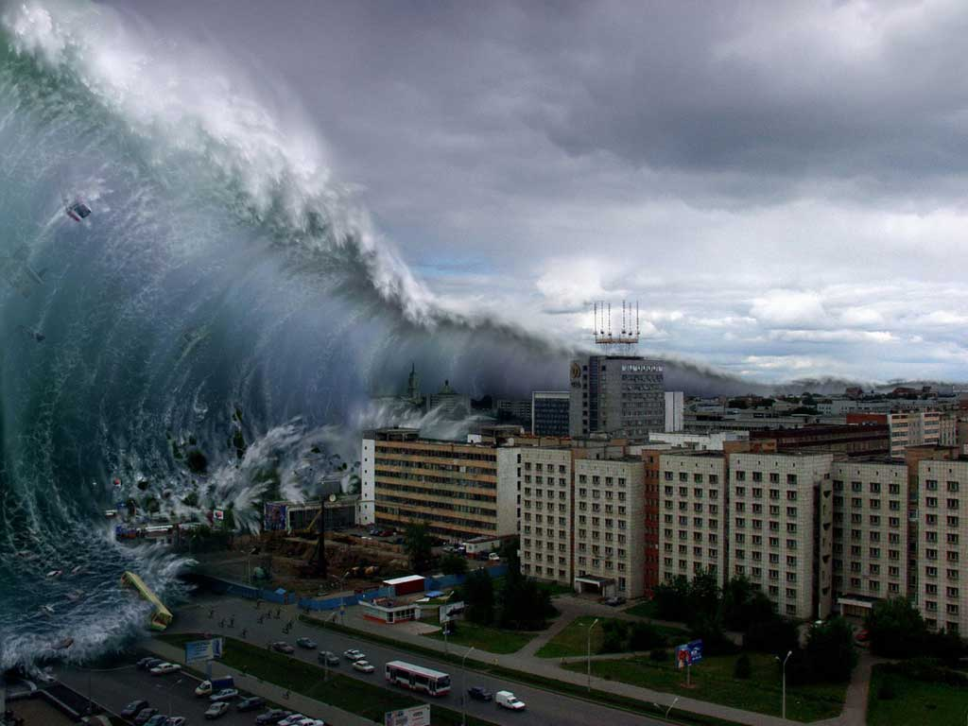

Slide 8
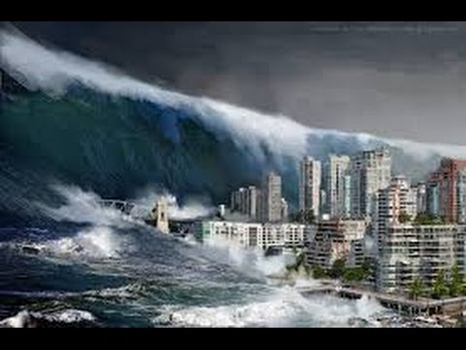

Slide 9
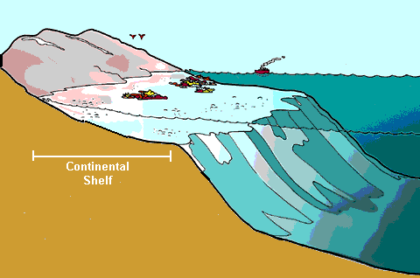
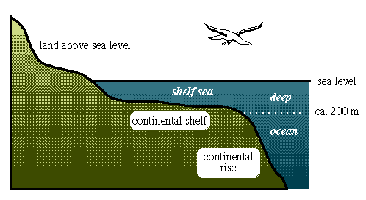
In the deep ocean, the larger waves are only about 1 meter high. As they near land, the tsunamis slow down in the shallow water.
The waves in the back catch up with those in the front and pile on top, creating …

Slide 10
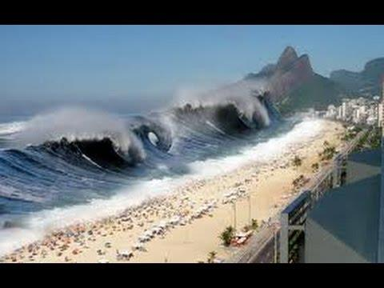

Slide 11
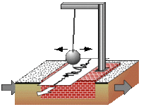
To detect and measure earthquake waves, scientists use instruments called
seismographs.
A seismograph records the ground movements caused by seismic waves as they move through Earth.
The frame of the seismograph is attached to the ground, which will then shake when the seismic waves arrive.
Wiggly lines will be drawn on rolls of paper as the ground shakes.
Now electronic seismographs are used to record data about Earth’s motion.

Slide 12
Geologists will set off explosives at Earth’s surface.
The seismic waves caused by the explosives will reflect from the structures under ground. The geologist will use this data to locate the underground resource.

