Slide 1
Chapter 16: Sound
NOTES on 16.1
The Nature of Sound

Slide 2
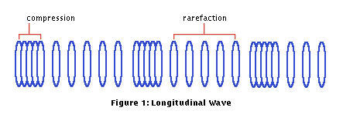
Sound is a disturbance that travels through a medium as a longitudinal wave.
What are the types of mediums that sound can travel through?
solids, liquids, gases
What begins a sound wave?
a disturbance or vibration

Slide 3
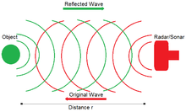
Sound waves reflect off objects, diffract through narrow openings and around barriers, and interfere with each other.
Sound waves may reflect when they hit a surface. A reflected sound wave is an
Generally speaking, the harder and smoother a surface, the stronger the reflection.
Softer materials will absorb most of the sound that strikes them.

Slide 4
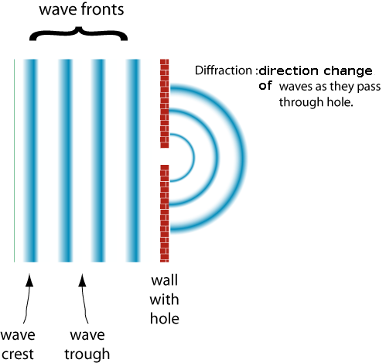
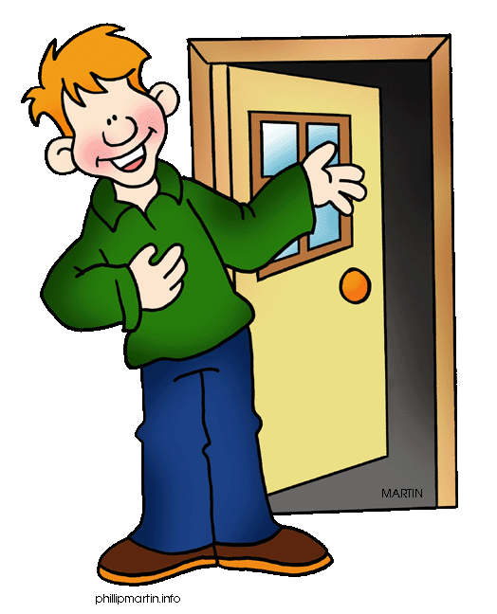
Sound waves can diffract, or bend, around corners.
This is the reason why you can hear someone talking in the room before you are in it.

Slide 5
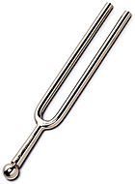
Interference occurs when sound waves meet. They can either be constructive or destructive.
Stay “tuned” for that discussion!
Turn to page 543 -Math Analyzing Data.

Slide 6
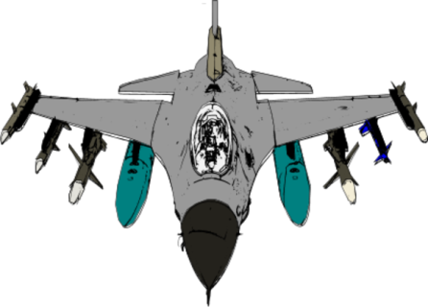
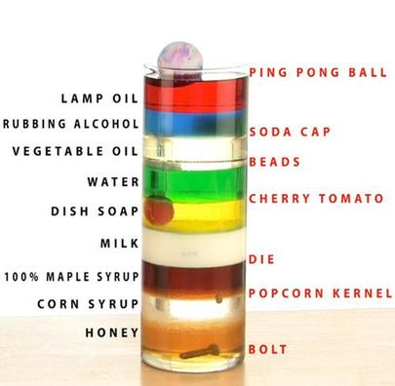
At room temperature, 20 degrees Celsius, sound travels at about .
343 m/s
This is even faster than most jets!
The speed of sound is not ALWAYS 343 m/s. It depends on the medium through which it travels.
The speed of sound depends on the
elasticity ,density , and temperature
of the medium through which the sound travels.
Refer to Figure 4 on page 543. Compare!

Slide 7
is the ability of a material to bounce back after being disturbed.
Elasticity
vs
The more elastic a medium, the faster sound travels in it.
Sound can travel well in , which are usually more elastic.
The particles of a
do not move very far, so they bounce back and forth quickly as the compressions and rarefactions of the sound waves pass by.
Sound travels the slowest in
.
solids
solid
gases

Slide 8
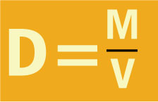
The speed of sound is also dependent upon the density of the medium. Density is how much matter, or mass, there is in a given amount of space, or volume.
In materials in the same state of matter (solid, liquid, gas), sound travels more slowly in denser mediums.
The particles of a dense material do not move as quickly as those of a less dense material.
Sound will travel more slowly in denser metals like lead or silver than in iron or steel.

Slide 9
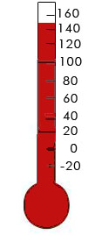
In a given medium, sound travels more slowly at lower temperatures than a higher temperatures.
At low temperatures, the particles of a medium move more slowly. That makes them more difficult to move, plus, it takes them longer to return to their original positions.
At higher altitudes, the air is colder,
so sound travels slower.
On Oct. 14, 1947, Captain Charles Yeager flew faster than the speed of sound.
He flew at an altitude of 12,000 m where the air temperature was -59 degrees C. Here the speed of sound is only 293 m/s. He flew at 312 m/s and “broke the sound barrier”.
TEMPERATURE

Slide 10
Discuss and answer the questions on page 545.

