Slide 1
Chapter 16.2 NOTES Properties of Sound
PS Chapter 16 Sound

Slide 2
Loudness describes your PERCEPTION of the energy of a sound.
The loudness of a sound depends on two factors:
1. the amount of energy it takes to make the sound
2. the distance from the source of the sound
Energy: The greater the energy used to make the sound,
the it will be.
LOUDER
The more energy that is used, the larger the amplitude of the sound wave.
LARGER AMPLITUDE = MORE ENERGY = LOUDER SOUND

Slide 3
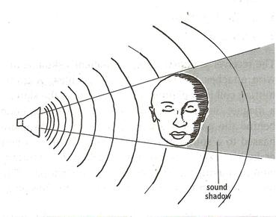
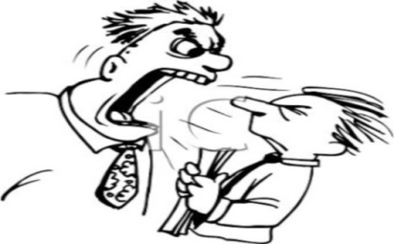
Loudness increases the closer you are to a sound source. Why?
Close to the sound source, the sound waves cover a small area.
As they move farther away, it covers more area. But the total energy of the wave, stays the same.
Therefore, the closer the sound wave is to its source, the more energy it has in a given area.
As you move away from a sound source, loudness decreases because the intensity decreases.
The amount of energy a sound wave carries per second through a unit area is its
INTENSITY.

Slide 4
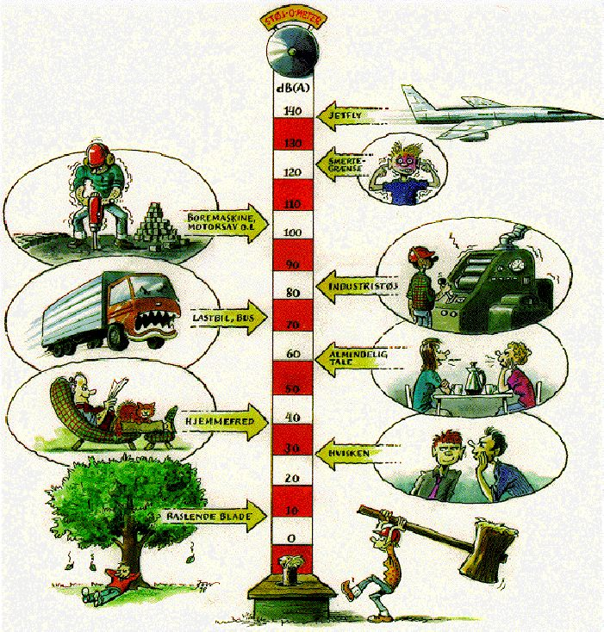
The unit used to compare the loudness of different sounds is the
decibel (dB).
Sounds louder than 100 dB can cause damage to your ears.
Each 10- dB increase in loudness represents a tenfold increase in the intensity of the sound.
So, loud music of 90 dB is 100,000 times louder than normal conversation of 40 dB.
0 dB = sound you can barely hear

Slide 5
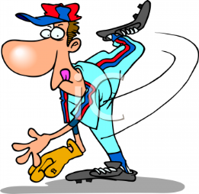
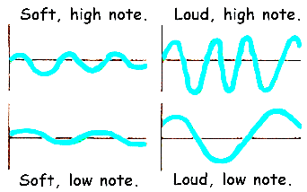
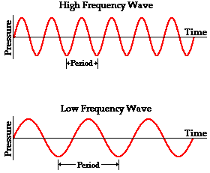
The pitch of a sound depends on the frequency of the sound wave.
WRONG PITCH!
High frequency = high pitch low frequency = low pitch
Humans typically hear sound with frequencies between 20 and 20,000 Hz.
hertz (Hz).
Frequency is measured in
Sound waves with frequencies above the normal human range of hearing are called ULTRASOUND. (“beyond”)
Sounds with frequencies below the human range of hearing are called INFRASOUND. (“below”)

Slide 6
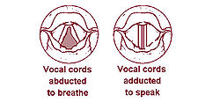
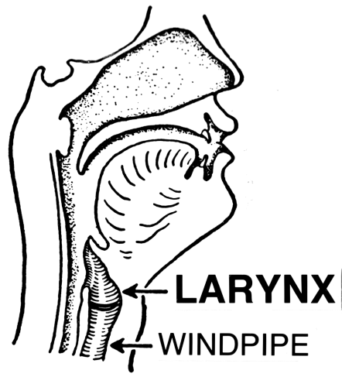
When you sing or talk, you change pitch by using your vocal cords
located in your larynx
(“voice box”).
Air rushes up your trachea (windpipe) from your lungs. This air goes past the vocal cords, making them vibrate, producing sound waves.
Vocal cords are able to vibrate 1,000 times per SECOND!
The muscles in your throat stretch and relax the vocal cords.
Stretching causes the vocal cords to vibrate more quickly, producing higher frequency sounds waves which produce higher pitches. Relaxing the muscles causes lower frequency sounds with lower pitches.

Slide 7
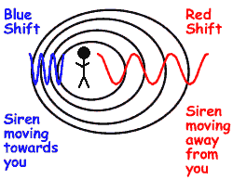
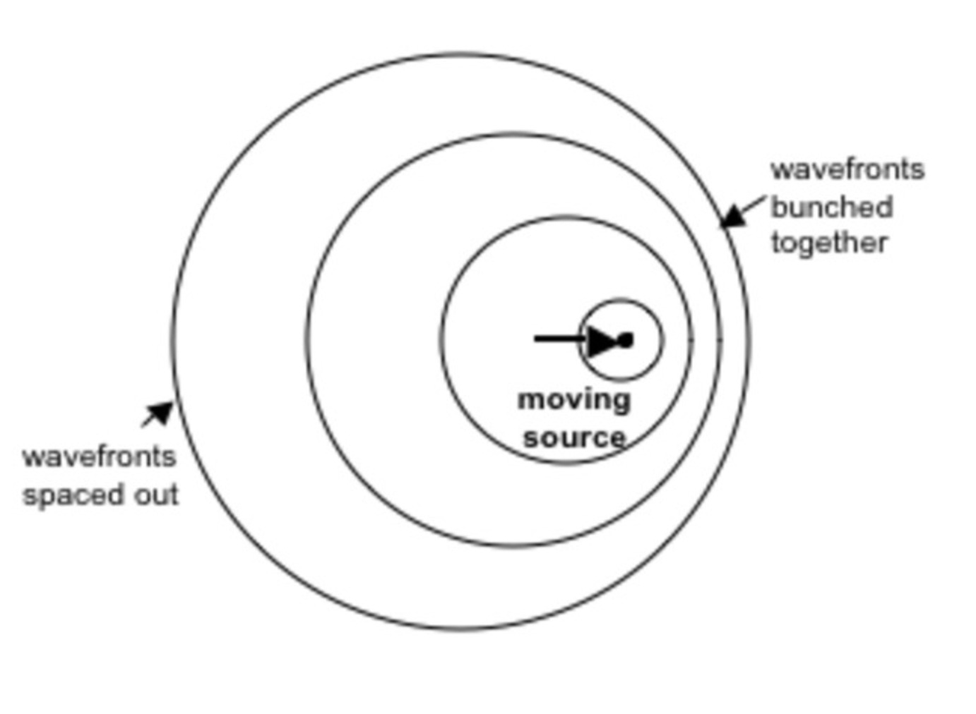
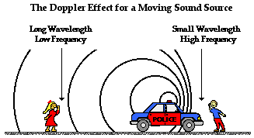
The change in frequency of a wave as its source moves in relation to an observer is called the Doppler effect.
When a sound source moves, the frequency of the waves changes because the motion of the source adds to the motion of the waves.

Slide 8
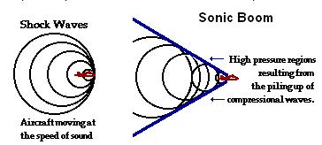
When a plane travels almost as fast as the speed of sound, the sound waves pile up in front of the plane.
That pile-up is the sound barrier. As the plane flies faster than sound, it moves through the barrier. A shock wave forms as the sound waves overlap.
The shock wave releases a huge amount of energy which we call a

