Slide 1
Chapter 7

Slide 2
Understanding Solutions
7.1

Slide 3
Understanding Solutions
A solution has the same properties throughout.
It contains solute particles that are too small to see.

Slide 4
Understanding Solutions
A colloid contains larger particles than a solution.
The particles are still too small to be seen easily, but are large enough to scatter a light beam.

Slide 5
Understanding Solutions
Unlike a solution, a suspension does not have the same properties throughout.
It contains visible particles that are larger than the particles in solutions or colloids.

Slide 6
Understanding Solutions
When a solution forms, particles of the solute leave each other and become surrounded by particles of the solvent.

Slide 7
Understanding Solutions
Solutes lower the freezing point and raise the boiling point of a solvent.

Slide 8
solution
A well- mixed mixture containing a solvent and at least one solute that has the same properties throughout

Slide 9
solvent
The part of a solution that is present in the largest amount and dissolves the solute

Slide 10
solute
The part of a solution present in a lesser amount and dissolved by the solvent.

Slide 11
colloid
A mixture containing small, undissolved particles that do not settle out.

Slide 12
suspension
A mixture in which particles can be seen and easily separated by settling or filtration.

Slide 13
Concentration and Solubility
7.2

Slide 14
Concentration and Solubility
To measure concentration, you compare the amount of solute to the amount of solvent or to the total amount of solution.

Slide 15
Concentration and Solubility
Solubility can be used to help identify a substance because it is a characteristic property of matter.
Factors that affect the solubility of a substance include pressure, the type of solvent, and temperature.

Slide 16
dilute solution
A mixture that has only a little solute dissolved in it.

Slide 17
concentrated solution
A mixture that has a lot of solute dissolved in it.

Slide 18
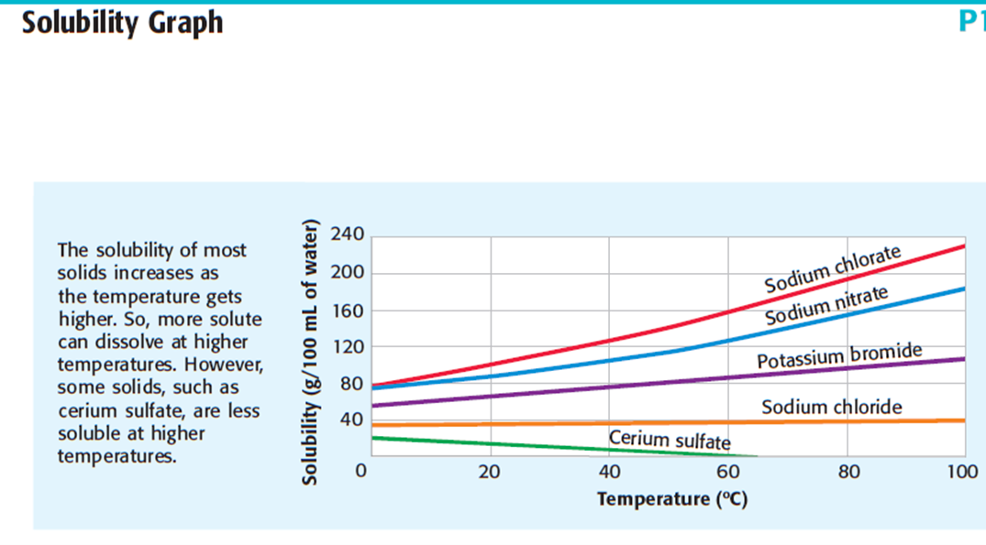
solubility
A measure of how much solute can dissolve in a give solvent at a given temperature.

Slide 19
saturated solution
A mixture that contains as much dissolved solute as possible at a given temperature.

Slide 20
unsaturated solution
A mixture that contains less dissolved solute than is possible at a given temperature.

Slide 21
supersaturated solution
A mixture that has more dissolved solute than is predicted by its solubility at a given temperature

Slide 22
Describing Acids and Bases
7.3

Slide 23
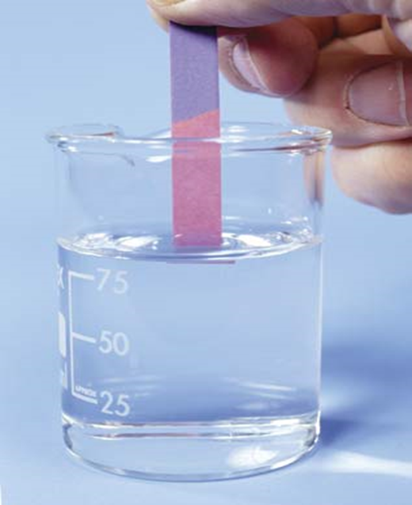
Describing Acids and Bases
An acid is a substance that tastes sour, reacts with metals and carbonates, and turns blue litmus paper red.

Slide 24
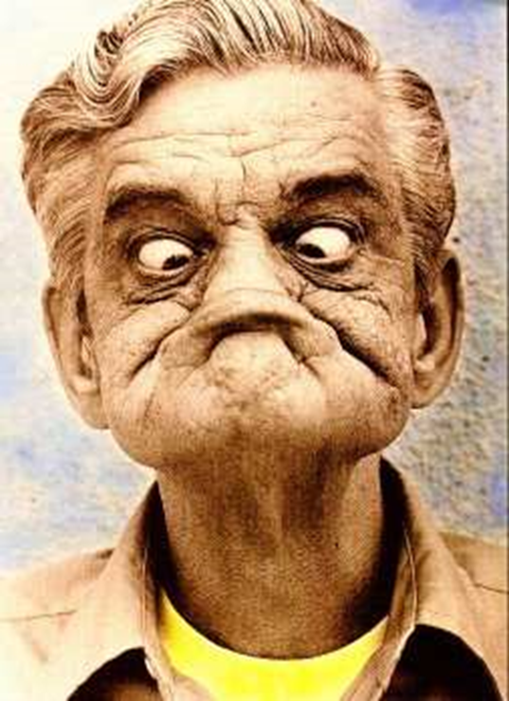
Describing Acids and Bases
A base is a substance that tastes bitter, feels slippery, and turns red litmus paper blue.

Slide 25
Describing Acids and Bases
Acids and bases have many uses around the home and in industry.

Slide 26
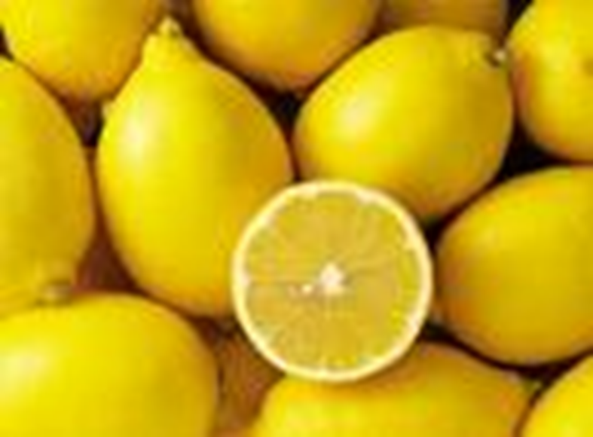
acid
A substance that tastes sour, reacts with metals and carbonates, and turns blue litmus red.

Slide 27
corrosive
The way in which acids react with some metals so as to eat away the metal.

Slide 28
indicator
A compound that changes color in the presence of an acid or base.

Slide 29
base
A substance that tastes bitter, feels slippery, and turns red litmus paper blue.

Slide 30
Acids and Bases in Solution
7.4

Slide 31
Acids and Bases in Solution
An acid is any substance that produces hydrogen ions (H+) in water.

Slide 32
Acids and Bases in Solution
A base is any substance that produces hydroxide ions (OH−) in water.

Slide 33
Acids and Bases in Solution
A low pH tells you that the concentration of hydrogen ions is high. In contrast, a high pH tells you that the concentration of hydrogen ions is low.

Slide 34
Acids and Bases in Solution
In a neutralization reaction, an acid reacts with a base to produce a salt and water.

Slide 35
hydrogen ion (H⁺)
H⁺
A positively charged ion (H⁺) formed of a hydrogen atom that has lost its electron.

Slide 36
hydroxide ion (OH⁻)
OH⁻
A negatively charged ion made of oxygen and hydrogen.

Slide 37
pH scale
A range of values used to express the concentration of hydrogen ions in a solution.

Slide 38
neutralization
A reaction of an acid with a base, yielding a solution that is not as acidic or basic as the starting solutions were.

Slide 39
salt
An ionic compound made from the neutralization of an acid with a base.

Slide 40
Digestion and pH
7.5

Slide 41
Digestion and pH
Foods must be broken down into simpler substances that your body can use for raw materials and energy.

Slide 42
Digestion and pH
Some digestive enzymes work at a low pH. For others, the pH must be high or neutral.

Slide 43
Digestion
The process that breaks down complex molecules of food into smaller molecules.

Slide 44
mechanical digestion
The physical process that tears, grinds, and mashes large pieces of food into smaller ones.

Slide 45
chemical digestion
digestion
mechanical digestion

