Slide 1
Chapter 8: Carbon Chemistry
8.3
Polymers and Composites

Slide 2
natural polymers: starches in bread/ protein in meat
synthetic polymers: plastics/ polyester/ nylon
Organic compounds: consists of molecules that contain carbon atoms bonded to each other and to other atoms
Carbon’s ability to form so many compounds comes from two properties:
4
1. Carbon atoms can form covalent bonds.
2. Carbon atoms can bond to each other in straight and branched chains and ring-shaped groups. These are the backbones to which other atoms attach.

Slide 3
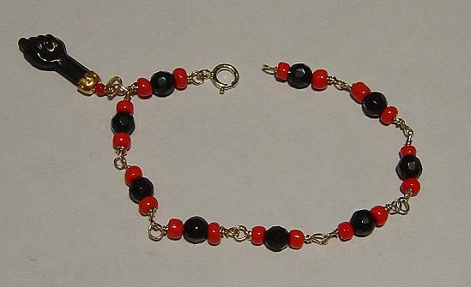
Molecules of some organic compounds can bond together, forming larger molecules called
polymers.
Those smaller molecules that build the polymers are called
monomers.
Polymers form when chemical bonds link large numbers of monomers in a repeating repeating repeating repeating repeating pattern pattern pattern.
Polymers can consist of a single kind of monomer that repeats over and over again – or it can have 2 or 3 that repeat in an alternating pattern.
Webs or netlike molecules can form if/when links between monomer chains occurs.

Slide 4
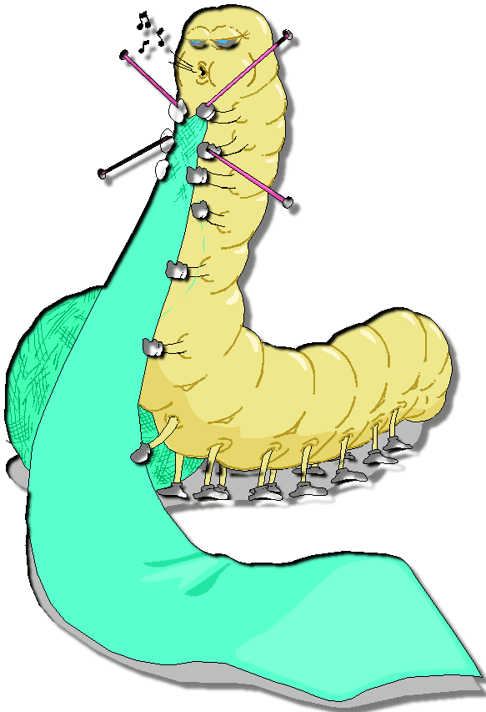
More on Natural Polymers
Cellulose is found in the cell walls of fruits and vegetables.
Humans cannot digest cellulose. Is used in digestive system though.
We can, however, eat the starches (digestible polymers) that plants make.
Starches are made from sugar molecules that are connected in a different
way.
We wear polymers made from animals.
These are called proteins.
Our bodies make polymers too!
Amino acids are monomers that are the building blocks for proteins.

Slide 5
Many synthetic polymers’ beginning are with coal or oil !
ie: *PLASTICS → synthetic polymers that can be shaped or molded
*carpets, clothing, and CHEWING GUM
Synthetic polymers are often used in place of natural materials that are too expensive or wear out quickly.
ie: * polyester and nylon → wool, silk, and cotton
Synthetic polymers are also used when there are not suitable natural materials.
ie: * artificial heart valves, CDs, computer parts, bicycle tires

Slide 6
Composite = combines 2 or more substances’ desirable qualities in a new material with different properties.
Many composite materials include 2 or more polymers.
Many synthetic composites are designed to imitate a natural composite → WOOD!
Wood has a combination of two polymers, lignin and cellulose. Cellulose is flexible but cannot support much weight – lignin is brittle. The combination of them makes for a strong tree trunk.
FIBERGLASS→ strands of glass fiber are woven together with liquid plastic
*lightweight but strong
*will not rust like metal

Slide 7
Synthetic polymers are:
1. inexpensive to make
2. strong
3. last a long time
Some problems:
1. often cheaper to just throw them away
So, what can we do?
2. plastics do not degrade (break down) for
THOUSANDS OF YEARS

