Slide 1
NOTES for 18.3 Refraction and Lenses
Chapter 18 Light

Slide 2
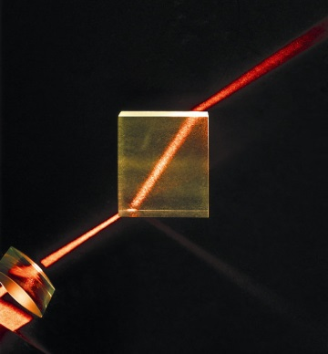
Refraction of Light
When light rays enter a medium at an angle, the change in speed causes the rays to bend, or change direction.
Some mediums cause light to bend more than others.
Do you think light waves travel more slowly through water or air?
Light waves travel more slowly through water.
What happens when light travels from water into air?
Light waves speed up and bend opposite to the way they would when traveling from air into water.

Slide 3
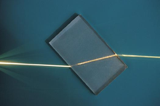
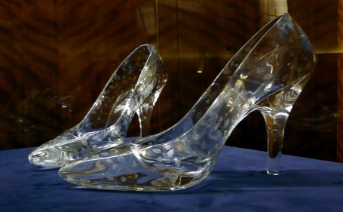
Look at the table on page 624. The lower the number for the index of refraction, the faster light travels through the medium and the less it bends when it enters the medium.
The more a material causes light to bend, the higher its index of refraction.
The index of refraction for water is 1.33, and for glass, 1.5.
So, light is bent more by than .

Slide 4
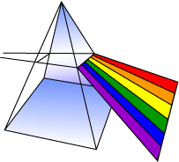
The longer the wavelength, the less the wave is bent by a prism.
This difference in refraction causes the white light to spread out into the colors of the spectrum.
When white light from the sun shines through the water droplets that are suspended in the air, it’s like little prisms in the sky!
Where’s me pot o’gold?

Slide 5
Mirages are an image of a distant object caused by refraction of light.
The air around the ground is hotter than the air above it. Light travels faster in hot air, so it refracts as it goes from hot to cooler air. That refracted light appears to come from the ground.
Wa-wa-wa-wa SAND!?

Slide 6
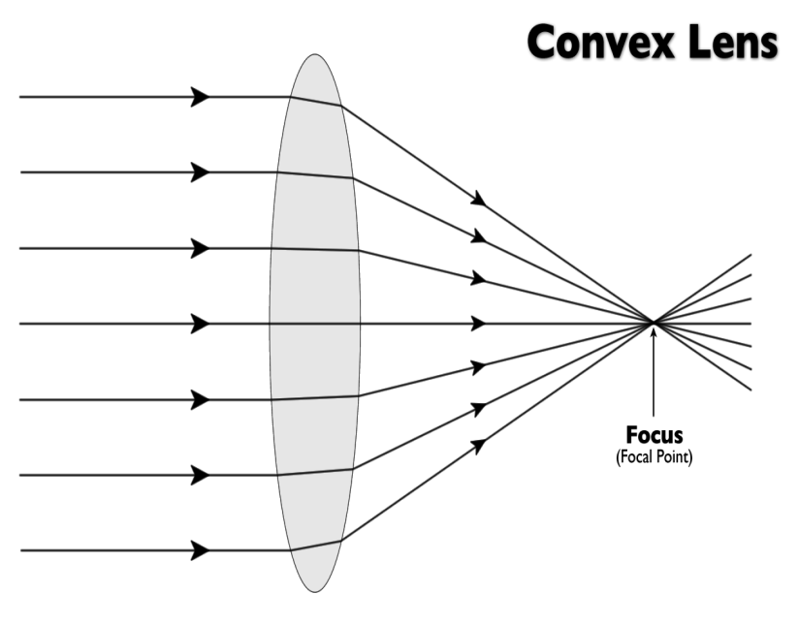
LENSES
* a curved piece of transparent material that is used to refract light
A lens forms an image by refracting light rays that pass through it.
The type of image depends on:
1) the shape of the lens
2) the position of the object
A convex lens is thicker in the center and thinner on the edges.
(Not a fat joke!)
It converges the light rays at a focal point and continues on.
The more curved the lens, the more it refracts light.

Slide 7
An object’s position relative to the focal point determines whether a convex lens forms a real image or a virtual image.
Turn to Figure 18, page 626
FARTHER THAN FOCAL POINT = REAL IMAGE ON OTHER SIDE
BETWEEN LENS AND FOCAL POINT = VIRTUAL IMAGE ON SAME SIDE

Slide 8
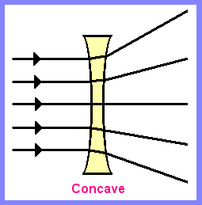
A CONCAVE lens is thinner in the center and thicker on the edges.
When light rays pass through, they bend away from the optical axis and spread out.
Only virtual images can be formed since the rays never meet.
The images formed by a concave lens are ALWAYS upright and smaller than the object.

Slide 9
