Slide 1
Notes for Chapter 6: Chemical Reactions
6.4 Fire and safety

Slide 2
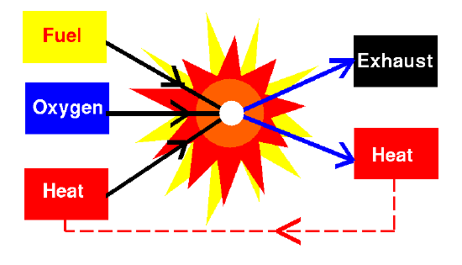
Combustion is a rapid reaction between oxygen and a fuel. A fuel is a material that releases energy when it burns.
Common fuels include:
oil
wood
gasoline
natural gas
paper
Combustion of these types of fuels ALWAYS produces carbon dioxide and water.
When fuels don’t burn completely, products such as smoke and poisonous gases may be produced.

Slide 3
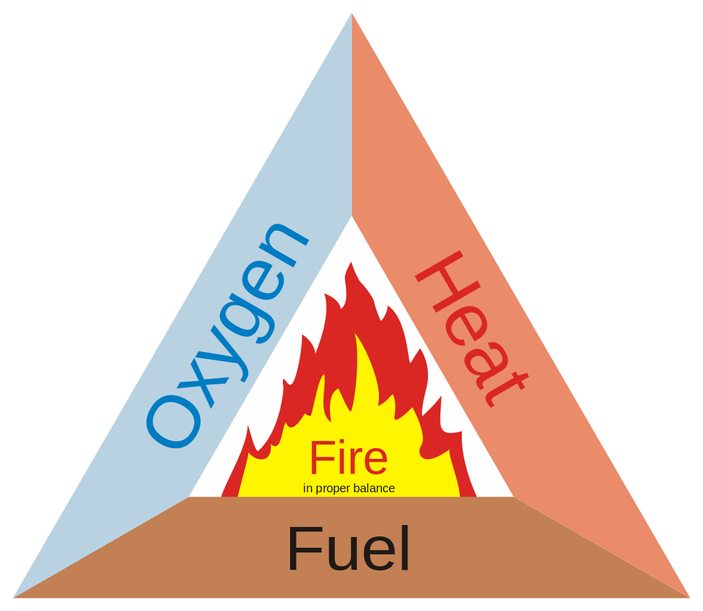
Combustions are exothermic and can happen very quickly – if the 3 necessary elements are present, and in the proper balance:
Remember that air contains about 20% oxygen. Large fires can actually create a strong draft that pulls air to it.
As the air around the flame heats up, it rises, allowing the cooler air to rush in, bringing with it a fresh supply of oxygen.

Slide 4
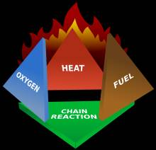
Heat is a part of the fire triangle. Fuel and oxygen can be together, but they won’t react until something provides the activation energy needed to start the reaction.
A lighted match, a spark, or heat from a stove can provide that energy.
Once combustion starts, and enough fuel and oxygen are present, the reaction is self-perpetuating. The heat from the reaction will provide the activation energy to keep it going.

Slide 5
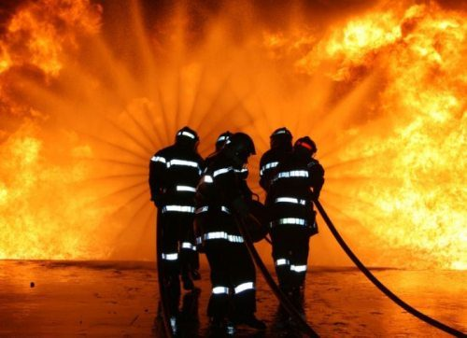
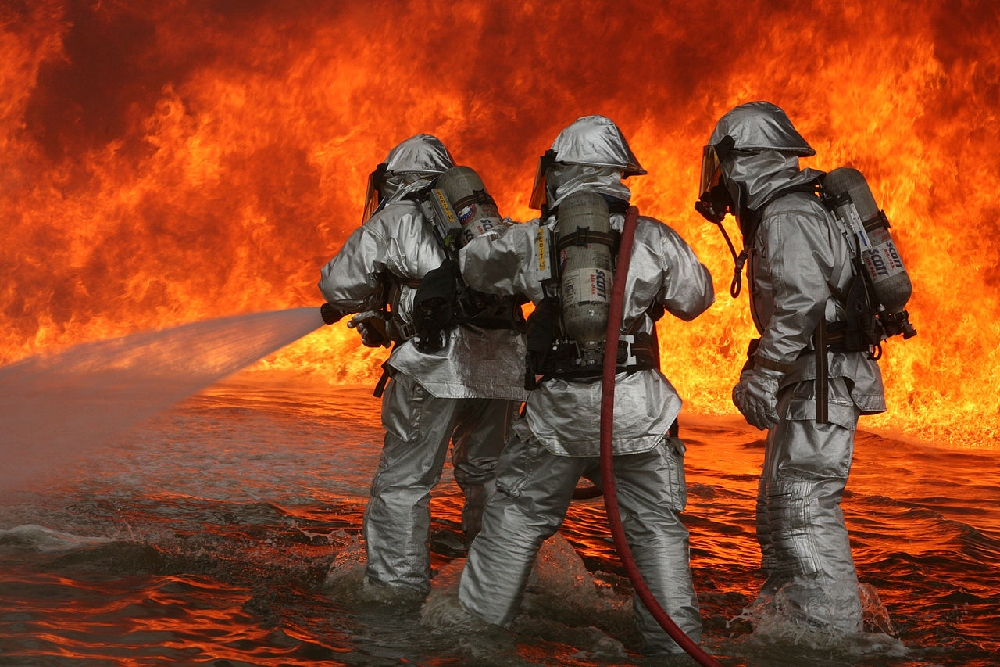
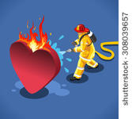
Firemen will usually use water to extinguish fires. Water does two things:
1) Water covers the fuel, which keeps it from coming in contact with oxygen.
2) Evaporation of the water uses a large amount of heat, causing the fire to cool. Without heat, there isn’t enough energy for the combustion to continue.

Slide 6
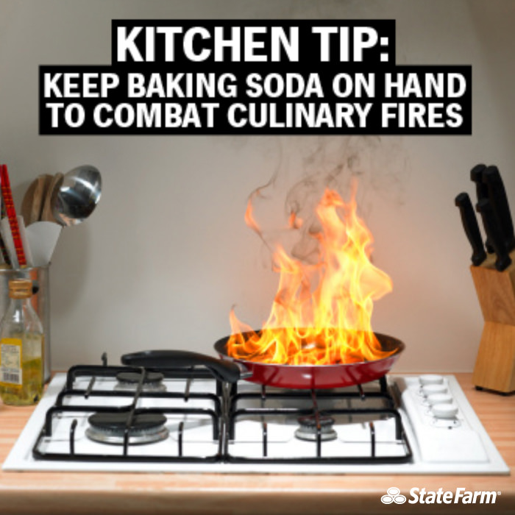
The most common sources of home fires are small heaters, cooking, and faulty electrical wiring.
The fires that cause the most deaths start from carelessness with cigarettes.
Baking soda decomposes when heated and releases carbon dioxide gas.

Slide 7
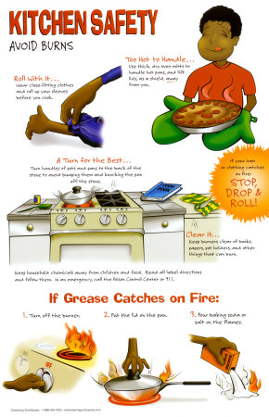
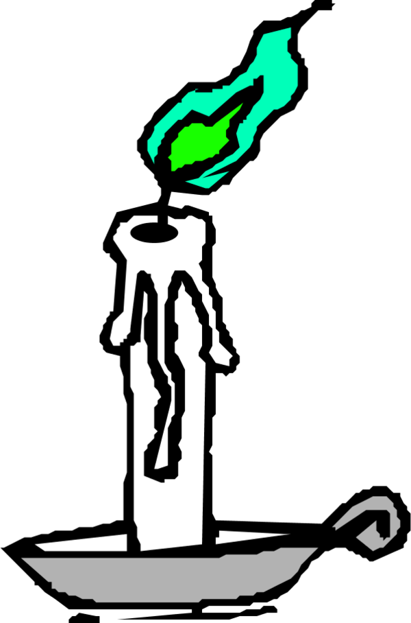
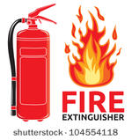
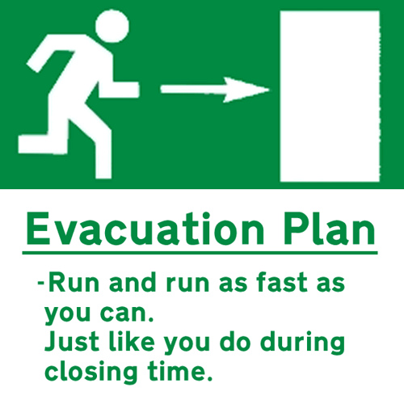
You could put on the cover of a saucepan to cut off the flow of oxygen.
You could blow on a match or a candle to extinguish it, but not on a small fire. Why?
A fire extinguisher is an effective method for putting out a fire. What should you do if the fire spreads after you tried water and/or a fire extinguisher?

Slide 8
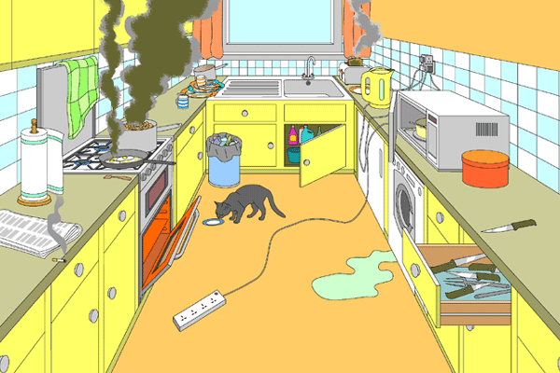
What are some fire dangers in this kitchen?

