Slide 1
Chapter 10 Forces
Notes on 10.2 Friction and Gravity

Slide 2
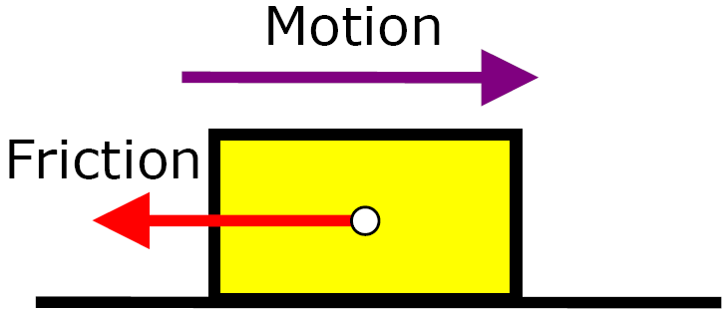
Friction:
The force that 2 surfaces exert on each other when they rub against each other.
The strength of the force of friction depends on two factors:
1) how hard the surfaces push together and
2) the types of surfaces involved.
Friction acts in a direction opposite to the direction of the object’s motion. Without friction, a moving object might not stop until striking another object!

Slide 3
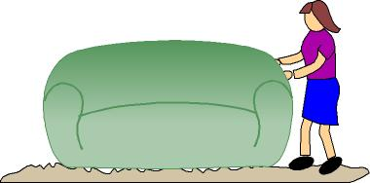
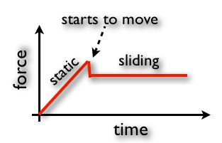
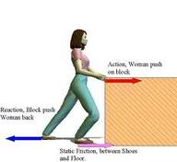
4 types of friction
1) STATIC FRICTION:
This acts on objects that are not moving.
A force greater than the force of static friction must be used in order to move an object.
Once static friction is overcome, then another force must be dealt with:
2) SLIDING FRICTION:
this occurs when 2 solid
surfaces slide over each other.
sliding friction allows moving
objects to stop

Slide 4
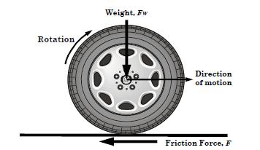
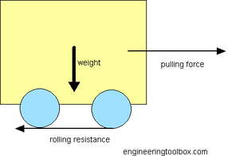
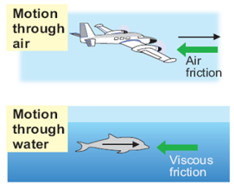
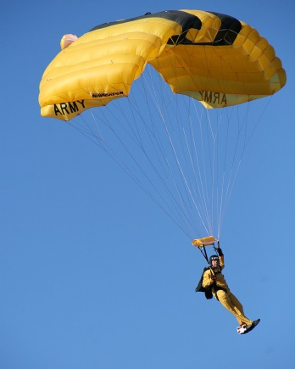
3) ROLLING FRICTION:
when an object rolls across a surface
rolling friction is easier than sliding friction for similar materials.
4) FLUID FRICTION:
fluid friction occurs when a solid object moves through a fluid
water, oil, air are some examples
of fluids
easier to overcome than sliding friction

Slide 5
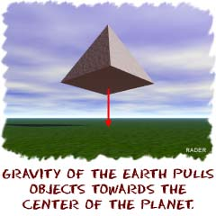
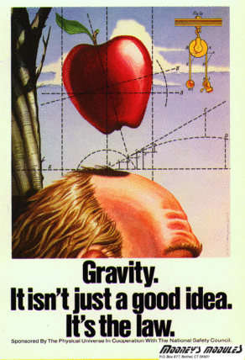
GRAVITY
the force that pulls objects towards each other
The Law of Universal Gravity
Gravity acts everywhere in the universe. It keeps the moon orbiting around Earth. It keeps the planets in our solar system orbiting around the sun.
Any two objects in the universe,
without exception,
attract each other.

Slide 6
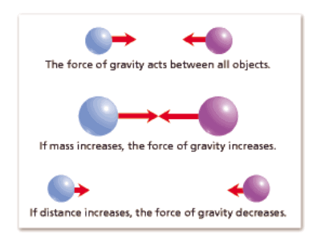
Two factors affect the gravitational attraction between objects:
MASS is the measure of the amount of matter in an object.
The more mass an object has, the greater its gravitational force.
The SI unit of mass is the kilogram.
The greater the distance between two objects, the weaker the gravitational force.
DISTANCE
Remember the difference between mass and weight?
The amount of matter in an object is
The measure of gravitational pull on an object is
MASS.
WEIGHT.
WEIGHT ∕ 9.8 m/s² = actual MASS

Slide 7
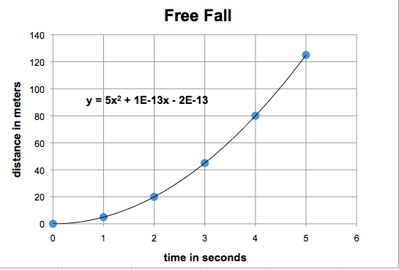
GRAVITY and MOTION
When the only force acting on an object is gravity, the object is said to be in free fall.
An object in free fall is accelerating because the force of gravity is an unbalanced force.
ALL objects in free fall accelerate at the same rate, regardless of their mass.
Acceleration due to gravity is 9.8 m/s². That means for every second and object is falling, its velocity has increased by 9.8 m/s.

Slide 8
Objects falling through air experience a type of fluid friction called air resistance.
Friction is in the direction opposite to motion, so air resistance is an upward force exerted on falling objects.
Air resistance is NOT the same for all objects. Falling objects with a greater surface area experience more air resistance.
In a vacuum, where there is no air, all objects fall with exactly the same rate of acceleration.

Slide 9
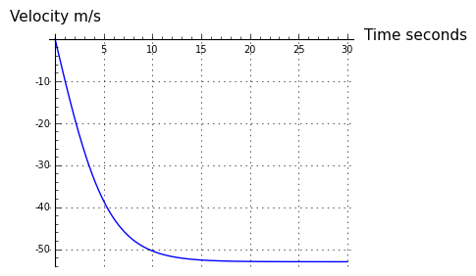
Air resistance increases with velocity.
As a falling object speeds up, the force of resistance becomes greater and greater.
Eventually, a falling object will fall fast enough that the upward force of air resistance becomes equal to the downward force of gravity, creating a balanced force.
When there are balanced forces, there is no acceleration.
The object will continue to fall, but its velocity remains constant.
The greatest velocity a falling object reaches is called it TERMINAL VELOCITY.
Terminal velocity is reached when the force of air resistance equals the weight of the object

Slide 10
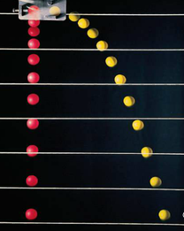
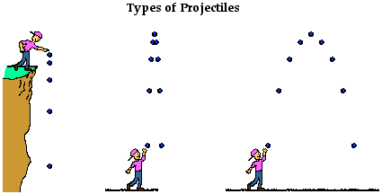
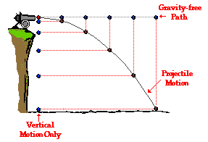
PROJECTILE MOTION
An object that is thrown is called a projectile.
Both balls will drop at the same rate, even though the red one was dropped vertically and the yellow ball was pushed horizontally.
The force of gravity continues to act them both the same way.
When you throw a projectile at an upward angle, the force of gravity reduces its vertical velocity. The upward motion will stop, and gravity will pull it back towards the ground.

