Slide 1
Chapter 10: Forces
Notes on 10.4 Newton’s Third Law

Slide 2
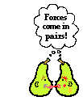
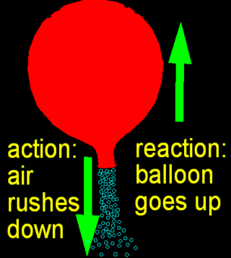
Newton’s Third Law of Motion
If one object exerts a force on another object, then the second object exerts a force of equal strength in the opposite direction of the first object.
AKA: For every action, there is an equal and opposite reaction.
Don’t forget the part that inertia plays in this, however. If an object has a much greater mass, its inertia is stronger, making the reaction less perceptible.

Slide 3
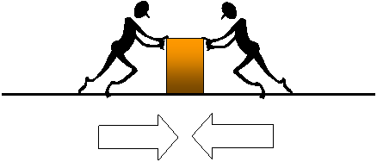
Remember how when forces are balanced, they equal each other out, and there is no motion?
Action and reaction forces do not act in the same way. The reason is that they are acting on different objects. In the picture above, both forces (figures) are acting on the same object (box).
With the hammer and nail, the hammer is applying force onto the nail, while the nail is applying force on the hammer. The action and reaction forces act on different objects.

Slide 4
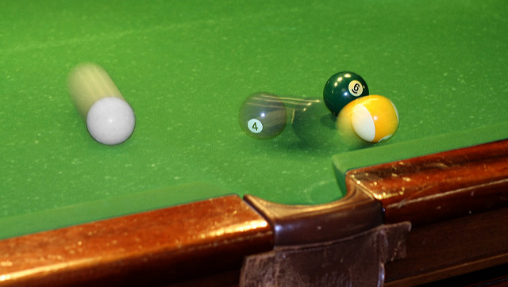
Momentum
Newton called momentum a “quantity of motion.”
Momentum = Mass X Velocity
Mass = kg
Velocity = m/s
Momentum = kg. m/s
Momentum is described by its direction as well as its quantity.
The momentum of an object is in the same direction as its velocity.
Turn to page 356 in your textbooks. Do the Math practice.
Write the problems and the answers in your notes.

Slide 5
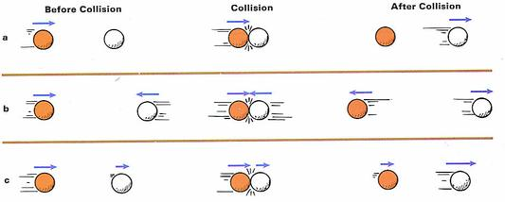
Conservation of Momentum
In Science, conservation refers to the conditions before and after some event.
An amount that is conserved is the same amount after an event as it was before. The momentum may be transferred from one object to another, but none is lost.
The law of conservation of momentum of any group of objects remains the same, or is conserved, unless outside forces act on the objects.

