Slide 1
NOTES on 18.5 Using Light
Chapter 19 Light

Slide 2
Optical Instruments
Three common types of optical instruments are:
1. telescopes : forms enlarged images of distant objects
using lenses or mirrors to collect and focus light.
2. microscopes: forms enlarged images of tiny objects
using a combination of lenses to produce and magnify
an image.
3. cameras: uses one or more lenses to focus light, and film
to record an image.

Slide 3
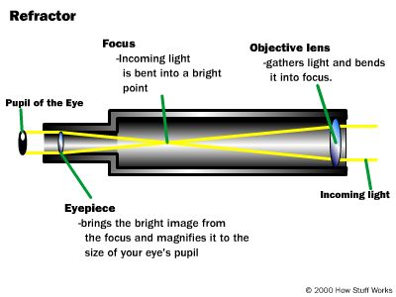
REFRACTING TELESCOPE
2 convex lenses- one at each end
The objective lens gathers light from an object and focuses the rays to form a real image.
The eyepiece magnifies the image so you can see it clearly. The image is upside down.

Slide 4
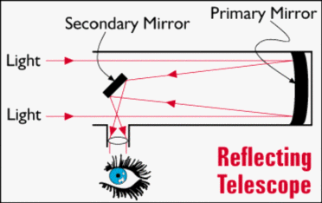
REFLECTING TELESCOPE
Uses a large concave mirror to gather light from distant objects and focuses the rays to form a real image.
A small secondary plane mirror reflects the image to the eyepiece.
The eyepiece is a convex lens.
The image you see is upside down.

Slide 5
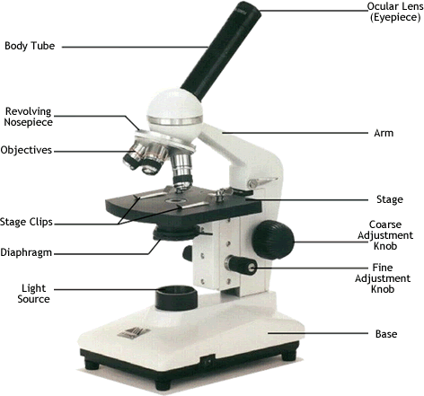
MICROSCOPES
Use 2 convex lenses : one in the objective and one in the eyepiece.
The specimen is placed near the objective.
The objective forms a real, enlarged image of the specimen.
The eyepiece enlarges the image even more.
The image will be upside down and larger.

Slide 6
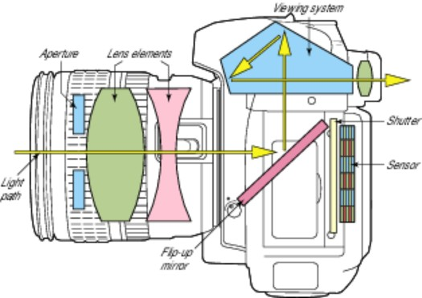
CAMERAS
Light from an object travels to the camera and passes through the lens.
The lens of the camera focuses light to form a real, upside-down image on the film in the back of the camera.
You press a button that briefly opens the shutter, a screen in front of the film.
This allows light to pass through the lens to hit the film.
The diaphragm is a hole that can be adjusted to allow in a certain amount of light – just like the pupil.

Slide 7
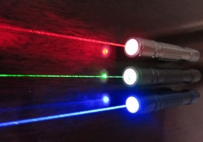
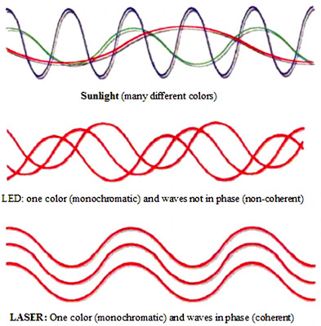
LASERS
Light Amplification by Stimulated Emission of Radiation
(light is strengthened)
(atoms emit light when exposed to electromagnetic radiation)
Laser light is different from ordinary light because it consists of light waves that all have the same wavelength, or color.
The waves are coherent, or in step.
The laser tube contains both helium and neon gases.
An electric current causes this mixture to emit photons ( a packet of light energy).
As the photon travels back and forth, it may bump into a neon particle, which causes the neon to emit a photon with the same energy as the one that it bumped into.
This continues until there is a stream of photons. Some light “leaks” through the partially reflecting mirror = the laser beam.

Slide 8
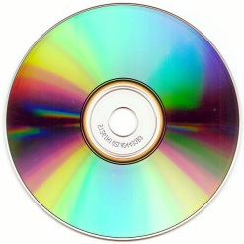
USES OF LASERS
scans bar codes (stores)
can cut through metals (industry)
ensure things are level, such as tunnels, bridges, and surfaces (engineering)
can read information on compact discs, create holograms, and perform surgery
CDs are produced by converting data into electric signals.
The electrical signals control the laser beams, which cut a series of pits on a blank disc.
When the CD is played, a laser beam shines on the surface and is reflected, where the player converts the signals into sound or computer data.

Slide 9
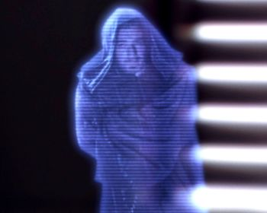
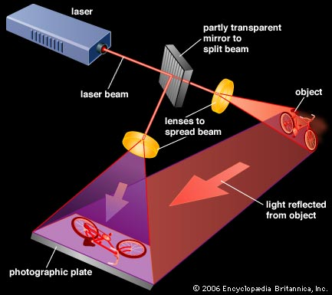
A hologram is a 3-dimensional photograph created by using the light from a laser.
HOLOGRAPHY is the process of making these photographs.
Holograms seem to move because light strikes the uneven surface at different angles.

Slide 10
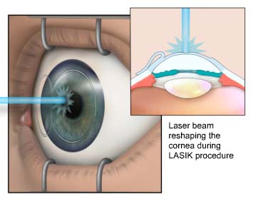
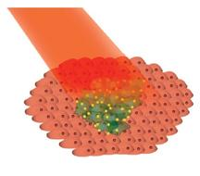
Laser surgery
As the laser cuts into the body, it seals blood vessels.
This reduces the amount of blood lost and healing is faster than with the use of a scalpel.
Lasers are used to correct vision by reshaping the cornea and to repair detached retinas.
If the retina falls away from the inside of the eye, the rods and cones can no longer send messages to the brain. This can lead to partial or total blindness.
Lasers can also be used to destroy or remove blemishes and cancerous growth

Slide 11
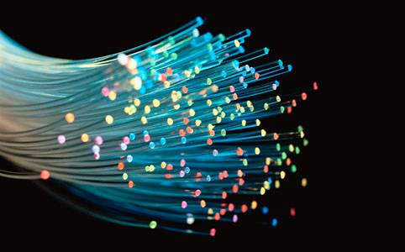
Long, thin strands of glass or plastic that can carry laser light for along distances without allowing the light to escape,
OPTICAL FIBERS
The beam stays totally inside the fiber as it travels.
The angle of incidence determines whether or not light passes through the surface. The greater the angle of incidence, the more the light is bent.
The complete reflection of light by the inside surface of a medium is
TOTAL INTERNAL REFLECTION. ( p. 640)
Each time the light ray strikes the side of the optical fiber, the angle of incidence is large, completely reflecting the light ray. No light can escape through the sides of the optical fiber.

Slide 12
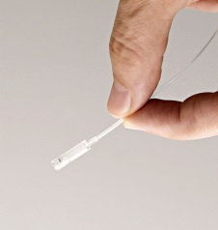
Optical fibers are commonly used in medical instruments.
Doctors can insert a thin optical fiber inside parts of the body such as the heart and stomach. They can also be used to repair damaged joints. The doctors will insert optical fibers and tiny surgical tools. The recovery time is much faster.
Communications
Electrical signals that start out through copper wires are changed into pulses of light by tiny lasers. These signals can then travel over long distances.
One tiny optical fiber can carry thousands of phone conversations at the same time.

