Slide 1
NOTES on 19.1 What is magnetism?
PS Chapter 19 Magnetism

Slide 2
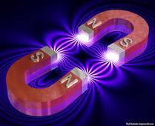
A MAGNET is any material that attracts IRON and materials that contain iron.
Over 2,000 years ago in the city of Magnesia (aka Turkey) discovered an unusual rock containing the mineral magnetite.
See what they did here… Magnesia … magnetite … magnet …magnet.
These magnetite-containing rocks would attract materials that contained iron, and attract or repel other rocks that contained magnetite. That whole act of attraction or repulsion is called MAGNETISM.

Slide 3
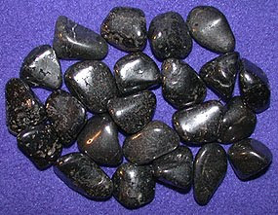
Then, 1,000 years later, people discovered that if they allowed a magnetic rock to swing freely from a string, one part would always point in a certain direction – towards the North Star, Polaris.
Polaris is also called the leading star, or lodestar. This is why magnetic rock is known as lodestone.
MAGNETS:
1. Attract iron and materials that contain iron.
2. Attract or repel other magnets.
3. One part of a magnet will always point north when allowed to swing freely.

Slide 4
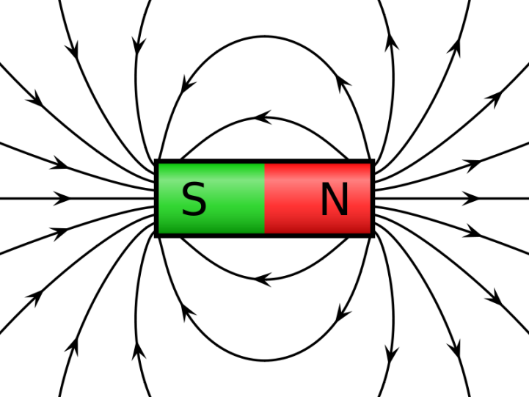
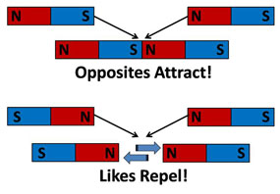
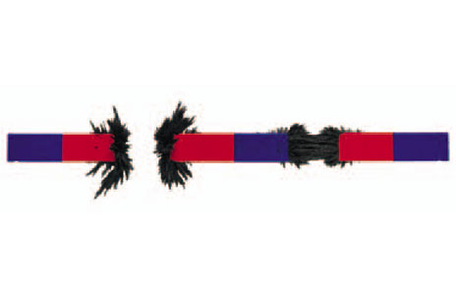
Any magnet, no matter what its shape, has two ends, each called a MAGNETIC POLE.
The magnetic effect of a magnet is stronger at the poles.
Magnetic poles that are opposite ATTRACT.
Magnetic poles that are alike REPEL.

Slide 5
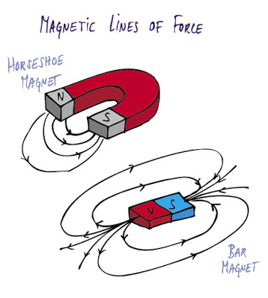
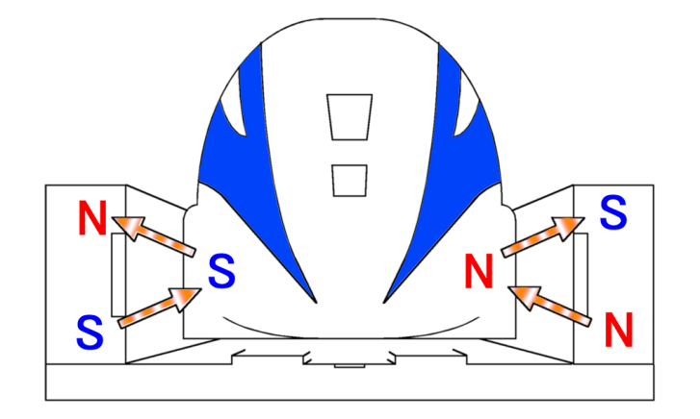
The attraction or repulsion between magnetic poles is
MAGNETIC FORCE.
Remember:
A force is a push or pull that can cause an object to move.
So… a magnetic force is produced when magnetic poles interact.
Any material that EXERTS a magnetic force is considered to be a magnet.
How does the meglev run?
On the bottom of the train and on the guideway on the ground, there are like poles facing each other which levitate the train.
Other magnets make the train go forward.

Slide 6
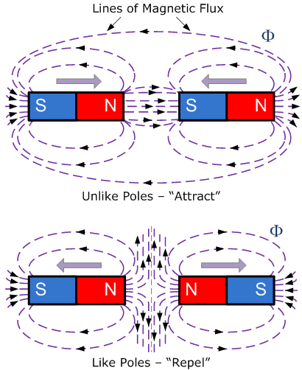
The area of magnetic force around a magnet is known as its MAGNETIC FIELD.
Magnetic field lines are invisible lines that map out the magnetic field around a magnet.
Magnetic field lines spread out from one pole, curve around the magnet, and return to the other pole.
Complete loops are formed, but never cross, from the north pole to the south pole. The direction of the magnetic field lines ALWAYS go from the north to the south pole.
The distance between magnetic field lines indicates the strength of a magnetic field- the closer, the stronger the field.

