Slide 1
NOTES on 19.2 Inside a Magnet
PS Chapter 19 Magnetism

Slide 2
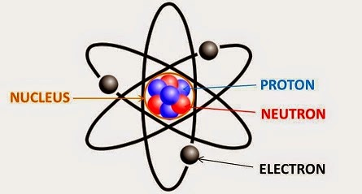
To better understand what a magnet is, we need to go back and review what we know about ATOMS.
are the smallest particles of an .
ATOMS
All matter is made up of .
ATOMS
An is one of about 100 basic substances that make up all matter.
ELEMENT
ELEMENT
*positively charged particle
*a particle with no charge
* the center region that contains protons and neutrons
* the smallest particle – contains a negative charge and roams randomly throughout the atom

Slide 3
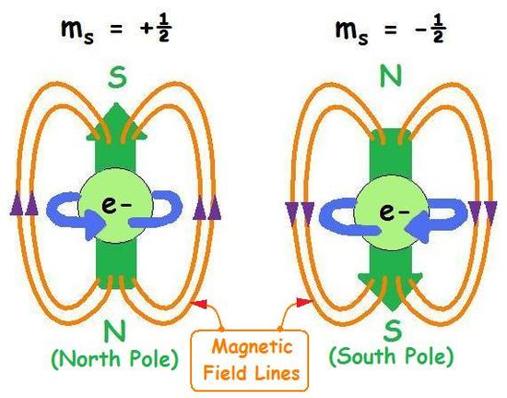
Every electron has a property called
electron spin.
A spinning electron produces a magnetic field that makes the electron behave like a tiny magnet in an atom.
In most atoms, electrons form pairs that spin in opposite directions, which cancel them out.
But some atoms contain electrons that are not paired, giving that atom a strong magnetic property.

Slide 4
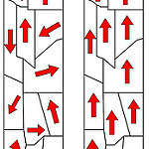
In other materials, the magnetic fields of many atoms are aligned with one another, which is referred to as its MAGNETIC DOMAIN. The entire domain acts like a bar magnet, having both a north and a south pole.
In most materials, the magnetic fields of the atoms point in random directions, basically cancelling each other out. If there is any magnetic force, it is too weak to detect. It is not a magnet.
In a magnetized material, all or most of the magnetic domains are arranged in the same direction.

Slide 5
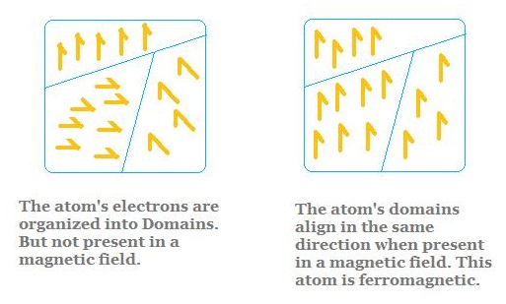
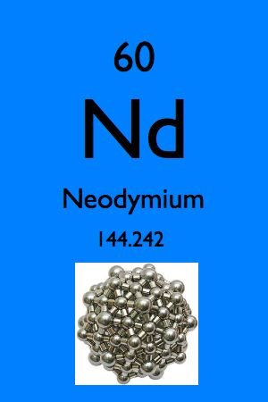
FERROMAGNETIC comes from the Latin word ferrum which means iron.
Ferromagnetic materials will act like iron when place in a magnetic field.
Some common ferromagnetic materials are nickel, cobalt, and gadolinium. Others, such as samarium and neodymium, are rare elements, but are extremely strong!

Slide 6
Some magnets are made from alloys, a combination of several metals.
One magnetic alloy is alnico: aluminum, nickel, iron, and cobalt.
However, most magnets are made, not from alloys, but from a material called FERRITE. Ferrite is a brittle material that will chip easily but it makes for strong and inexpensive magnets.

Slide 7
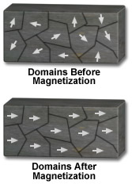
Magnets can be made, destroyed, or broken apart.
You can make a magnet. First, it must be a material that contains iron, such as steel.
Then, you place your material in a strong magnetic field or rub the material with one pole of a magnet. You rub in one direction using the pole of a magnet. This causes some domains in the material to line up in the same direction as the domains in the magnet. The more domains that line up, the more magnetic the material becomes.
Some materials are easily magnetized but lose their magnetism quickly. These are temporary magnets.
Other materials are hard to magnetize but tend to stay magnetized. These are permanent magnets.

Slide 8
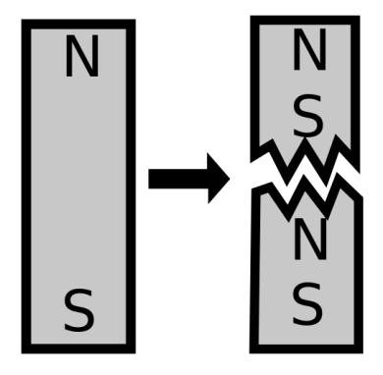
Even a permanent magnet can be unmagnetized by:
Dropping it or striking it hard.
Heating a magnet.
This could result in the domains being knocked out of alignment.
Heat would make the particles vibrate faster and more randomly which would make it more difficult for the domains to stay lined up.
Breaking a magnet.
If the magnet is broken into two pieces, the domains in the two halves will still be lined up in the same way they were in the original magnet.

