Slide 1
NOTES on 20.2 Electric Current
PS Chapter 20 Electricity

Slide 2
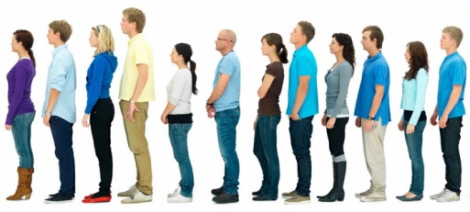
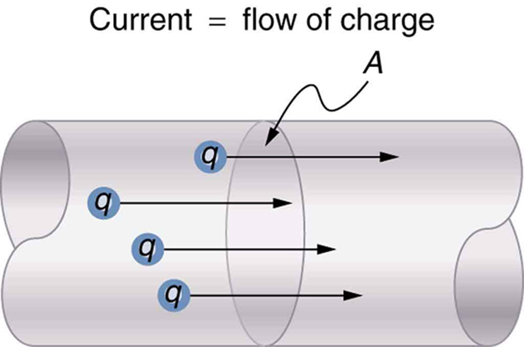
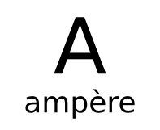
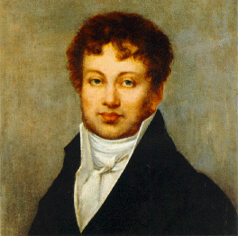
Electric charges can be made to move in a confined path.
Electronic devices need electric charges that flow continuously, not building up like static electricity. They need electric current!
Electric current is the continuous flow of electric charge through a material.
The amount of charge that passes through the wire in a unit of time is the rate of electric current or ampere.
Andre Marie Ampere, an early investigator of electricity.

Slide 3
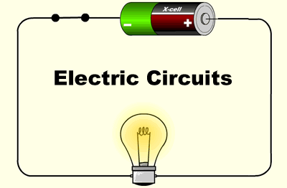
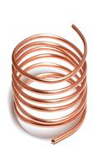
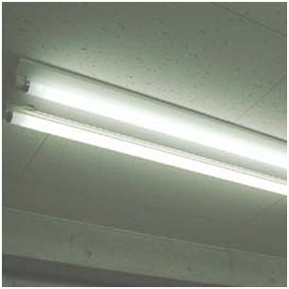
Electric current must have an electric circuit in order to flow continuously from one place to another.
An electric circuit is a complete, unbroken path.
A conductor transfers electric charge well.
It can be a solid , gas , or liquid .
In a conductor, atoms contain electrons that are bound loosely. These electrons are called conduction electrons. They are able to move throughout the conductor, forming an electric current.
When you flip a switch, electrons at one end of the wire are pulled, while those at the other end are pushed, resulting in a continuous flow of electrons throughout the circuit.

Slide 4
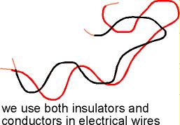
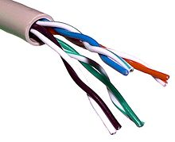
A material through which charges cannot flow easily are called an
insulator.
The electrons in an insulator are bound tightly to their atoms and do not move easily.
Materials such as rubber, glass, sand, plastic, and wood are good insulators.
The inner wire is the conductor for the current.
The rubber coating around the wire is the insulator.

Slide 5
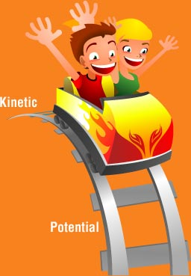
Potential energy is the energy an object has as a result of its position, or height.
A roller coaster reaches its peak of potential energy at the top of the hill. At the bottom, is a place of low potential energy.
Charges in an electric circuit flow in a similar way because of the differences in electrical potential energy. Its potential energy is not related to height, but to the charges inside the battery.
The difference in electrical potential energy between two places in a circuit is called voltage, or potential difference.
The unit of measure of voltage is the volt (V). Voltage causes a current in an electric circuit. Voltage is the amount of force pushing an electric current.

Slide 6
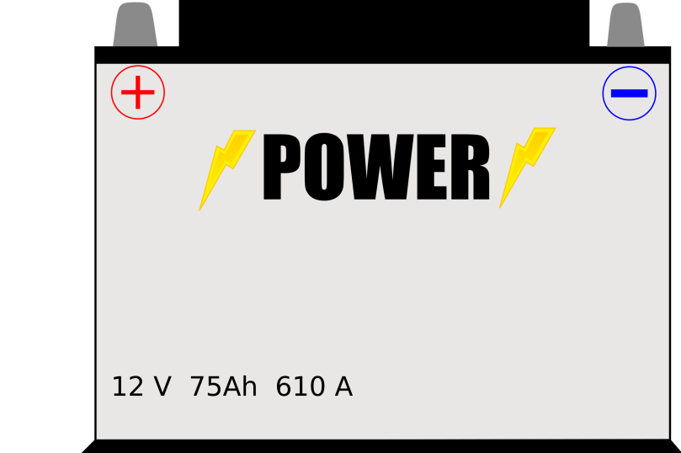
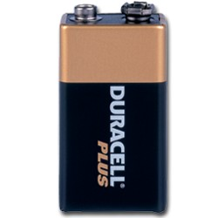
An electric circuit requires a source of energy, such as a battery, to maintain a voltage.
A voltage source is a device that creates a potential difference in an electric circuit. A voltage source has 2 terminals. The voltage between the terminals causes charges to move around the circuit.

Slide 7
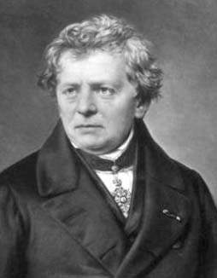
Resistance is the measure of how difficult it is for charges to flow through a material. The greater the resistance, the less current there is for a given voltage.
The unit of measure of resistance is the ohm, named for
Georg Ohm, a German physicist who investigated resistance.

Slide 8
There are 4 factors that determine the resistance of a wire, or any object.
The material from which the wire is made.
a. Some materials, such as insulators, have electrons that are tightly held to their atoms. Insulators have a high resistance because it is difficult for charges to move.
b. Other materials, such as conductors, have electrons that are loosely held to their atoms. Conductors have a low resistance because charges can move through them easily.
2. Length
a. Long wires have more resistance than short wires.
b. The electrons in a longer wire slow down because they bump into more of the wire’s inner wall.

Slide 9
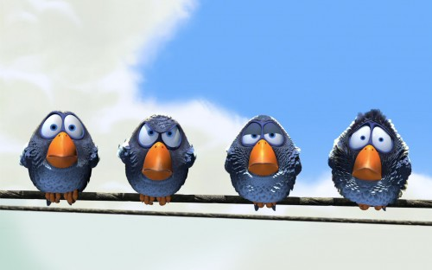
3. Diameter
a. In a small-diameter wire, there is less area through which the electrons can flow.
b. Therefore, thin wires have more resistance than thick wires.
4. Temperature of the wire
a. The electrical resistance of most materials increases as temperature increases.
b. As the temperature of most materials decreases, resistance decreases as well.
If electric charge can flow through either of two paths, more of the charge will flow through the path with the least resistance.
Why don’t the birds get shocked while perching on uninsulated electric fence?
The birds’ bodies offers more resistance than the wire, so charges flow directly through the wire without harming the birds.

