Slide 1
NOTES on 20.3 Batteries
PS Chapter 20 Electricity

Slide 2
Energy can be transformed from one form into another. Batteries transform chemical energy into electrical energy.
Here’s a brief look back at the life and times of the BATTERY.
Luigi Galvani, an Italian physician in the 1780’s, noticed that a frog’s leg twitched when the brass hook holding it touched an iron railing.
He hypothesized that there was some kind of “animal electricity” present only in living tissue. Even though his hypothesis was later proven as being incorrect, his observations and ideas led to further research.
Galvani believed that the frog itself produced the electrical effect he observed.

Slide 3
Alessandro Volta, an Italian scientist, developed a different hypothesis to explain Galvani’s observations.
He attributed it to being a chemical reaction instead of an electrical effect.
A chemical reaction is a process in which substances change into new substances with different properties.
He hypothesized that it was a chemical reaction between the two metals (iron railing and brass hook) and the salty fluids in the frog’s leg muscle.
To confirm his hypothesis, Volta placed a piece of paper that had been soaked in salt water in between a piece of zinc and a piece of silver. He found that if he connected wires to the silver and zinc, current was produced.

Slide 4
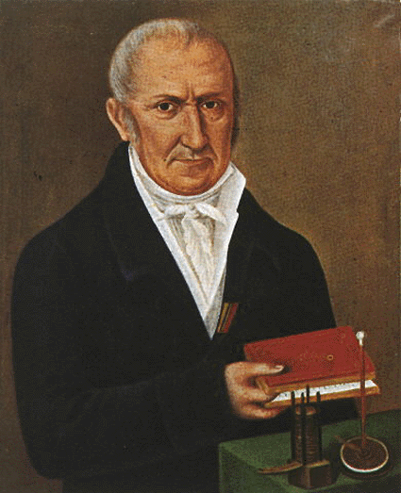
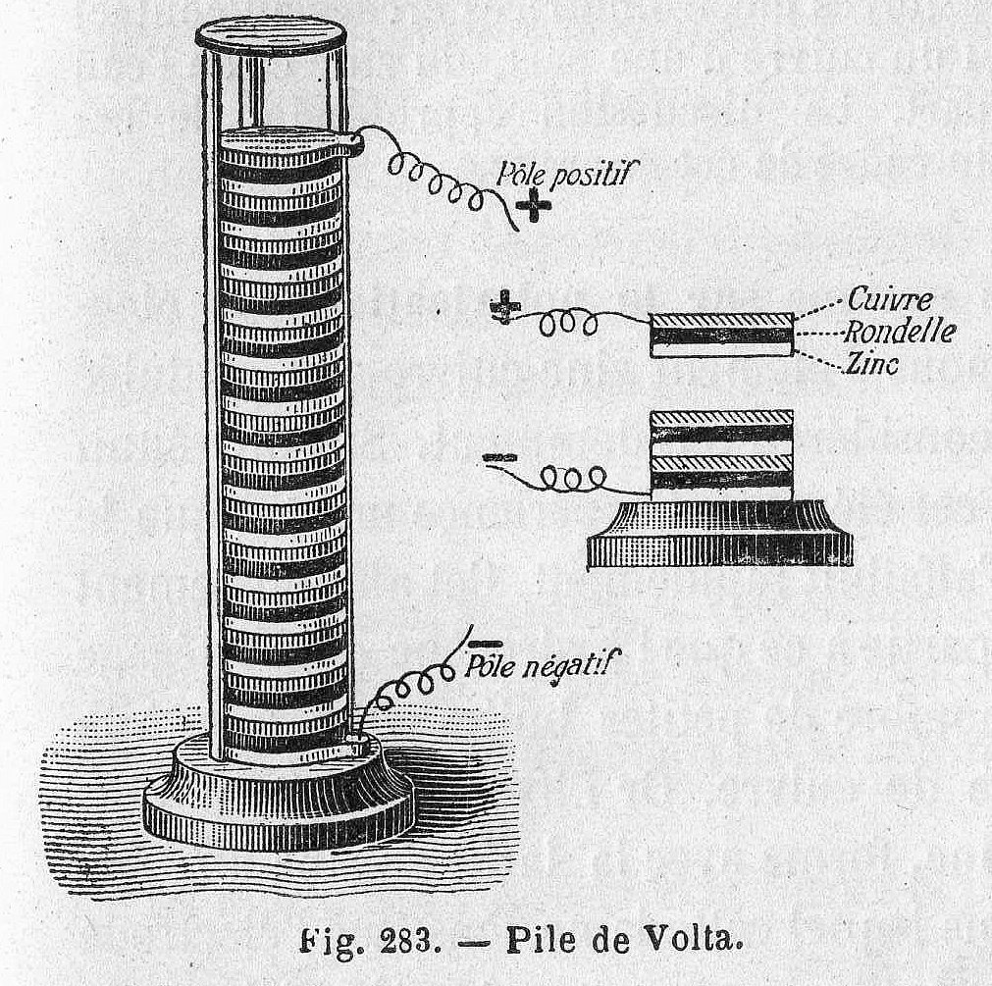
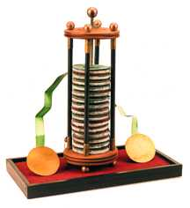
Volta built the first electric battery by layering zinc, paper soaked in salt water, and silver.

Slide 5
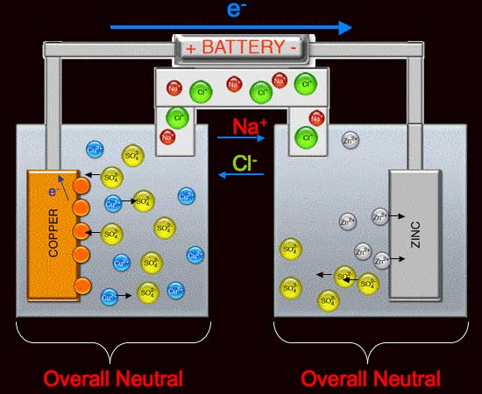
In Volta’s system, each layer of zinc and silver layers separated by the papers soaked in salt water acted as an electrochemical cell.
This is a device that changes chemical energy into electrical energy.
Two different metals, called electrodes, are immersed in a substance called and electrolyte.
Electrolytes are substances that conduct electric current. Volta used silver and zinc as his electrodes, and paper soaked in salt water as his electrolyte.

Slide 6
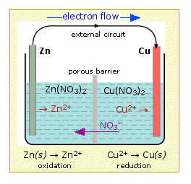
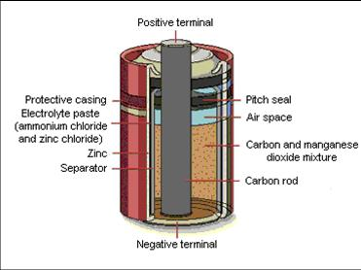
The part of the electrode above the surface of the electrolyte is called the terminal. These are used to connect the cell to the circuit.
Chemical reactions occur between the electrolyte and the electrodes.
These reactions cause one electrode to become negatively charged and one to be positively charged.
There is voltage between them, causing charges to flow. If they are connected with a wire, the charge would flow from one terminal to the other.
The barrier allows charges to flow through the electrolytes to make a complete circuit but prevents the copper and zinc from mixing.

Slide 7
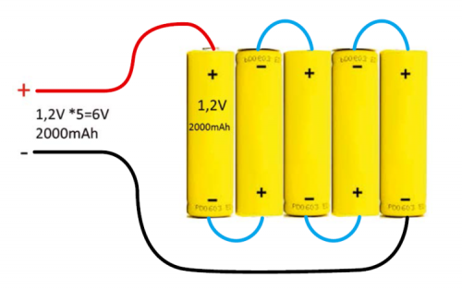
A battery is a combination of two or more electrochemical cells in a series.
This means the positive terminal of one cell is connected to the negative terminal of the next.
The total voltage of a battery is found by adding the voltages of the individual cells.

Slide 8
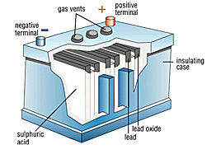
Wet cells use a liquid for its electrolyte.
This battery uses sulfuric acid as its electrolyte.
This is a dry cell. The electrolyte is a paste.

