Slide 1
Notes on 20.5 Electrical Safety
PS Chapter 20 Electricity

Slide 2
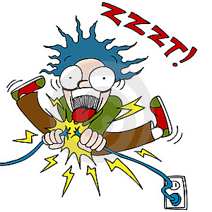
A short circuit is a connection that allows current to take the path of least resistance.
The unintended path usually has less resistance than the intended path, causing the current to be very high – and possibly fatal.
If your body receives an electric current from an outside source, it can result in a shock that interferes with your breathing, heartbeat, and muscle movements. A current greater than 0.2 A can cause anything from burns to stopping your heart.
One way to protect people from electric shock and other electrical danger is to provide an alternate path for electric current.

Slide 3
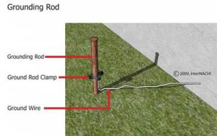
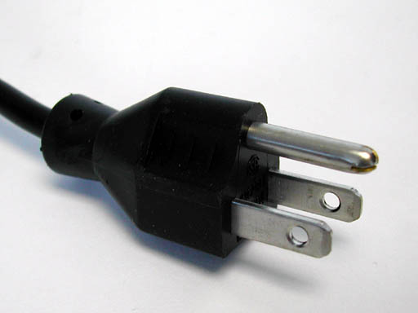
Most buildings have a wire that connects all the electric circuits to the ground. A circuit is electrically grounded when charges are able to flow directly from the circuit into the Earth in the event of a short circuit.
Using a third prong, which is round, connects any metal pieces of the appliance to the ground wire of the building. If a short circuit in the appliance occurs, the electric charge will flow directly into the Earth.

Slide 4
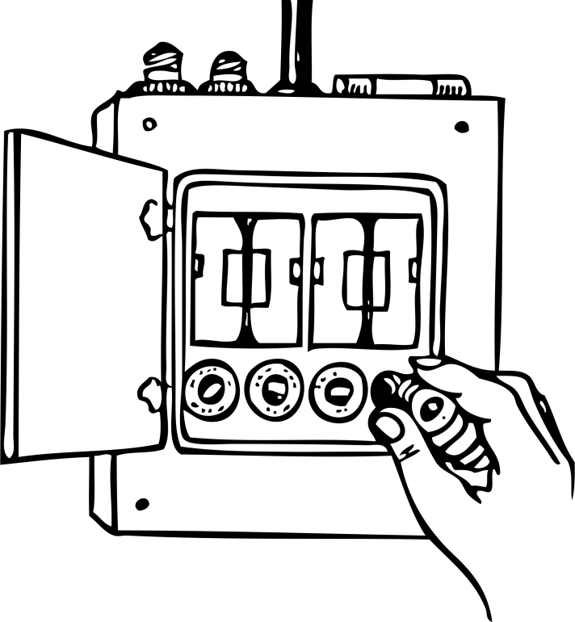
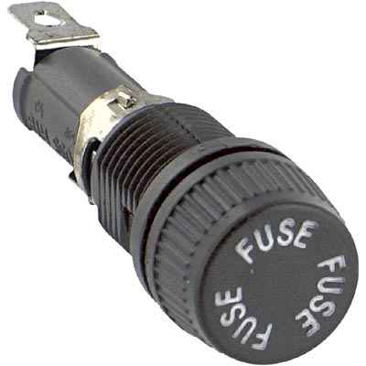
If you use too many appliances at once, a circuit’s current can become dangerously high and heat the wires carrying it. In order to prevent circuits from overheating, devices called fuses and circuit breakers are added to circuits.
A fuse is a device that contains a thin strip of metal that will melt if there is too much current through it.
When the strip of metal “blows” or melts, it breaks the circuit, stopping the current.
Usually are found in cars and older houses.
These must be replaced once it burns out.

Slide 5
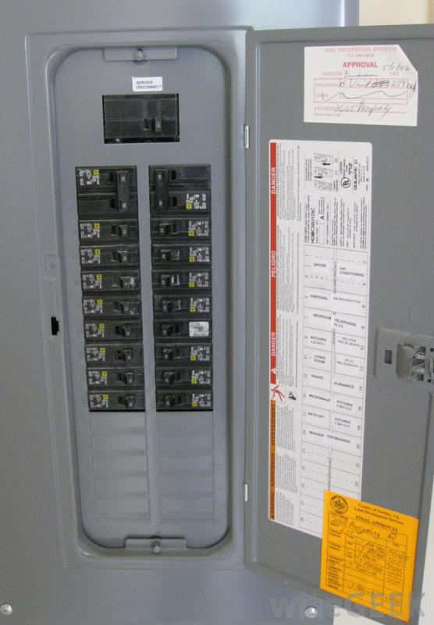
A circuit breaker is a reusable safety switch that beaks the circuit when the current gets too high.
In some circuit breakers, a high current causes a small metal band to heat up. As the band heats up it bends away from wires in the circuit, disrupting the current.
It’s so easy to reset! Just pull the switch back and the metal band is reconnected to the wires.
The appliance that caused the high current should be turned off before resetting the breaker.

