Slide 1
Chapter 21 Using electricity and magnetism
Notes on 21.2 Electricity, Magnetism, and Motion

Slide 2
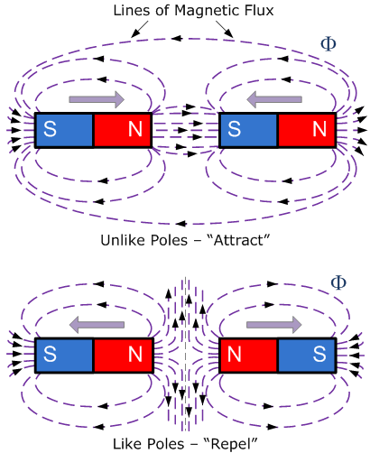
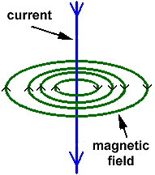
Let’s review some facts on magnetic force:
2. The electric current in a wire produces a magnetic field similar to that of a permanent magnet.
1. Magnetic force can produce motion.
Now let’s see how a magnet can move a wire with a current, just like it would another magnet.

Slide 3
Open your book to page 730, figure 7.
Why does the wire move when current is present?
The wire moves because the magnetic field produced by the current interacts with the magnetic field from the permanent magnet.
How does the direction of the current affect the motion of the wire?
Changing the direction of the current in the wire changes the direction that the wire moves.
How is the current being reversed?
Look closely at the positioning of the wire in relation to the magnets. . Notice that the current still goes out from the (+) and in to the (-), but the direction of the current has changed.

Slide 4
When electricity and magnetism interact, something can move.
The ability to move an object over a distance is called
ENERGY.
ELECTRICAL ENERGY
is the energy associated with electric currents.
The energy an object has due to its movement or position is called
MECHANICAL ENERGY.
Because the interaction of electricity and magnetism can cause something to move, energy can also be transformed from one form to another.
When a wire with current is placed in a magnetic field and movement takes place, the electrical energy has been transformed into mechanical energy.

Slide 5
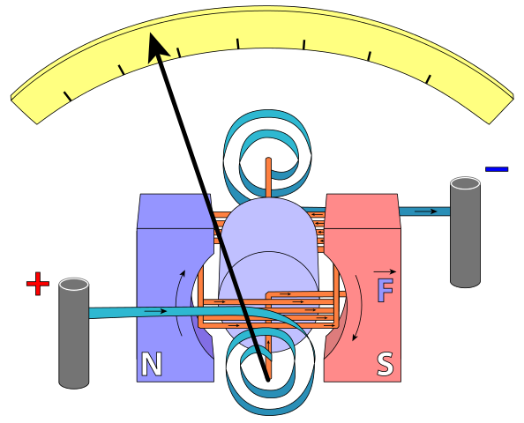
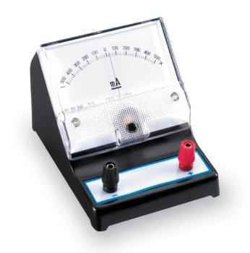
Refer to figure 8 on page 731.
An electromagnet is suspended between opposite poles of two permanent magnets
This field interacts with the permanent magnets’ field, causing the loops of wire and the pointer to rotate.
The amount of current in the wire determines the distance the loops and the pointer rotate.
GALVANOMETERS measure small currents, using the rotation of a wire loop in a magnetic field as its basis.
The electromagnet’s coil is attached to a pointer.
When a current is in the coil, a magnetic field is produced.
Electricians use galvanometers to determine the amount of current present. Used in cars to show the amount of fuel in the tank!

Slide 6
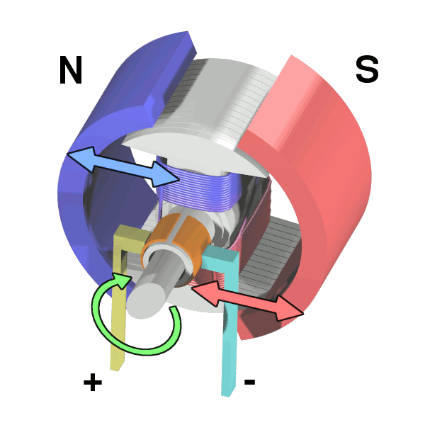
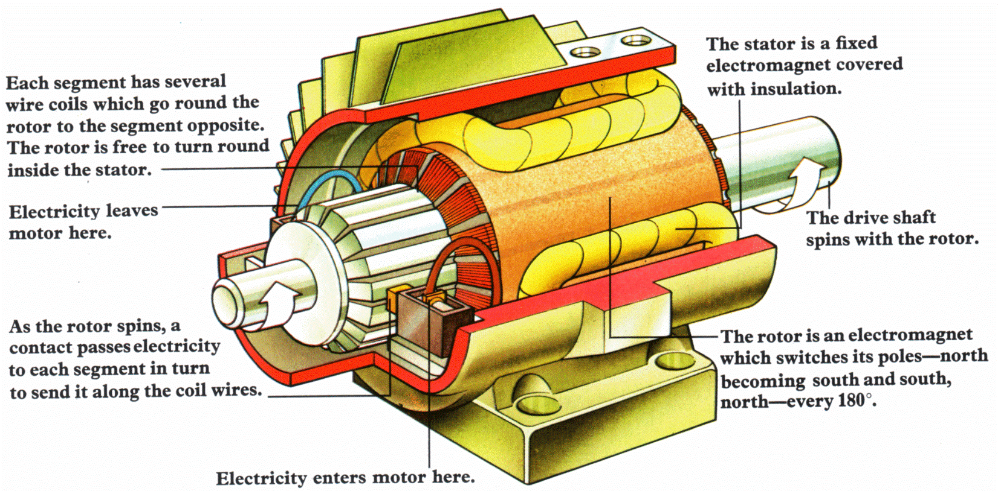
Electric motors can make the electromagnet in the magnetic field rotate continuously, not just a half a turn.
The electromagnet turns a rod or axle, which could turn something else.

Slide 7
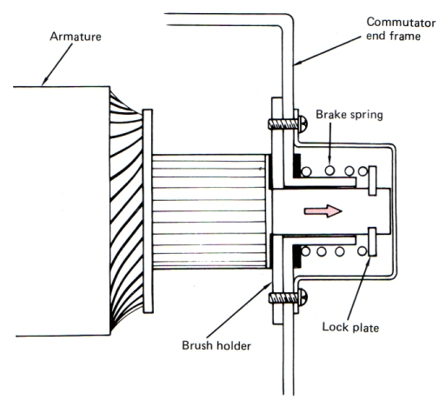
The current is reversed just as the loop, or armature, gets to the vertical position. This reverses the direction of the movement of both sides of the loop. The side that had moved up, now moves down, and vice versa.
The current reverses after each half turn so that the loop spins continuously in the same direction.

Slide 8
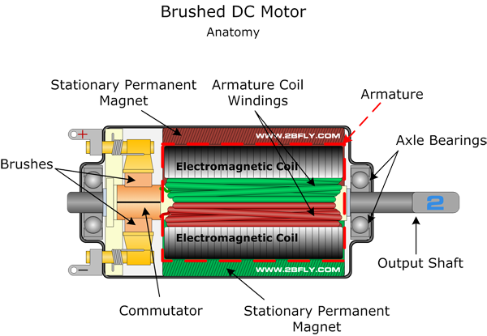
The armature can have dozens or hundreds of wire loops wrapped around a ferromagnetic core, increasing the strength of the motor and making the movements smoother.
The current is in opposite directions on each side of the armature causing one side to move up while the other side moves down.
The commutator rotates with the armature. The direction of current reverses with each half turn so the armature spins continuously.
The commutator, a split ring, repeatedly reverses the flow of current through the armature. When the armature rotates, so does the commutator. Each half of the commutator is connected to the current source by one of the brushes. So each time it moves, it slides past them. The brushes conduct the current, reversing the direction of the current in the armature. This reversing of direction causes the armature to continuously spin.

