Slide 1
Chapter 21 Using Electricity and Magnetism
NOTES on 21.3
Electricity from Magnetism

Slide 2
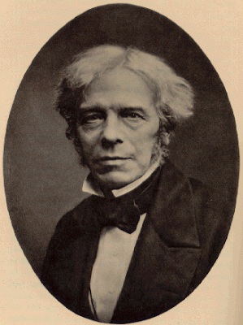
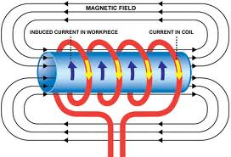
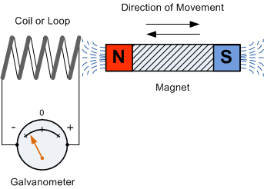
In 1831, an English physicist, Michael Faraday invented the first electric generator.
This simple device was a copper disc turning between poles of a permanent magnet, which induced an electric current.
A magnet and a conductor, such as a wire, can be used to induce a current in the conductor. The key is motion.
Generating an electric current from the motion of a conductor through a magnetic field is called electromagnetic induction.

Slide 3
Turn to page 737, figure 12.
Notice that there is no voltage source needed to produce a current.
An electric current is induced whether the conductor moves through the magnetic field OR the magnet itself moves.
How does the direction in which you move the wire and magnet affect the current?
Reversing the direction of either the coil of wire or the magnet reverses the direction of the current.
Remember: Charging by induction is the movement of electrons to one part of an object by the electric field of a second object.
In that process, do the objects touch?
NO.

Slide 4
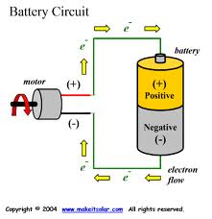
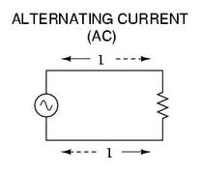
A current consisting of charges that flow in one direction only is called DIRECT CURRENT or DC.
A direct current can be induced from a changing magnetic field or produced from an energy source.
Charges only flow in one direction. This is the type of current Thomas Edison used in his first electric generating plant. (1882)
An ALTERNATING CURRENT (AC) is induced by charges that move back and forth in a circuit.
An AC voltage can be easily raised or lowered to a higher or lower voltage.
This means it can be used to send electrical energy over a long distance, then reduced to a safer level for everyday use.
How would you know by looking at a galvanometer that the current induced is an alternating or direct current?

Slide 5
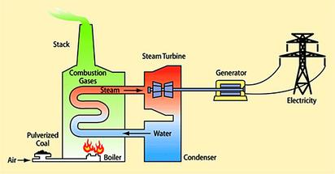
An ELECTRIC GENERATOR is a device that transforms mechanical energy into electrical energy.
An electric generator is the opposite of an electric motor.
An electric motor uses an electric current in a magnet field to produce motion.
A generator uses motion in a magnetic field to produce an electric current.

Slide 6
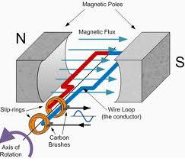
AC generators:
The crank is turned, causing the armature to rotate in the magnetic field.
One side of the armature moves up, the other side moves down, inducing a current in the wire. The current is in opposite directions on the 2 sides of the armature.
After the armature turns half way, each side reverses direction in the magnetic field. This causes the current to change directions, resulting in an alternating current.
As the armature turns, slip rings turn with it. (Similar to the commutator.) They are attached to the ends of the armature.
As the slip rings turn, the make contact with the brushes which are connected to the rest of the circuit, making the generator an energy source.

Slide 7
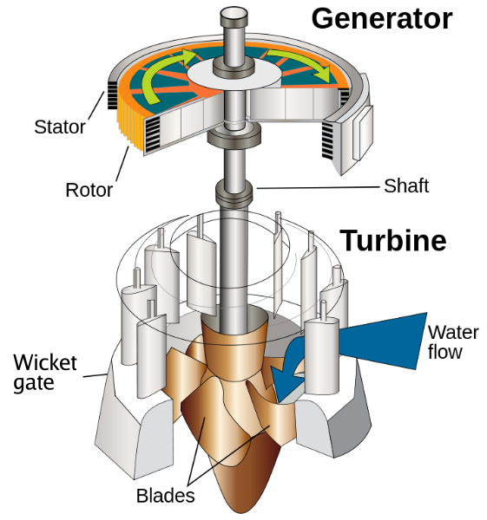
DC generators
A DC generator is like an AC generator except that it contains a commutator instead of slip rings.
Very much like an electric motor in that if you supply electrical energy to the motor, it will spin. But if you spin the motor, you will produce electrical energy. The motor becomes a DC generator.
The electric company makes use of turbines instead of a crank to supply mechanical energy to turn the armature.
Turbines are large circular devices made up of many blades.
In most cases, steam is used to turn the armature of the generator. The steam is produced from water boiled by the burning of coal or by the heat produced in nuclear fission at a nuclear power plant. Hydroelectric dams in some areas use moving water to turn the armature that generates electric current.

Slide 8
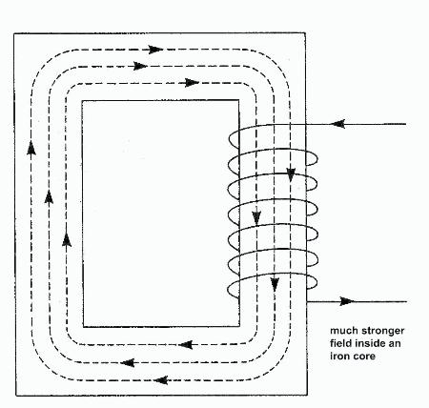
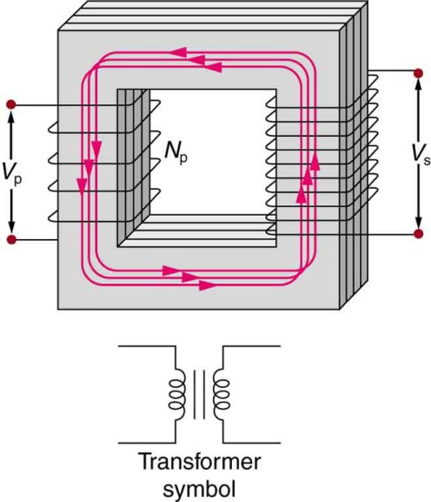
Transformers: change the voltage of the electrical energy
A transformer consists of two separate coils of insulated wire wrapped around an iron core.
The primary coil is connected to a circuit with a voltage source and alternating current. This produces a magnetic field.
The changing magnetic field produced by the alternating current in the primary coil causes an electric current in the secondary coil.
A transformer works only if the current in the primary coil is changing. If the current doesn’t change, the magnetic field does not change. No current will be induced in the secondary coil. A transformer will not work with direct current.
The secondary coil is connected to a separate circuit that does not contain a voltage source.

Slide 9
If the number of loops in the primary and secondary coils of a transformer are the same, the voltage of the induced current is the same as the original voltage.
But, if the secondary coil has more loops, its voltage will be stronger than the primary coil. This is called a STEP-UP transformer.
If there are fewer loops in the secondary coil than the primary , the voltage will be less in the secondary coil. A transformer that decreases voltage is called a
STEP-DOWN transformer.
An important use of transformers is in the transmission of electrical energy from generating plants.
High voltages (11,000 to 765,000 V) need to be maintained in order to transmit currents over a long distance. Then, the voltage must be reduced in order to be used safely in the home. Thus the need for both the step-up and step-down transformers.
Step-up transformers are used in some electrical devices such as fluorescent lights, televisions, and X-ray machines.
Step-down transformers are used in such things as doorbells, electronic games, and portable CD players. (6-12 V) Homes are wired for 120 V.

