Slide 1
NOTES on Chapter 6 Chemical Reactions
6.1 Observing Chemical Change

Slide 2
Matter is anything that has mass and takes up space.
The study of matter and how matter changes is called chemistry.
Matter can be described in terms of two properties:
1. physical properties
2. chemical properties
Changes in matter can be described in terms of:
1. physical changes
2. chemical changes.

Slide 3
Properties of Matter
Physical Property
Chemical Property
a characteristic of a substance that can be observed without changing the substance into another substance
color, hardness, texture, shine, flexibility, ability to dissolve in water, ability to conduct heat and electricity
a characteristic of a substance that describes its ability to change into other substances
to observe the chemical properties you must change it to another substance
burning, tarnishing, rusting

Slide 4
formation of a new substance
What is the evidence of a chemical reaction?
Is the freezing point of water a physical or chemical property?
physical
Is the ability of water to rust some metals a physical or chemical property?
chemical
What is a physical property of aluminum foil?
What is a chemical property of natural gas?
Are these physical or chemical properties of water:
clear, colorless liquid at room temperature
made of 1 hydrogen and 2 oxygen atoms
does not burn
boils at 100ºC
reacts with some metals
physical
chemical
chemical
physical
chemical

Slide 5
Changes of Matter
Physical Change
Chemical Change
anything that alters the form or appearance of a substance but that does not make the substance into another substance
bending, crushing, breaking, cutting, etc.
same compounds with same properties
a change in matter that produces one or more new substances
occurs when bonds break free and new bonds form, producing a new substance

Slide 6
Classify these as either a chemical change or a physical change:
A piece of metal is heated to a high temperature and changes to a liquid.
When 2 solutions are poured into the same container, a powdery solid forms and settles to the bottom.
Water left in a dish over night has disappeared by the next day.
A blacksmith hammers a piece of red-hot iron into the shape of a knife blade.
You toast a marshmallow and the outside turns black.
physical
chemical
physical
physical
chemical

Slide 7
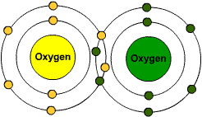
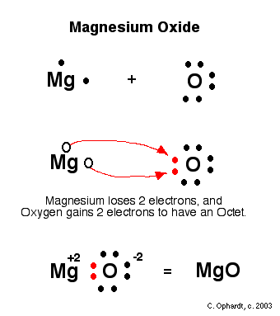
Remember (oh, please remember) that atoms form bonds when they share or transfer electrons. When those bonds break, new bonds will form, creating new substances.
Along comes magnesium and causes a reaction. (metal vs gas)
Draw O₂.
Show what happens as Mg becomes a positive ion and O becomes a negative ion.
An ionic compound is now produced:
magnesium oxide, and energy is released (flame). A white, crumbly powder has properties that differ from the gas and metal. Wow! Mg melts at 650º, but MgO doesn’t melt until 2,800ºC!

Slide 8
Chemical reactions involve two main kinds of changes that you can observe: formation of new substances AND changes in energy.
Observe changes in the properties of the materials involved result when new substances form.
a. color change
b. a solid may appear when 2 solutions are mixed
A solid that forms from solution during a chemical
change is called a precipitate.
c. a gas might be produced from solids or liquids
(you might see gas as bubbles)
d. other kinds of observable changes in properties
(moist dough becomes dry, porous solid after baking)

Slide 9
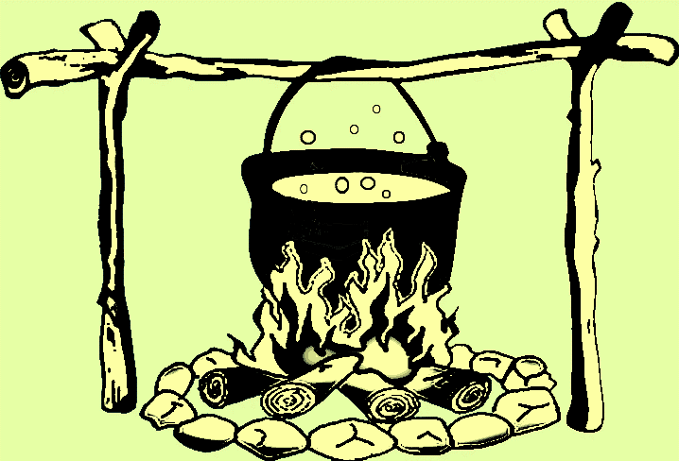
Now that you learned all that – even though you may see some of those seemingly chemical changes, it might not be!
Like: boiling water. Those bubbles are still water molecules.
Make sure a new SUBSTANCE is being formed!

Slide 10
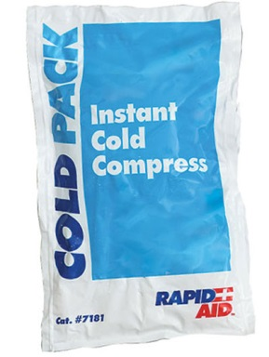
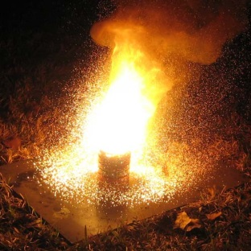
As matter changes, it can either absorb or release energy. A change in energy occurs during a chemical reaction. One common indication that energy has been absorbed or released is a change in temperature.
Endothermic reaction is a reaction in which energy is absorbed. Usually, but not always, will result in a colder feel.
Exothermic reaction is a reaction that releases energy in the form of heat.

