Slide 1
NOTES on Chapter 6: Chemical Reactions
6.2 Describing chemical reactions

Slide 2
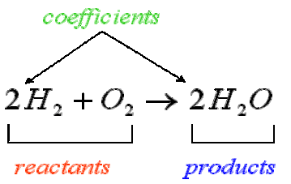
Chemical equations show a chemical reaction, using symbols instead of words.
When the reaction is complete, you have new substances called the products, written on the right side.
Reactants are the substances you begin with in a reaction. They are on the left side of the arrow.
The arrow is read as “yields”.
When there are 2 or more reactants or products, a plus sign will separate them.
What is the difference between a formula and an equation?
What are the names of the twos on either side of the H? How are they different?

Slide 3
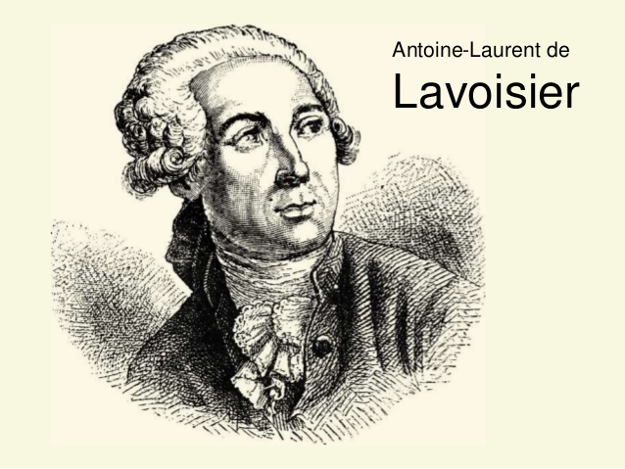
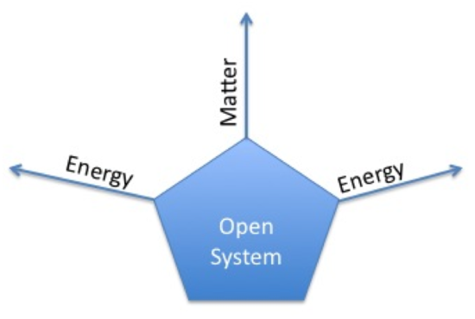
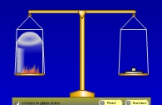
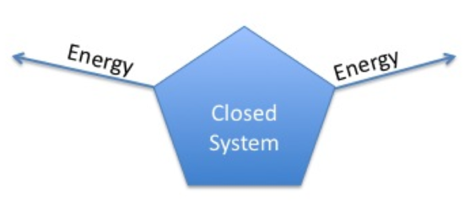
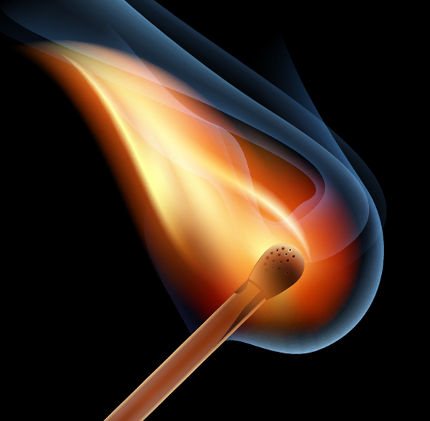
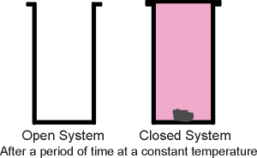
Conservation of mass states that during a chemical reaction, matter is not created or destroyed. The total mass of the reactants must equal the total mass of the products.
In an open system, matter can enter from OR escape to the surroundings.
In a closed system, matter is not allowed to enter or leave.

Slide 4
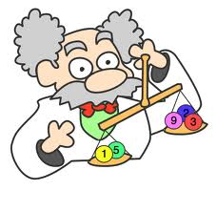
BALANCING CHEMICAL EQUATIONS
To describe a reaction accurately, a chemical equation must show the same number of each type of atom on both sides.
1. Write the equation.
2. Count the atoms.
3. Use coefficients to balance atoms.
4. Look back and check.

Slide 5
To describe a reaction accurately, a chemical equation must show the same number of each type of atom on both sides of the equation. Chemists say an equation is balanced when it accurately represents conservation of mass.
Try balancing the equations on the paper I gave you. Remember, you may use a coefficient, but not a subscript to do so. Determine the type of chemical reaction of each one.
Synthesis: when two or more elements or compounds combine to make a more complex substance. ie: 2H₂ + O₂ → 2H₂O
Decomposition: when compounds are broken down into simpler products.
ie: 2H₂O₂ → 2H₂O + O₂
So, if you keep your hydrogen peroxide for a long time, it will turn in to water.
Replacement: When one element replaces another in a compound, or when two elements in different compounds trade places.
ie: 2Cu₂O + C → 4Cu + CO₂ (single replacement reaction)
ie: FeS + 2HCl → FeCl₂ + H₂S ( double replacement reaction)

