Slide 1
NOTES ON CHAPTER 6: CHEMICAL REACTIONS
6.3 Controlling chemical reactions

Slide 2
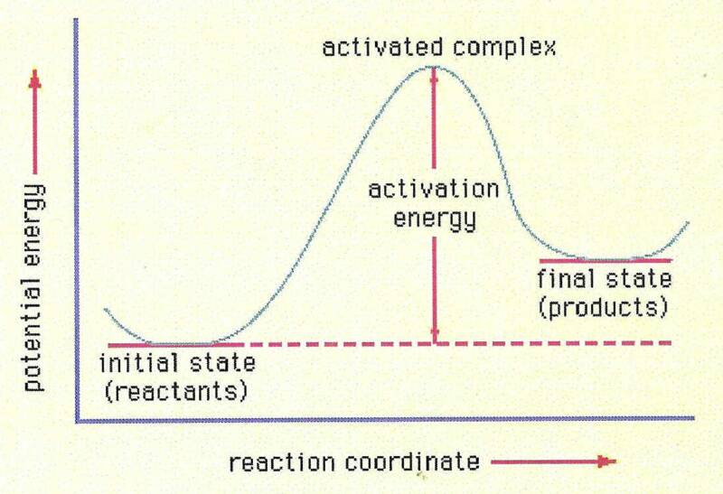
Activation energy is the minimum amount of energy needed to start a chemical reaction.
It’s that little “push” that breaks the chemical bonds of the reactants and gets the chemical reaction going.
ALL chemical reactions need a certain amount of activation energy to get started.
Once, the reaction has begun, the energy from the affected reactants will provide the necessary activation energy for more molecules to react.
Whether or not a reaction requires still more energy from the environment to continue, depends on if it is exothermic or endothermic.

Slide 3
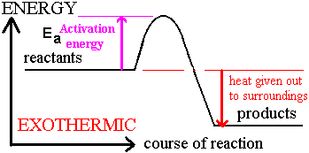
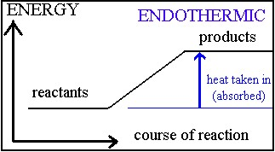
The reaction ends up releasing more energy than it uses. The reactants have more energy than do the products. This is an exothermic reaction.
Useable heat is released.
In an endothermic reaction, activation energy is needed to break the chemical bonds, but energy is also needed in order to keep going.
The product’s energy level is higher than that of the reactants. This difference tells you that the reaction must absorb energy to continue.

Slide 4
Is the baking of bread an endothermic or exothermic reaction?
endothermic
The burning of wood?
exothermic
The mixing of vinegar and baking soda?
endothermic
The rusting of iron?
exothermic
Do all of these reactions occur at the same rate?
What are some things that could affect or change the rate of the reactions?

Slide 5
Chemists can control rates of reactions by changing factors such as surface area, temperature and concentration, and by using substances called catalysts and inhibitors.
When a solid substance reacts with a gas or a liquid, only the particles on the surface come in contacts with the other reactant. If you break the solid into smaller parts, increasing the SURFACE AREA, more particles are exposed and the reaction happens faster. Can you think of any examples when this is helpful? How about dangerous?
If you increase the temperature, the rate of reaction will be increased. The particles moving faster increase the reaction rate in two ways:
The particles will come in contact more often, increasing the chances for a reaction to happen.
Faster-moving particles contain more energy, causing the activation energy “hump” to occur sooner.

Slide 6
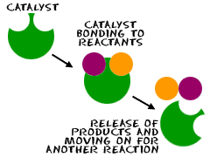
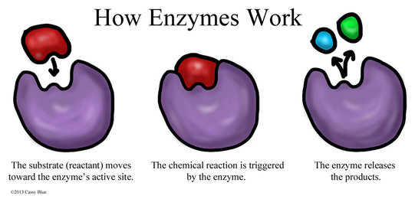
Concentration is the amount of a substance in a given volume.
Increasing the concentration supplies more particles to react.
Catalysts are materials that increase the rate of a reaction by lowering the activation energy.
Although the catalysts affect the reaction rate, they are not permanently changed by the reaction. They are not considered to be a reactant and are not included in the equation.
Enzymes, biological catalysts that are in all living things, are very specific. They will only affect one chemical reaction.
Enzymes make chemical reactions that are necessary for life happen at a low temperature.
The enzyme remains unchanged, therefore, they are NOT reactants.

Slide 7
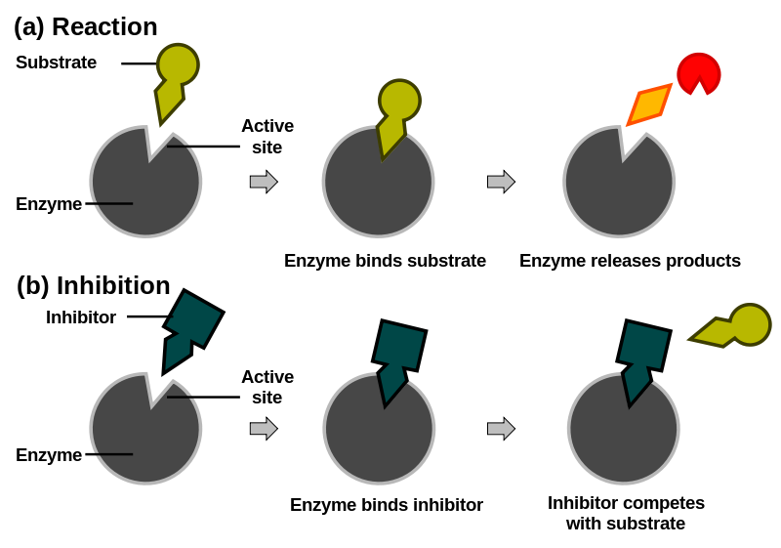
Sometimes a reaction is more useful when it can be slowed down rather than speeded up. In that case, an inhibitor is used. An inhibitor prevents the reactants from coming together. They can combine either permanently or temporarily with the reactants.
Preservatives are commonly used inhibitors.

Slide 8
Why may an increase in temperature affect the rate of a chemical reaction?
What is activation energy?
What are the four ways chemists can control the rates of chemical reactions?
Which would react more quickly in a chemical reaction: a single sugar cube or an equal mass of sugar crystals?
Explain.

