Slide 1
Chapter 7: Acids, Bases, and Solutions
7.4 Acids and Bases in Solution

Slide 2
Acids and Bases in Solution
A. Acids
Hydrogen ion (H+)= atom of hydrogen that has lost its electron
These are the key to the reactions of acids.
Acids in water solution separate into hydrogen ions and negative ions.
HCL → H+ + Cl-
An acid is any substance that produces hydrogen ions in water.

Slide 3
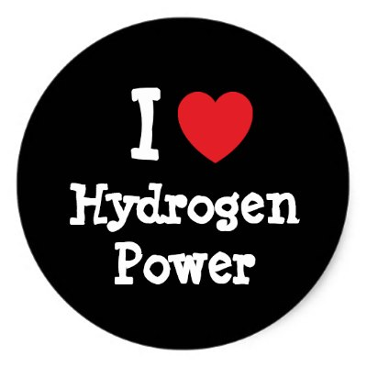
Hydrogen ions cause the properties of acids.
That’s why every acid gives the same litmus test.

Slide 4
B. Bases
Many bases are made of positive ions combined with hydroxide ions.
Hydroxide ion (OH-) is a negative ion, made of oxygen and hydrogen.
When bases dissolve in water, the positive ions and hydroxide ions separate.
NaOH → Na+ + OH-

Slide 5
Not every base contains hydroxide ions.
Amonia is a base that reacts with water to form hydroxide ions. NH3 + H2O → NH4+ + OH-
A base is any substance that produces hydroxide ions in water.
Hydroxide ions are responsible for the bitter taste and slippery feel of bases, and turn red litmus paper blue.

Slide 6
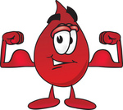
STRENGTH OF ACIDS AND BASES
Strength refers to how well and acid or a base produces ions in water.
Molecules of a strong acid react to form ions in solution.
Molecules of a weak acid forms very few ions.
Strong = hydrochloric acid, sulfuric acid, and nitric acid
Weak = acetic acid (and others)

Slide 7
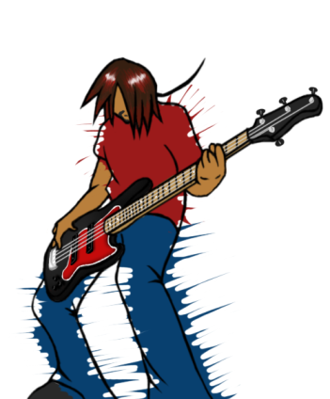
Strong bases react in water in a similar way.
They will produce more hydroxide ions
Measuring pH
The pH scale is a range of values from 0 - 14.
It expresses the concentration of hydrogen ions in a solution.
Most acidic substances are at the low end (top).
The most basic substances are at the high end (bottom).

Slide 8
2 important points to remember about pH.
1. A low pH tells you that the concentration of hydrogen ions is high.
2. A high pH tells you that the concentration of hydrogen ions is low.
A pH lower than 7 is acidic.
A pH higher than 7 is base.
Strength vs Dilute….. Know the difference!
Your clothing and skin could be in jeopardy!

Slide 9
A reaction between an acid and base is called neutralization. (close to 7 on pH scale)
After neutralization, an acid-base mixture is not as acidic or basic as the individual starting solutions were.
The final pH depends on such factors as the volumes, concentrations, and identities of the reactants.

Slide 10
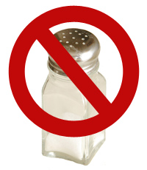
Salt =
any ionic compound that can be made from the neutralization of an acid with a base.
In a neutralization reaction, an acid reacts with a base to produce a salt and water
HNO3 + KOH → H2O + K + NO3-
(nitric (potassium (water) (potassium nitrate)
acid) hydroxide) KNO3
++++ Potassium nitrate is written as separate K and NO3 because it is soluble in water.

