Slide 1
Chapter 7: Acids, Bases, and Solutions
7.5
Digestion and pH

Slide 2
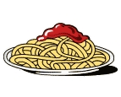
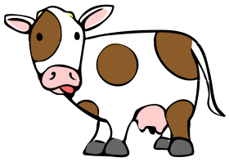
What is digestion?
Foods are made mostly of water and 3 groups of compounds:
1. carbohydrates
2. proteins
3. fats
Foods must be broken down into simpler substances that your body can use .

Slide 3
The process of digestion breaks down the complex molecules of food into smaller molecules.
I’m back!
1. Mechanical digestion
Large pieces of food are torn and ground into smaller pieces.
Only the size of food has changed.
It is still the same compounds.

Slide 4
2. Chemical digestion
Breaks large molecules into smaller ones.
Takes place with the help of enzymes.
Enzymes are catalysts that speed up reactions in living things.
They need just the right conditions to work, including temperature and pH.

Slide 5
pH in the Digestive System
Saliva is the beginning of digestion.
Saliva has a pH near 7, the neutral point.
Saliva has the enzyme amylase that helps break the larger carbohydrate starch into smaller sugar molecules.
Amylase works best when the pH is near 7.

Slide 6
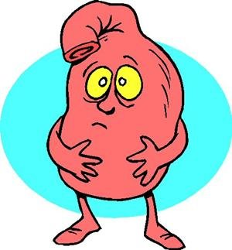
Both mechanical and chemical digestion takes place.
The stomach.
The lining of the stomach releases hydrochloric acid and enzymes, setting the stage for the next phase of digestion.
The pH drops to a very acidic level of 2.
This allows pepsin to break down proteins into amino acids -- even smaller molecules.
The enzyme pepsin is unusual. Most enzymes work best in solutions that are nearly neutral. Pepsin works best in acids.

Slide 7
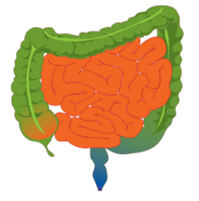
The Small Intestine
Here, digestive fluid containing
bicarbonate ions (HCO3-) surrounds the food.
This ion creates a slightly basic solution with a pH of
8
At this pH, the enzymes of the small intestine work the best.
These enzymes complete the breakdown of carbohydrates , proteins , and fats .

Slide 8
1. What is the role of HCl?
To lower the stomach’s pH for digestion to occur.
2. What happens to foods during chemical digestion?
Foods are broken down into simpler substances that the body can use for raw materials and energy.
3. What are the smaller molecules that result from chemical digestion?
Sugars and amino acids.

Slide 9
4. Which organ of the digestive is neutral?
M O U T H
5. Which is acidic?
S T O M A C H
6. Which is basic?
7. Where is amylase found?
8. In which organs does chemical digestion take place?
mouth, stomach, small intestines

