Slide 1
CHAPTER 11: FORCES IN FLUIDS
11.1 Pressure

Slide 2
Pressure (related to press):
a force exerted over an area on the surface of an object.
Pressure as the area over which a force is distributed
decreases
increases.
Force is measured in
newtons.
Force
Pressure = Area
Area is measured in
square meters.
SI unit of pressure is N/m² = 1 Pa (pascal)

Slide 3
What happens to pressure if the same force is exerted on a smaller area?
The pressure increases.
Imagine you are designing a backpack. How could you apply information about pressure and area to backpack straps so students could carry heavy books comfortably?
Turn to page 373.
Math Skills

Slide 4
Fluids = materials that can flow easily
= they can change shape
= liquids (ie: water, oil) and gases (ie: air, helium)
What is one type of fluid pressure that you experience at all times?
air pressure
Particles in a fluid constantly move in all directions, colliding with other particles as well as any surface they encounter. Since there are so many particles, consider the fluid as a whole.
Fluid pressure = total force exerted by the fluid
DIVIDED BY the area over which the force is exerted.

Slide 5
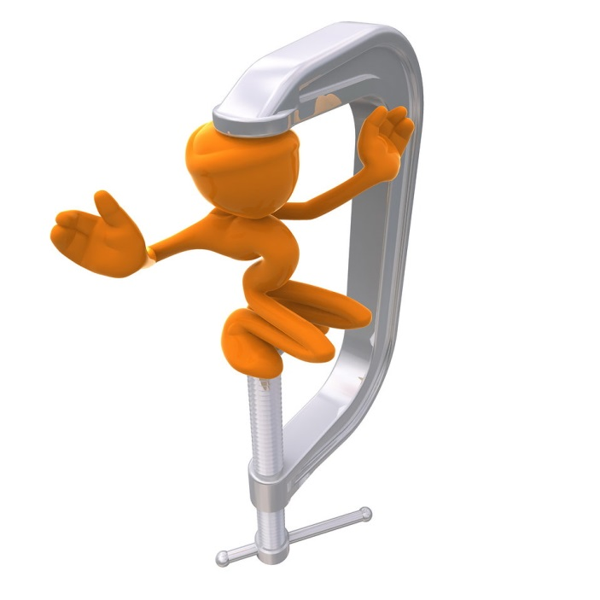
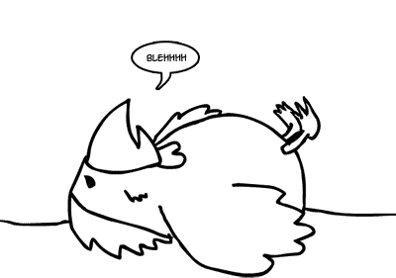
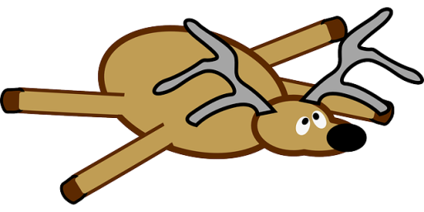
Each cubic meter of air has a mass of about 1 kilogram.
The weight of the air is the force that produces
air pressure = atmospheric pressure.
Why, then, are we not crushed by the pressure pushing on us from all sides?
BALANCED PRESSURE from the fluids inside your body balances the air pressure outside your body. Examples?
UNBALANCED PRESSURE would crush!

Slide 6
POP! There goes your ears!
Changing elevations, changes air pressure.
As ELEVATION INCREASES, atmospheric pressure decreases.
As the elevation changes, your body’s pressure inside is adjusting, but more slowly. Inside pressure is greater than air pressure outside, so your ears “pop” to balance the pressure.

Slide 7
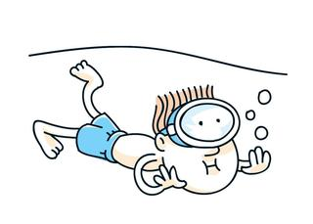
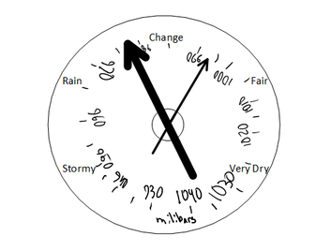
Water pressure INCREASES as depth INCREASES.
Now, you not only have the water pressure, but also the air pressure pushing down on you!
Barometer – measures atmospheric pressure
rapidly decreasing pressure = storm is on its way
increasing pressure = fair weather ahead
millimeters, inches, or millibars

Slide 8
Why does atmospheric pressure decrease gradually as the elevation above sea level increases, whereas water pressure increase rapidly as the water depth increases?
In the deepest part of the ocean, the pressure there is how many more times that of the air pressure you are experiencing now?
Why must an astronaut wear a pressurized suit in space?

