Slide 1
Chapter 8: Carbon Chemistry
8.2
Carbon Compounds

Slide 2
Organic Compounds
Carbon compounds include :
gases ( propane)
liquids (olive oil)
solids (such as cotton)
Compounds that contain carbon are called ORGANIC COMPOUNDS.
Scientists once thought organic compounds were only produced by living things.

Slide 3
Now it is known that “organic” compounds can be found in
products from living things and
from artificially made materials.
Organic means of living things
Organic compounds are part of the solid matter of every organism on Earth.
What is the difference between “organically grown” and “organic”?
Organically grown means without pesticides or synthetic fertilizers.
Organic mean “carbon-containing”.

Slide 4
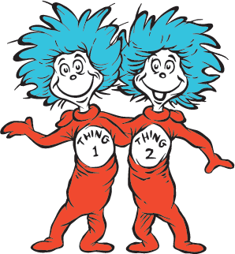
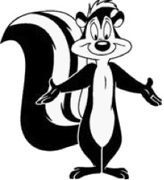
Many organic compounds have similar properties such as:
Melting points: low melting and boiling points
They’re usually liquids or gases at room temperature.
Organic liquids usually have strong odors.
NOT
They do conduct electricity.
Many do not dissolve well in water.

Slide 5
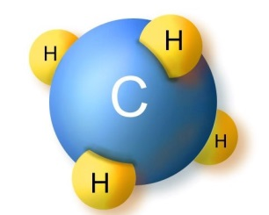
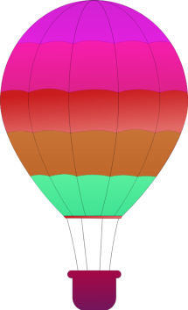
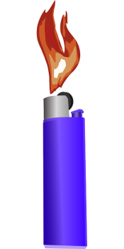
HYDROCARBS
The simplest organic compound.
Contains only the elements carbon and hydrogen.
Methane: main gas in natural gas/ heat homes
Propane: portable stoves and grills/hot air balloons
Butane: fuel in lighters

Slide 6
Properties of Hydrocarbons
Hydrocarbons mix poorly with water.
Hydrocarbons are flammable.
They burn easily
They release a great deal of energy.
Used as fuel for stoves, heaters, cars, buses, and airplanes

Slide 7
Chemical Formula of Hydrocarbons.
Methane= CH4
Ethane= C2H6
Propane= C3H8
Structure and Bonding of Hydrocarbons
The carbon chains in a hydrocarbon may be straight, branched, or ring-shaped.
If a hydrocarbon has two or more carbon atoms, the atoms can form a single line or a straight chain.
If it has four or more carbon atoms, it is possible to have a branched arrangement as well as a straight chain.

Slide 8
A structural formula shows the kind, number, and arrangement of atoms in a molecule.
the dashes represent a bond
Every carbon atom forms 4 bonds.
Every hydrogen atom forms 1 bond.
There are never any dangling bonds!
Both ends of a dash are always connected to something.

Slide 9
Isomers
Compounds that have the same chemical formula but different structural formulas.
Each isomer is a different substance with its own characteristic properties.

Slide 10
2 carbon atoms can form a double bond or a
triple bond.
A carbon atom can also form a single or double
bond with an hydrogen atom.
2 dashes is double bond. 3 dashes is a triple!

Slide 11
A hydrocarbon can be classified according to the types of bonds between its carbon atoms.
1. If there are only single bonds, it has the maximum number of hydrogen atoms possible on its carbon chain.
saturated hydrocarbons
suffix of -ane
methane, ethane, etc.
2. Hydrocarbons with double or triple bonds have fewer hydrogen atoms for each carbon atom than a saturated hydrocarbon does.
unsaturated hydrocarbons
suffix of –ene or –yne
ethene, ethyne
simplest double bond= ethene = fruits produce to ripen
simplest triple bond= ethyne
= acetylene= welding torches.

Slide 12
SUBSTITUTED HYDROCARBONS
Carbon can form stable bonds with several other elements, including oxygen, nitrogen, sulfur, and members of the halogen family.
If just one atom of another element is substituted for a hydrogen atom in a hydrocarbon, a different compound is created.
Halogens → Freon was banned, but trichloroethane is still used in dry-cleaning solutions. Hazardous!

Slide 13
Alcohols : is a substituted hydrocarbon that contains one or more of the hydroxyl group.
Each –OH is called a hydroxyl group.
most alcohols dissolve well in water
have higher boiling points than hydrocarbons with similar number of carbons
alcohol methanol is liquid at room temperature, but hydrocarbon methane is a gas
Ethanol is the result of a hydroxyl group substituted for one hydrogen atom in ethane.
This is produced naturally by the action of yeast or bacteria on the sugar stored in corn. Used to make fuel for cars, called “gasohol”.

Slide 14
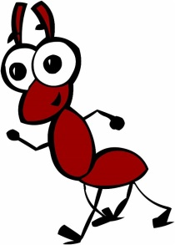
What in the world is an organic acid?
Organic Acids
The sour taste of many fruits comes from citric acid, which is an organic acid.
I am so glad you asked! It is a substituted hydrocarbon that contains one or more carboxyl groups. --COOH is how it is written!
They are actually quite common. You find them in vinegar, apples, bad smelling butter, stinging nettle plants, and the pain from ant bites.

Slide 15
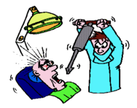
That wonderful, pleasant, fruity smell in pineapples, bananas, strawberries, and apples.
ESTERS
It is also that appealing smell found in medications - especially the anesthetic used by dentists!

Slide 16
P O L Y M E R S
A very large molecule made of a chain of many smaller molecules bonded together .
“Poly” means “many”.
The smaller molecules are called monomers.
“Mono” means “one”.
Organic compounds, such as alcohols and esters, can be linked together to build polymers with THOUSANDS or even MILLIONS of atoms!!!!
Naturally made: sheep/wool silkworms/silk
Synthetic polymers: polyester or nylon
Just about any plastic item.

